Slide 1


Images © Alamy
www.alamy.com
Images used in powerpoint presentation are part of the presentation and not to be used out of context of the presentation, may not be used as stand-alone images unless to promote the presentation/event, and may not be resold in singular form or as part of an image library. Images are © Alamy and presentation templates and content therein are © MISDA, any other usage requires written permission from both parties.

Slide 2
Scripture quotations used in Balanced Living PowerPoints are taken from Bibles in the Public Domain which have no USA copyright restrictions. We have indicated which version each quotation is taken from as follows:
KJV - King James Version
BBE - Bible in Basic English
WEB - World English Bible
DBY - Darby's Translation
Any scriptures not otherwise noted are the author's paraphrase of one of these versions.

Slide 3
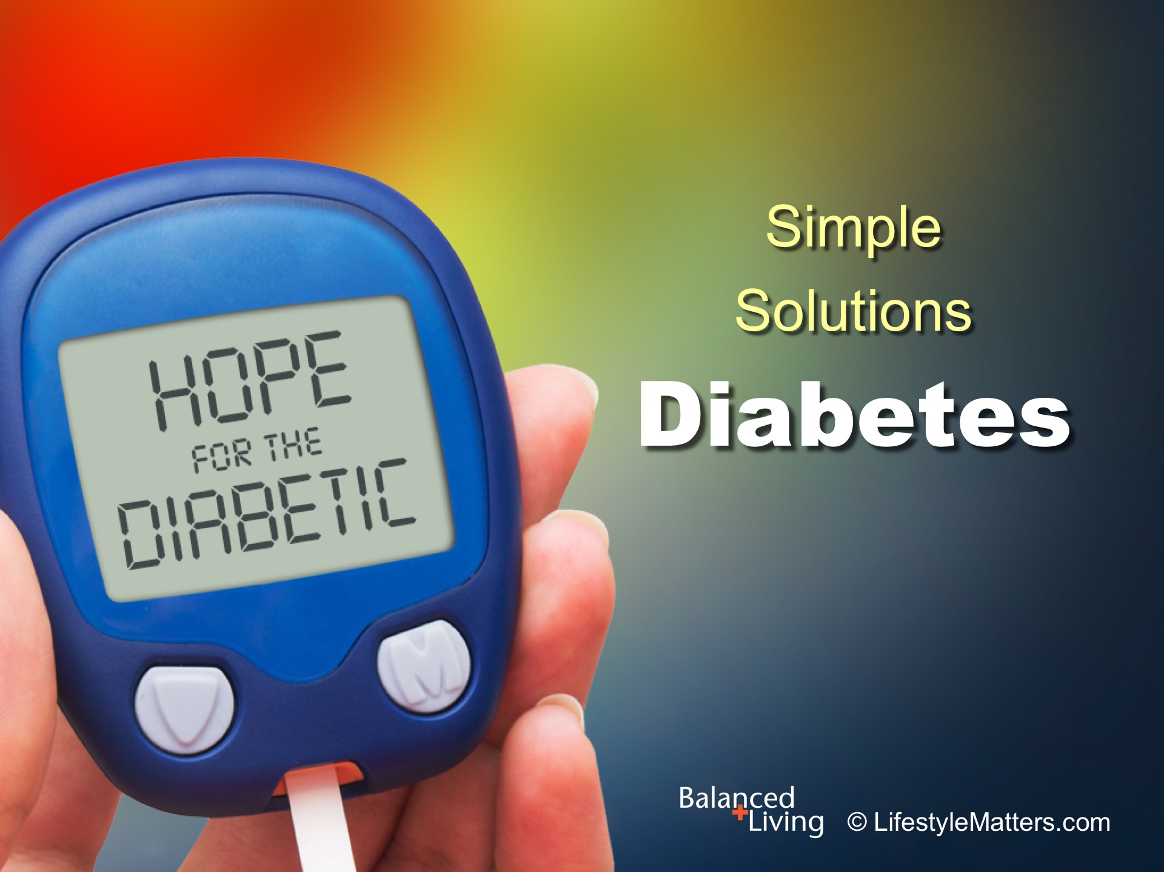
Notes:
Presenter: Please read and study the tract that accompanies this PowerPoint to prepare for this presentation.
In this session we will be discussing diabetes—but before we begin, let’s notice a key positive word that is central to this image.
It is HOPE! When it comes to diabetes, there is bad news but there is also good news!
The bad news is that diabetes is a stealth disease—a slow and silent killer that has reached epidemic proportions.
The good news is that positive lifestyle choices can prevent or reverse pre-diabetes, and have a dramatic, life-altering impact on diabetes symptoms and progression. There is hope for the diabetic and pre-diabetic!

Slide 4
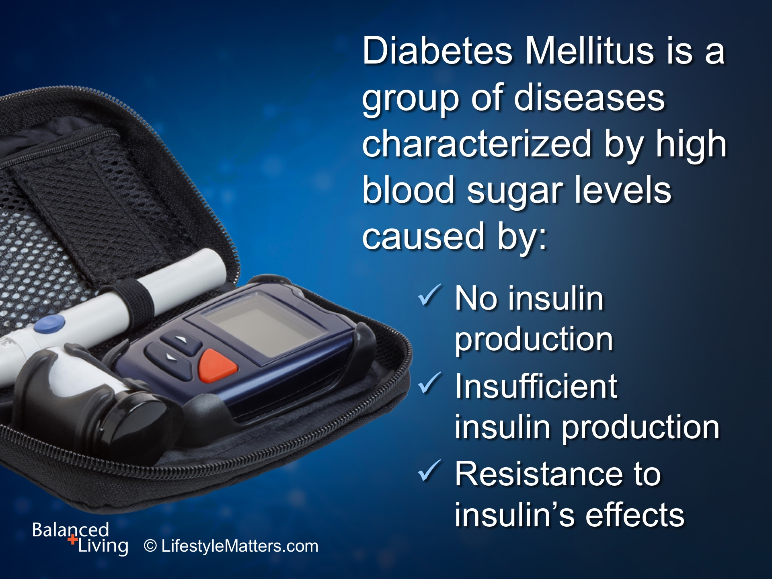
Notes:
What is diabetes? Read slide.
Wes Youngberg, author of Goodbye Diabetes describes diabetes as “having blood sugar levels so high, and for so long, that they eventually cause significant health complications if not corrected.”

Slide 5
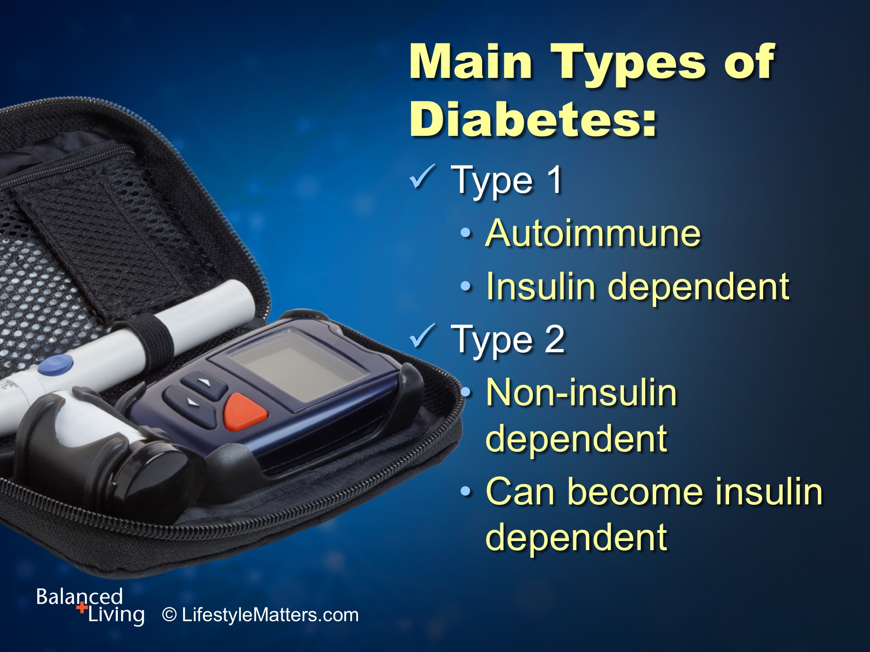
Notes:
Read slide.
Type 1 diabetes is an autoimmune disease where the pancreatic cells that produce insulin are damaged. Only 5 to 10 percent of people with diabetes have this type.
Type 2 diabetes is the most common form of diabetes. In type 2 diabetes, the body becomes resistant to insulin, requiring more insulin than normal to control blood sugar or glucose.
Insulin is the hormone that “unlocks” cells to receive glucose, their major fuel source.

Slide 6
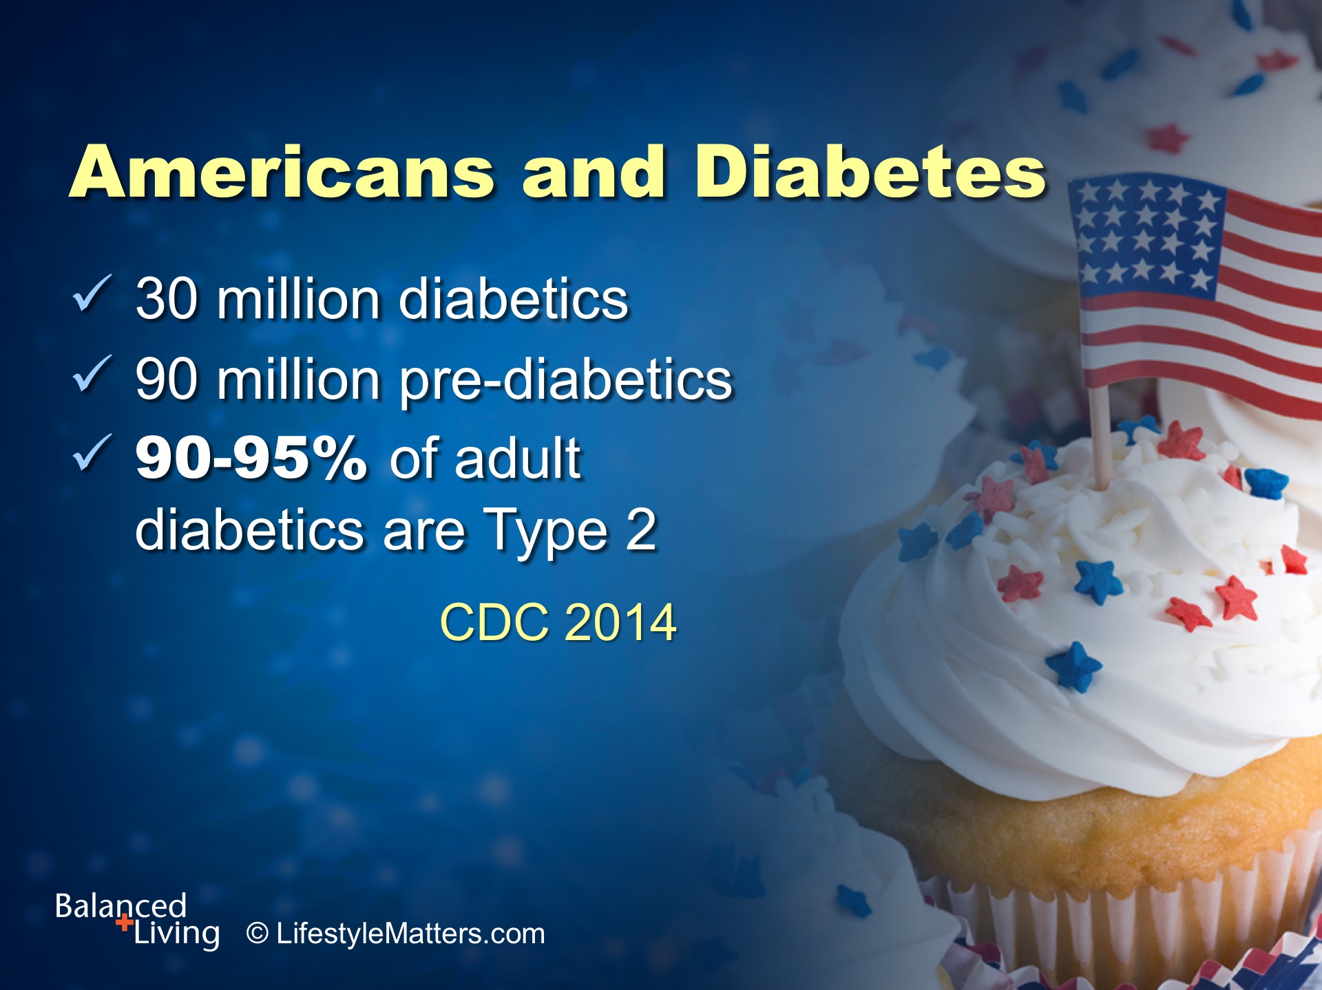
Notes:
Read slide.
You may be thinking, “I’m overweight and I don’t exercise. I already have high blood sugar levels. Is there any hope for me?”
Lifestyle changes can greatly reduce the risk of developing diabetes, and if you already have full blown diabetes, lifestyle can make a big difference in the course of the disease.
(Note: CDC stands for Centers for Disease Control)

Slide 7
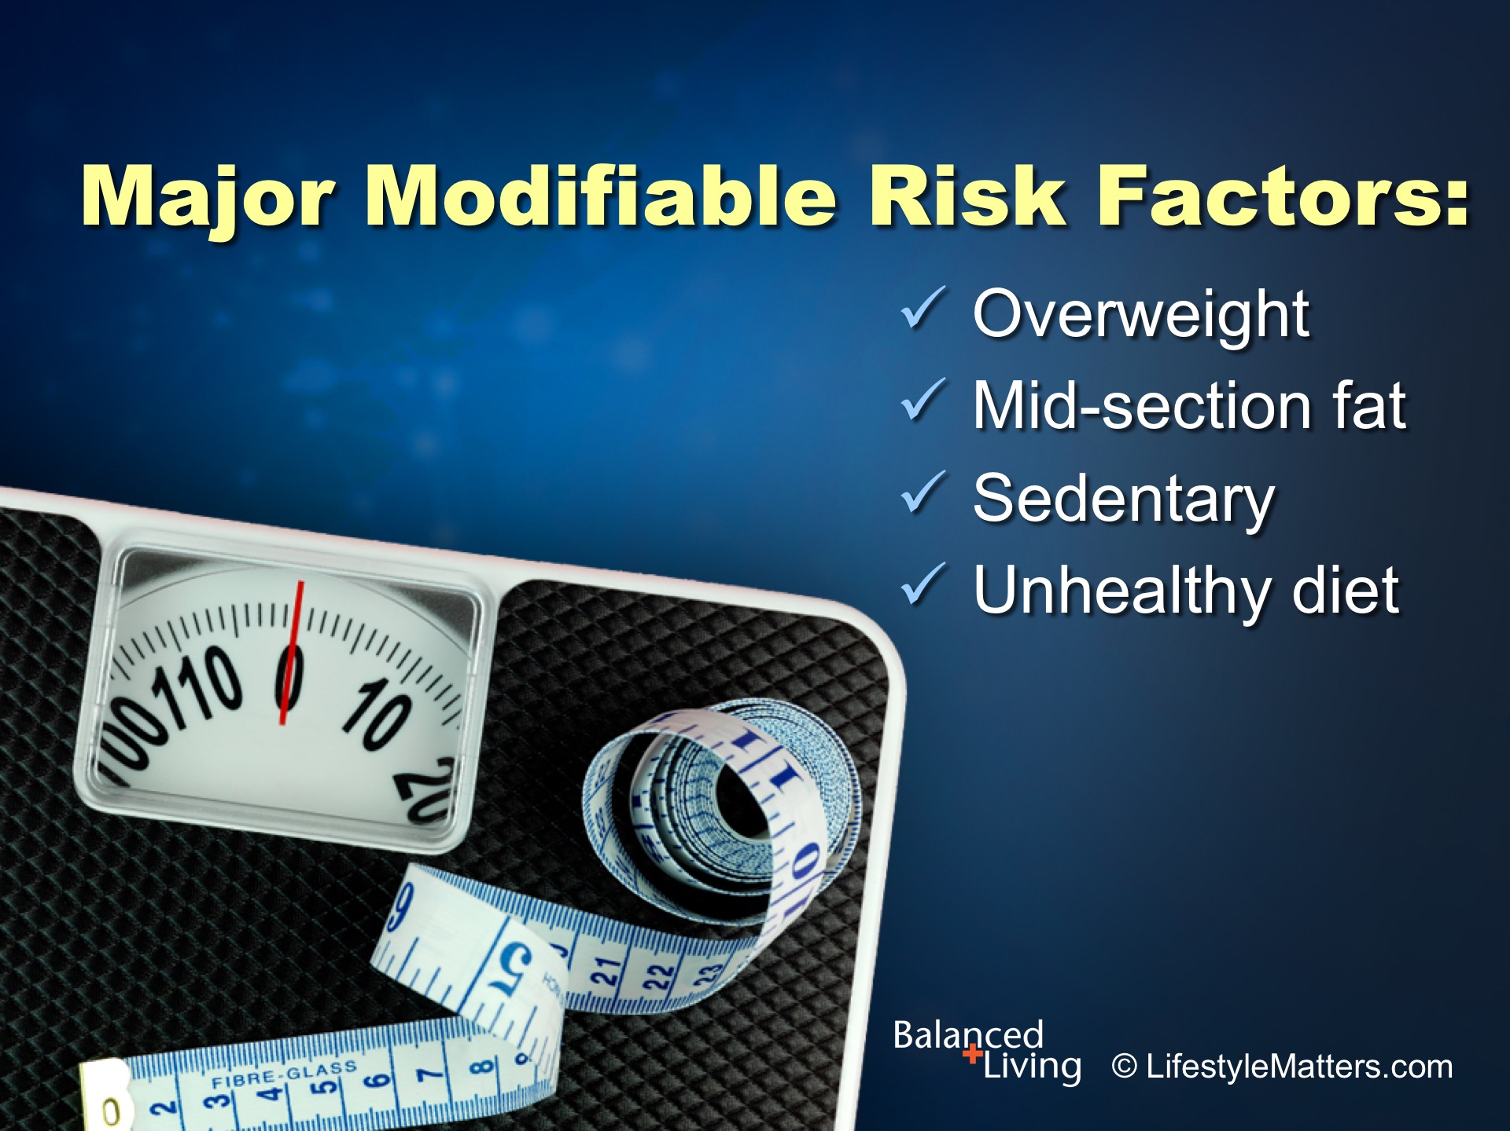
Notes:
These are some of the major modifiable risk factors for type 2 diabetes: Read slide.
(Source: Youngberg W. Goodbye, Diabetes, p. 59.)

Slide 8
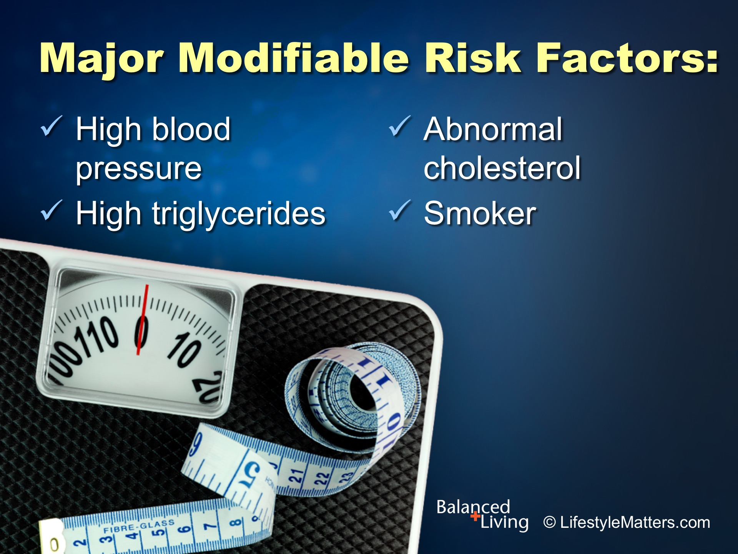
Notes:
Read slide.
(Source: Youngberg W. Goodbye, Diabetes, p. 59.)

Slide 9
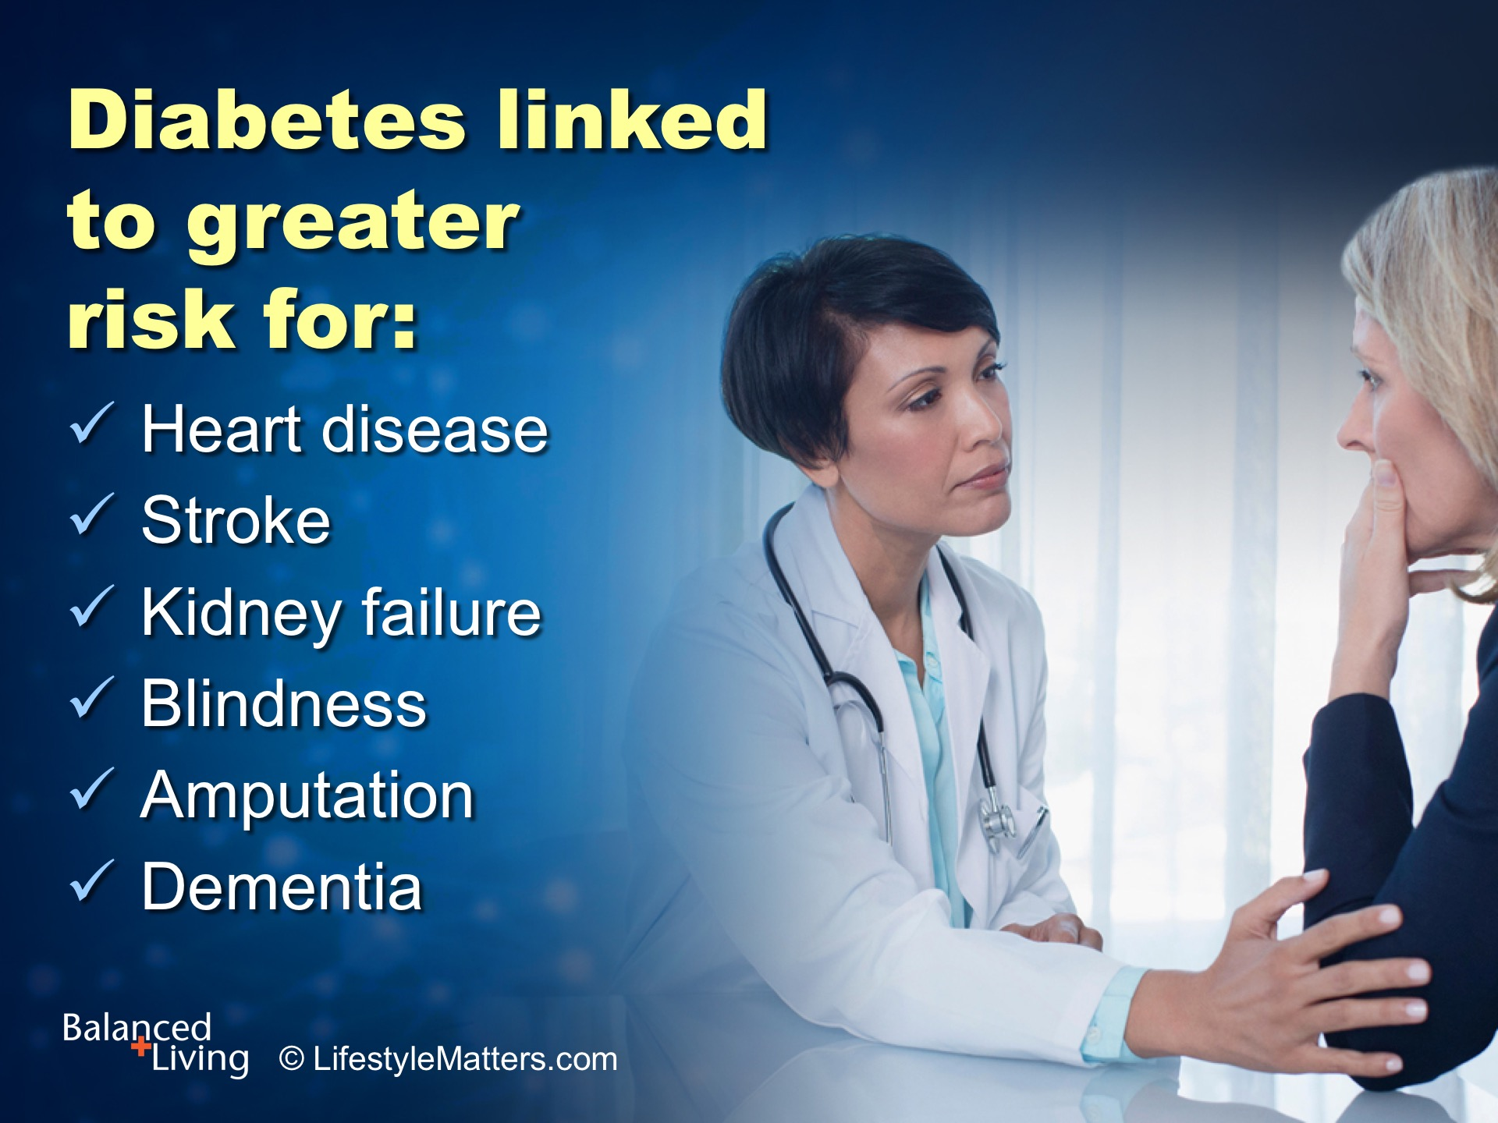
Notes:
Read slide.
One expert explained it this way: “Unless something is done to prevent it, diabetes will result in 35 million heart attacks, 13 million strokes, 6 million episodes of kidney failure, 8 million instances of blindness , 2 million amputations, and 62 million deaths, for a total of 121 million serious diabetes-related adverse events in the next 30 years.” Robert Rizza, MD, Academy of Nutrition and Dietetics.

Slide 10

Notes:
Read slide.

Slide 11
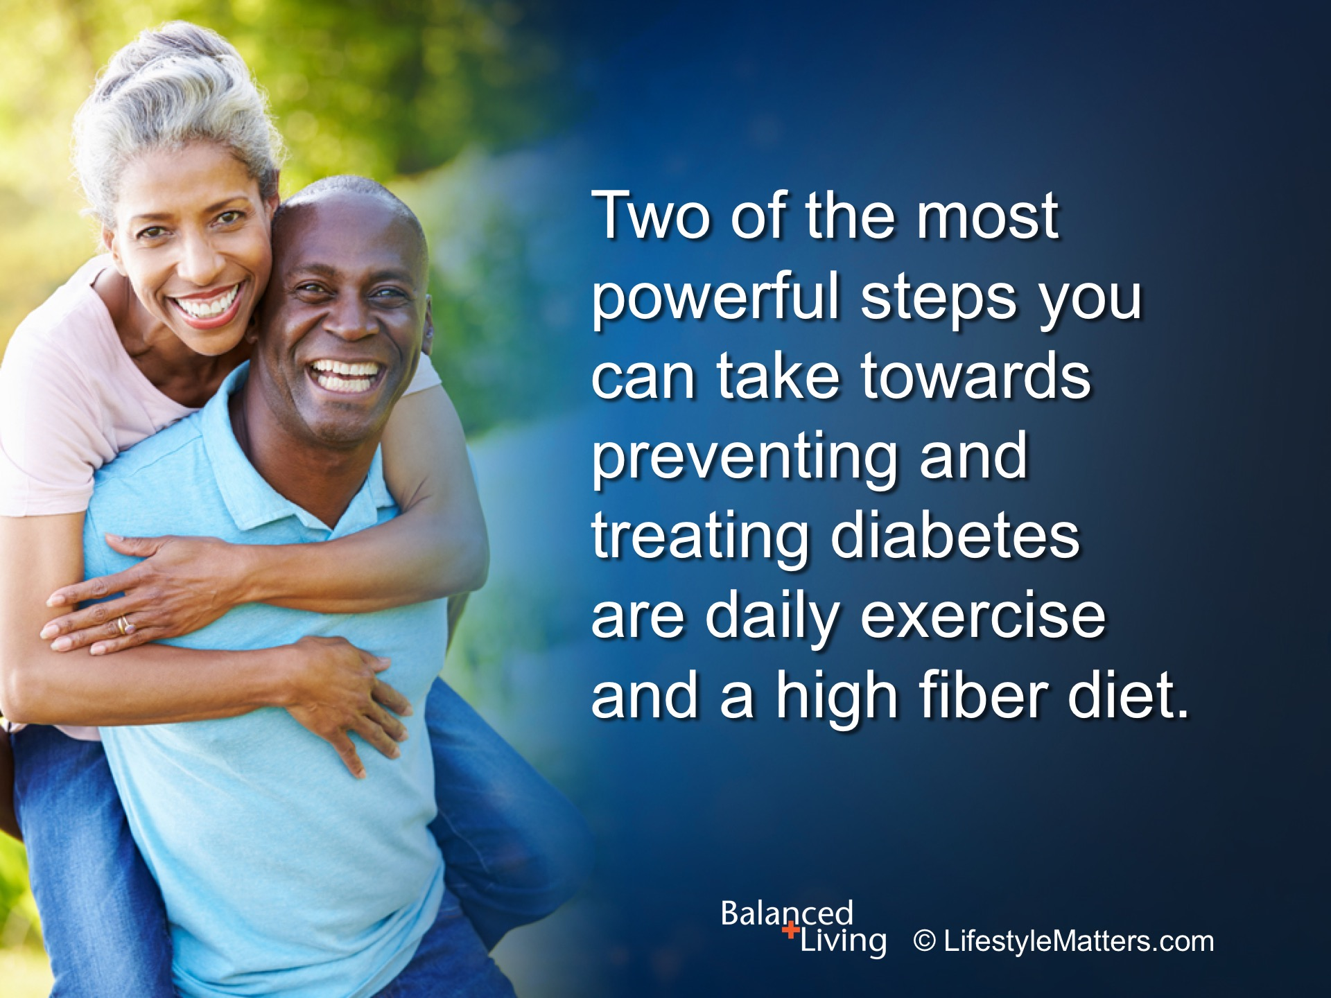
Notes:
Read slide.

Slide 12

Notes:
Diabetes and pre-diabetes have a dietary face.

Slide 13

Notes:
Read slide.
The dietary face of diabetes is consuming a diet low in fiber but rich in:
Meat and high fat dairy products
Fried foods
Sweets and white flour products
Sugary drinks
We could call it the “chips, chops, and lollipops” eating style.

Slide 14

Notes:
But there is hope for better health! Let’s look at: Read slide.

Slide 15
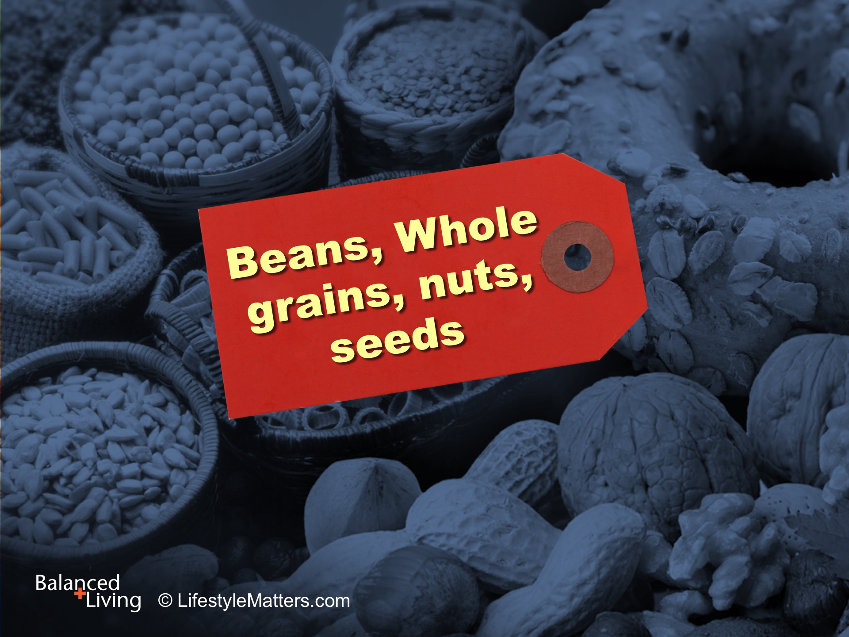
Notes:
Read slide.
A powerful therapeutic intervention for diabetes is the frequent intake of beans– every day or even every meal.
Dr. Don Hall, author of 9 Ways to Prevent Diabetes states: “Beans, peas, and lentils—contain the most fiber of any food group, running as high as 10-15 grams per serving. Include legumes in your diet often…They provide good, plant-based proteins; they’re inexpensive; and their an excellent source of protein.
Be sure your grains are “whole” grains. Brown rice has more than twice the fiber as white rice, and 6 times as much magnesium. Enjoy Old Fashioned or steel cut oats instead of quick oats. After-breakfast blood sugars of volunteers who ate whole grains was 46 percent lower than those who ate refined grains!
What are some ways to include more to your daily meals? (wait for response)
(Source: Don Hall, Dr.PH. 9 Ways to Prevent Diabetes, pp. 40-43.)

Slide 16

Notes:
Read slide.
Here’s another winner when it comes to weight and blood sugar control.
Plenty of vegetables; look for bright colors, leafy greens, and “crunch factor.”
What are ideas for including more? (wait for response)

Slide 17

Notes:
Read slide.
This colorful food group contains essential trace minerals and potassium which is critical for a healthy blood pressure.
They also contain powerful antioxidants and anti-inflammatory agents that build a healthy digestive environment for weight loss and blood sugar control.
What do you already enjoy in these food groups that you can increase? (Wait for response)
What do you think will happen to sugar cravings over time with healthier food choices? (Wait for response)

Slide 18

Notes:
Read slide.
Walnuts contain heart-healthy omega 3 fats, and so do flax, chia, and hemp seeds.
Soy beans (edamame), soy oil, and canola oil also contain omega 3 fats.
It is healthy to include raw nuts in your diet every day. Sprinkle on salad or over cereal to add flavor and nutrition!

Slide 19
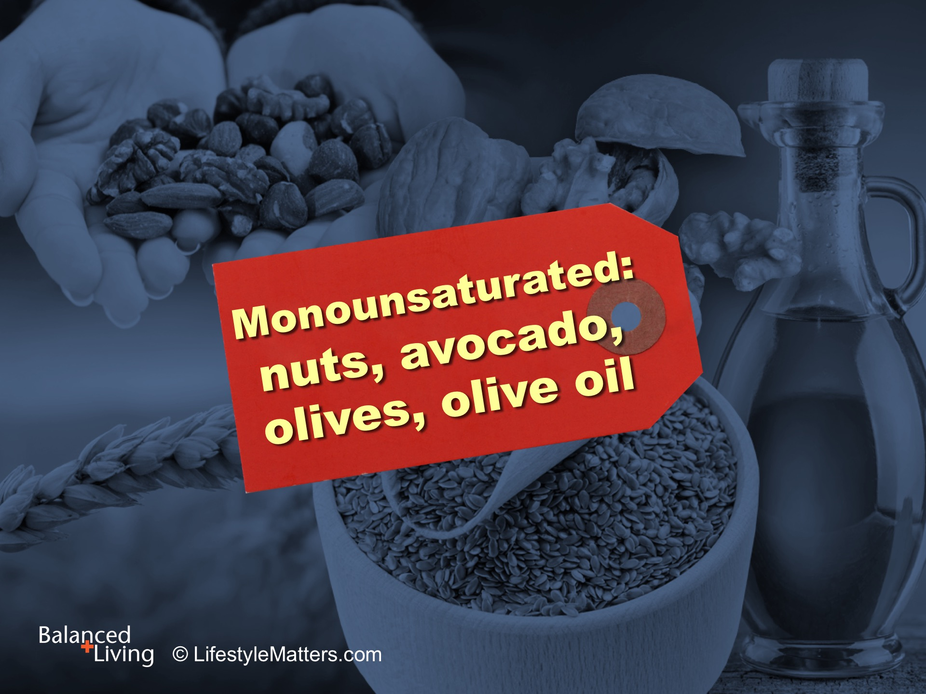
Notes:
Read slide.
Olives, avocados, and olive oil contain flavorful and healthy monounsaturated fats.
Nuts and seeds are good sources of fiber, nutrition, and protein; they also protect against diabetes.
Almonds, for example, contain 3.5 grams of fiber per serving. Sunflower seeds have almost 4 grams per serving.
A serving is about an ounce, or a small handful.
Healthy fats lower stress, improve cholesterol levels, blood pressure, and the risk for dementia.
Treat yourself to healthy fats every day!

Slide 20
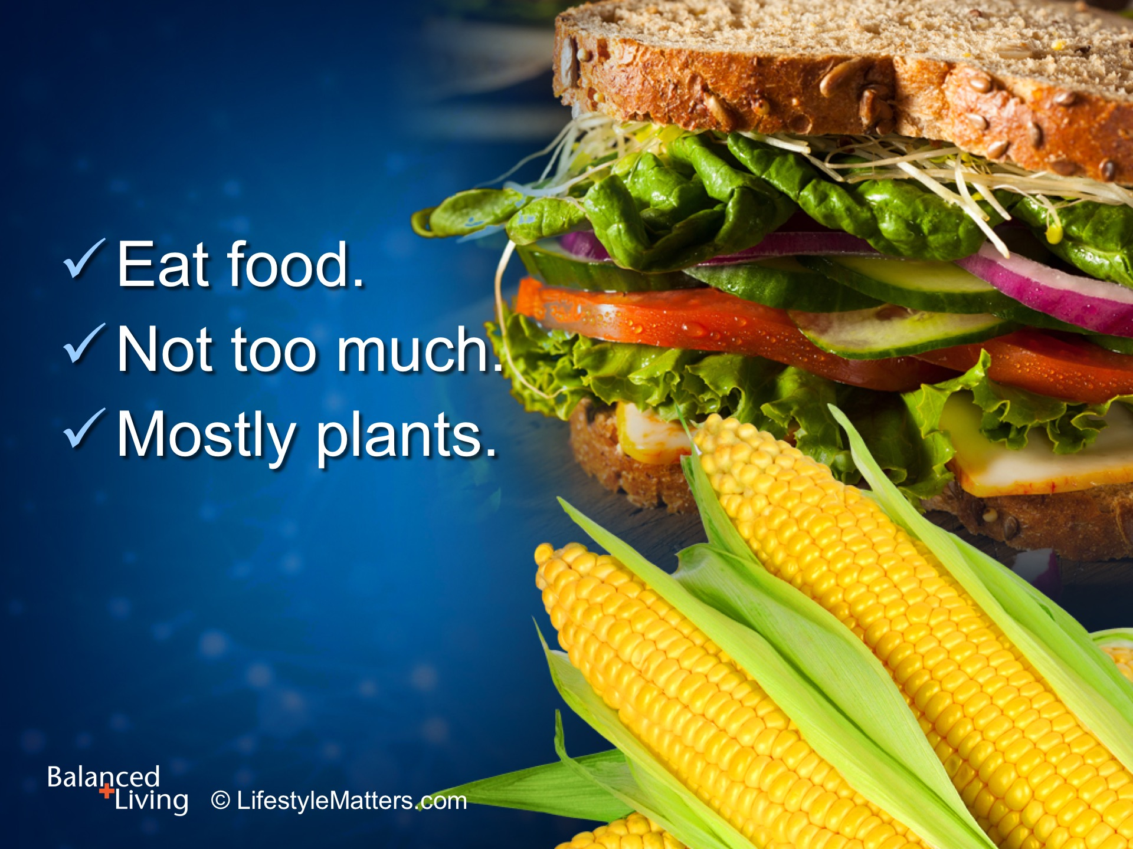
Notes:
What’s the bottom line? Read slide.
When it comes to plant foods, more is better!
More on your plate; more nutrition, variety, and flavor!
(Source: Michael Polen)

Slide 21

Notes:
Regular exercise is a key component for improving fitness, energy, and blood sugar control.
Exercise improves energy and mood and reduces fatigue and depression, two big enemies of good mental and physical health!
Read slide.

Slide 22

Notes:
Read slide.
If you have not been exercising, start slowly and choose activities that you enjoy.
If you enjoy walking, begin at an easy pace but pick up the pace as you become stronger.
You will notice a difference! Just a 10-minute brisk walk after meals is helpful in controlling blood sugar.

Slide 23
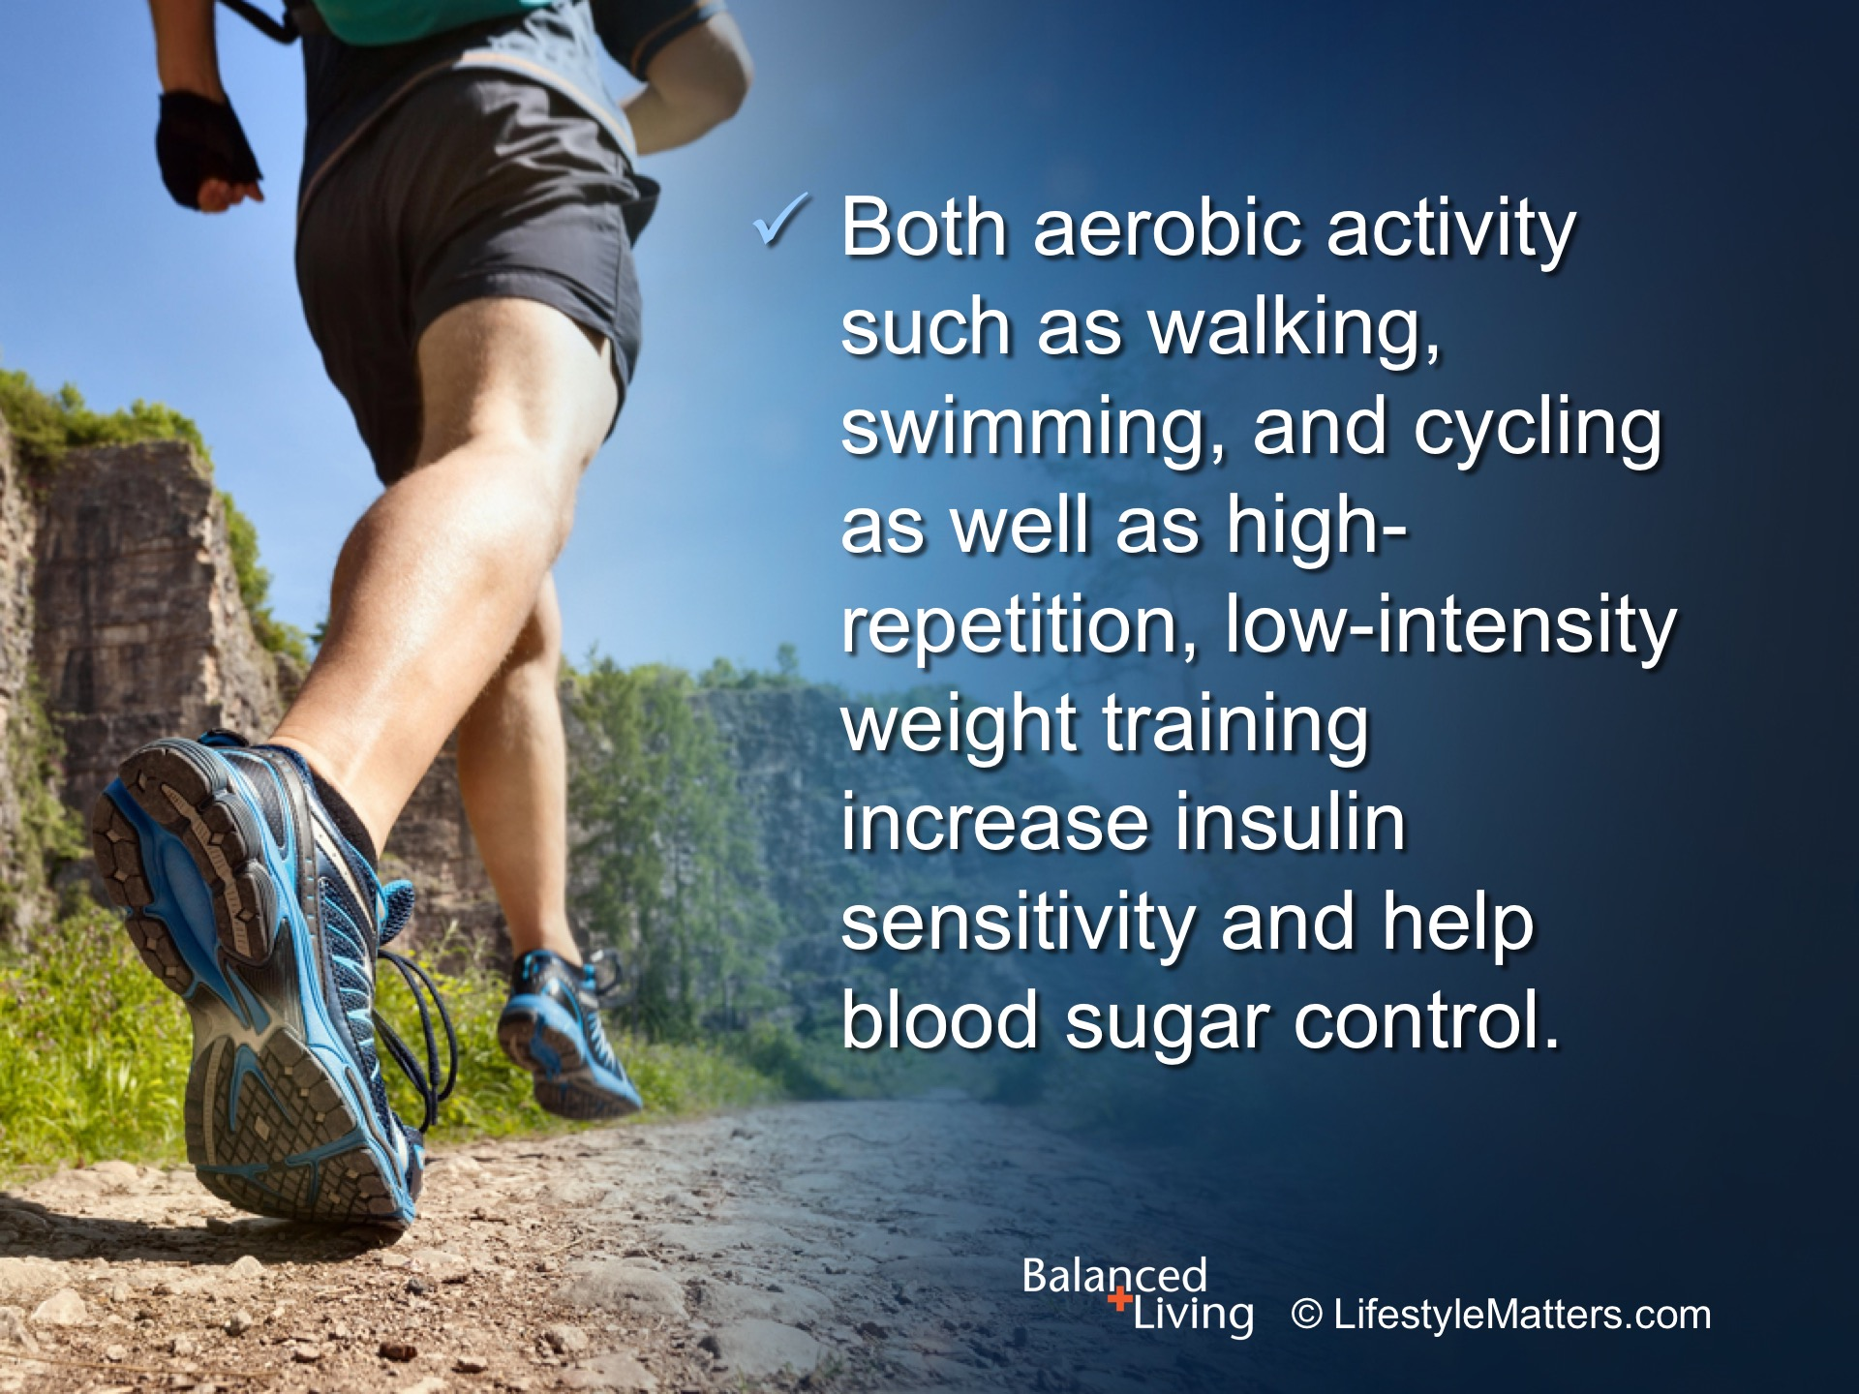
Notes:
Read slide.
Excess body fat is the primary risk factor for type 2 diabetes.
Since 80% of type 2 diabetics are overweight, a regular exercise program to lose excess body fat is critical to improving metabolic health.

Slide 24
Notes:
Read slide.
What exercise do you like to do? (wait for response)
What’s the plan for bad weather? (wait for response)

Slide 25
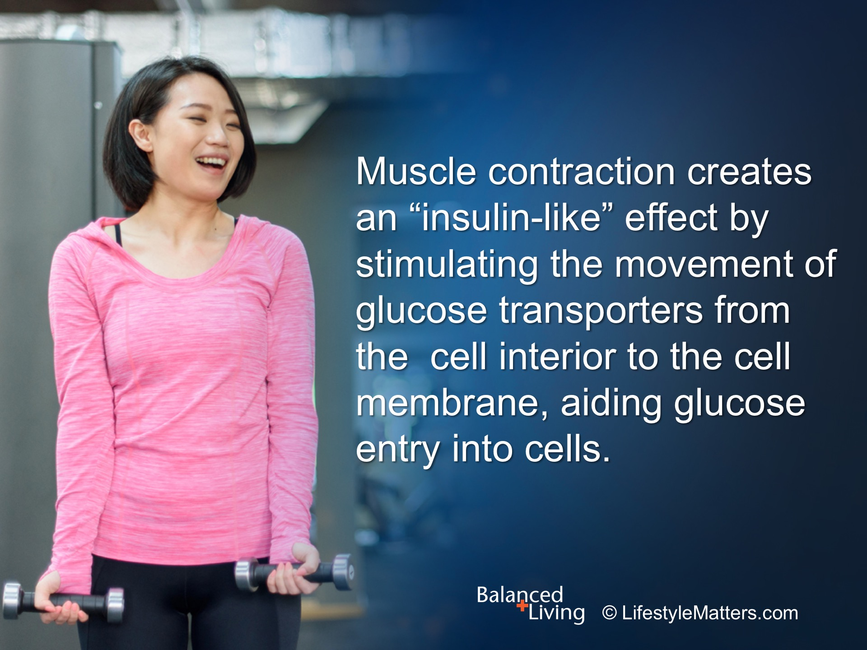
Notes:
Read slide.
This is wonderful news. The question is not, “Am I going to exercise?”
The question is: “Where, and when!”
Are you motivated? (wait for response)
(Reference, Don Morgan, PhD, Dept. of Exercise Physiology, University of Tennessee)

Slide 26
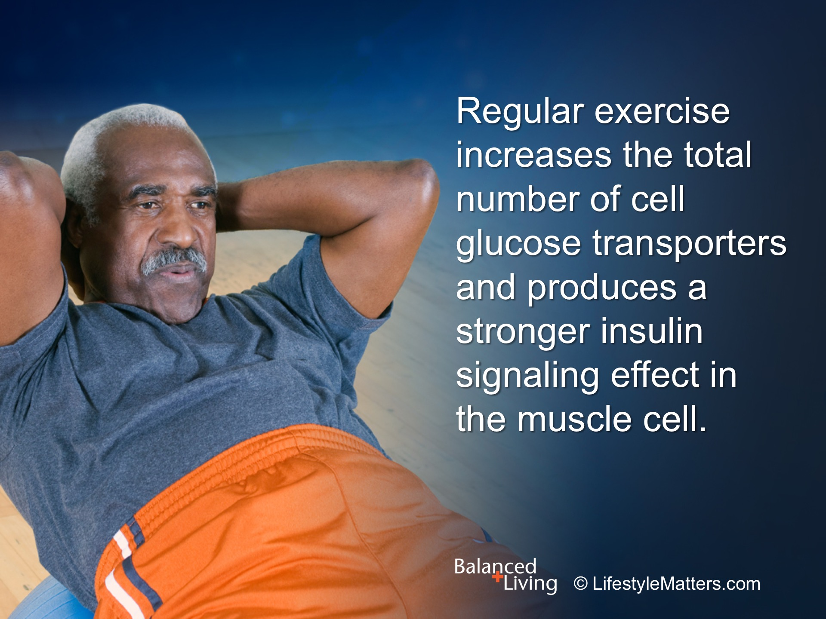
Notes:
Read slide.
That’s even more good news!
All types of diabetics—and everyone seeking better health benefits from this blood sugar control “back-up system.”
(Reference, Don Morgan, PhD, Dept. of Exercise Physiology, University of Tennessee)

Slide 27
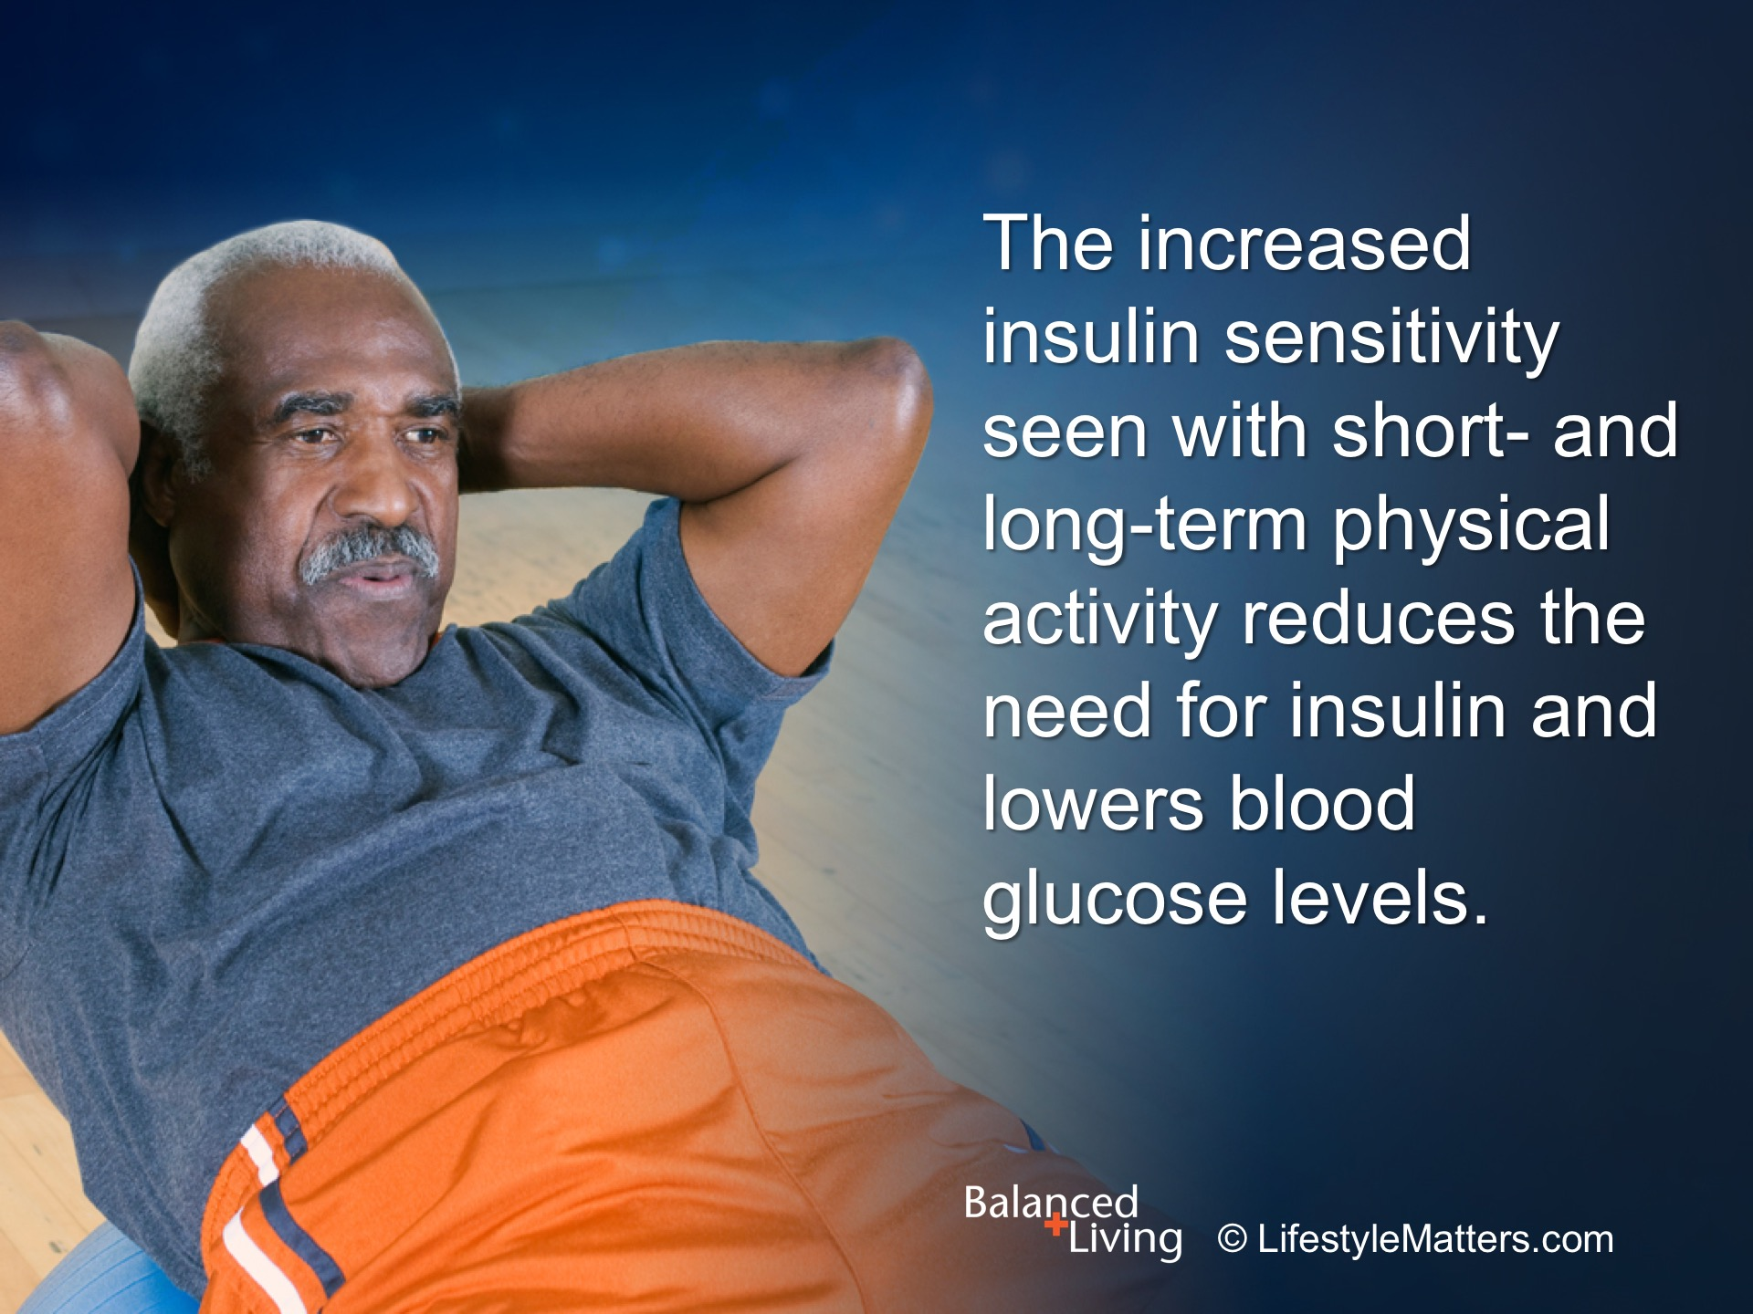
Notes:
Read slide.
Long-term physical activity—this is a major lifestyle link to better health.
What would the value of an exercise class, coach, or “buddy” provide? (wait for response)
(Reference, Don Morgan, PhD, Dept. of Exercise Physiology, University of Tennessee)

Slide 28
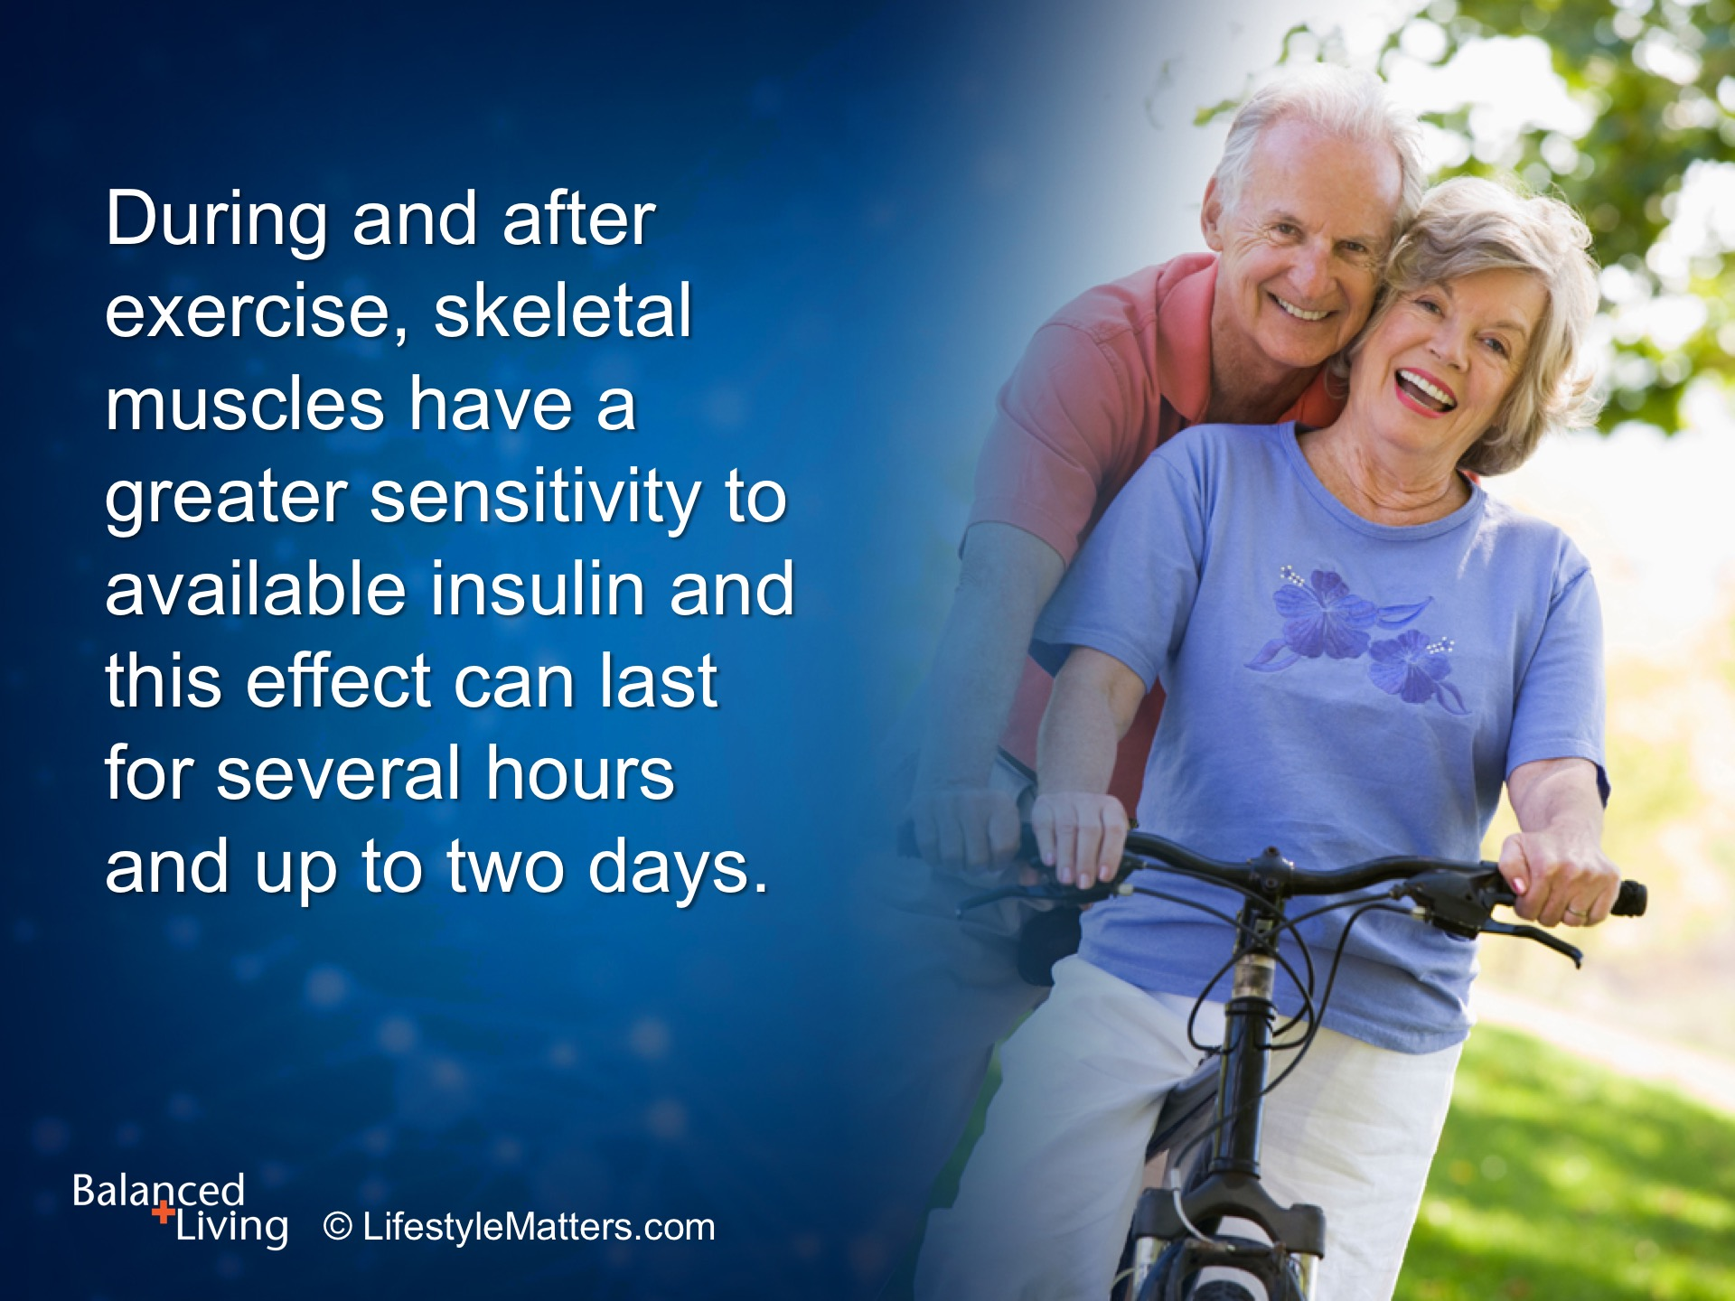
Notes:
Read slide.
Consistency and regularity are key. Don’t overdo, but DO challenge yourself!
(Reference, Don Morgan, PhD, Dept. of Exercise Physiology, University of Tennessee)

Slide 29
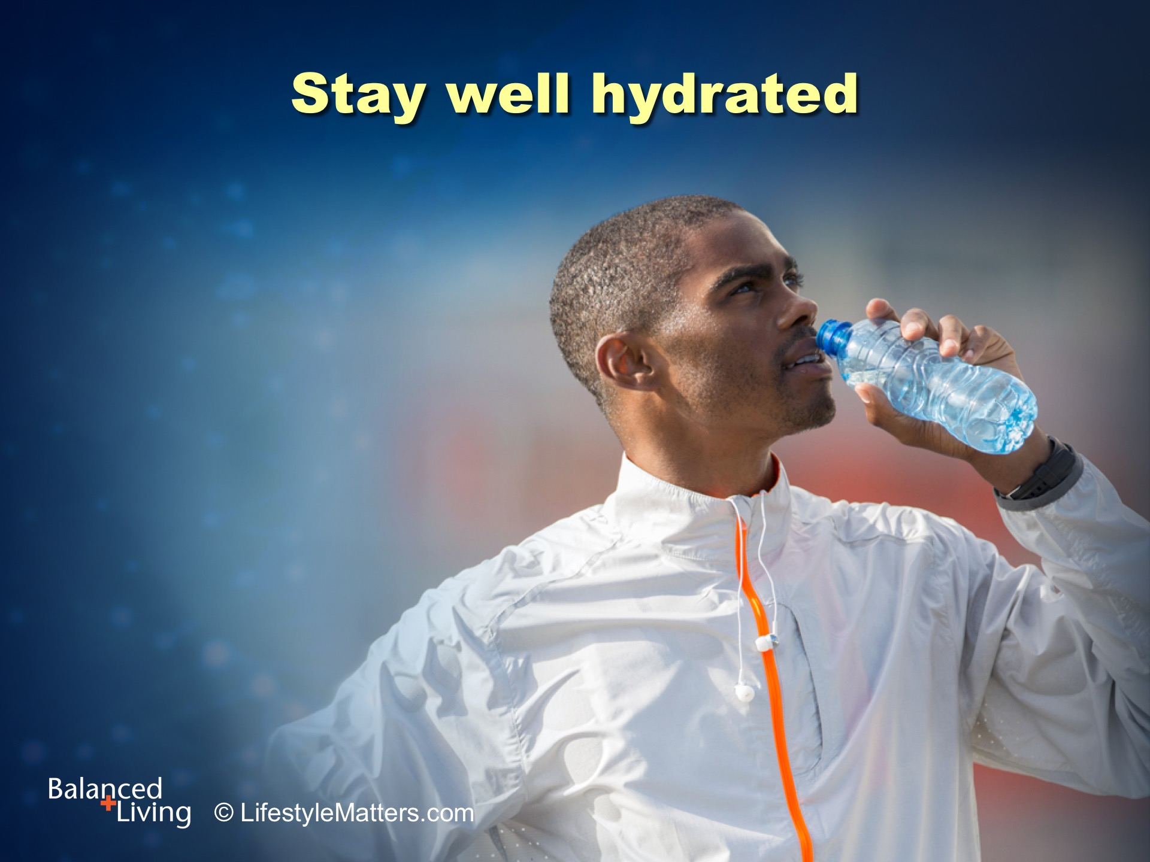
Notes:
Read slide.
Why is drinking plenty of water when exercising important? (wait for response)
(Note: Better than energy drinks, which can be dehydrating and bad for blood sugar. Water replaces lost fluids and keeps energy and alertness levels high)
Why is drinking water between meals instead of sweetened drinks an important choice? (wait for response)
(Note, Sugary drinks bad for diabetes; loaded with calories; increase hunger signals; artificially sweetened drinks also increase hunger signaling and are a risk factor for diabetes)

Slide 30
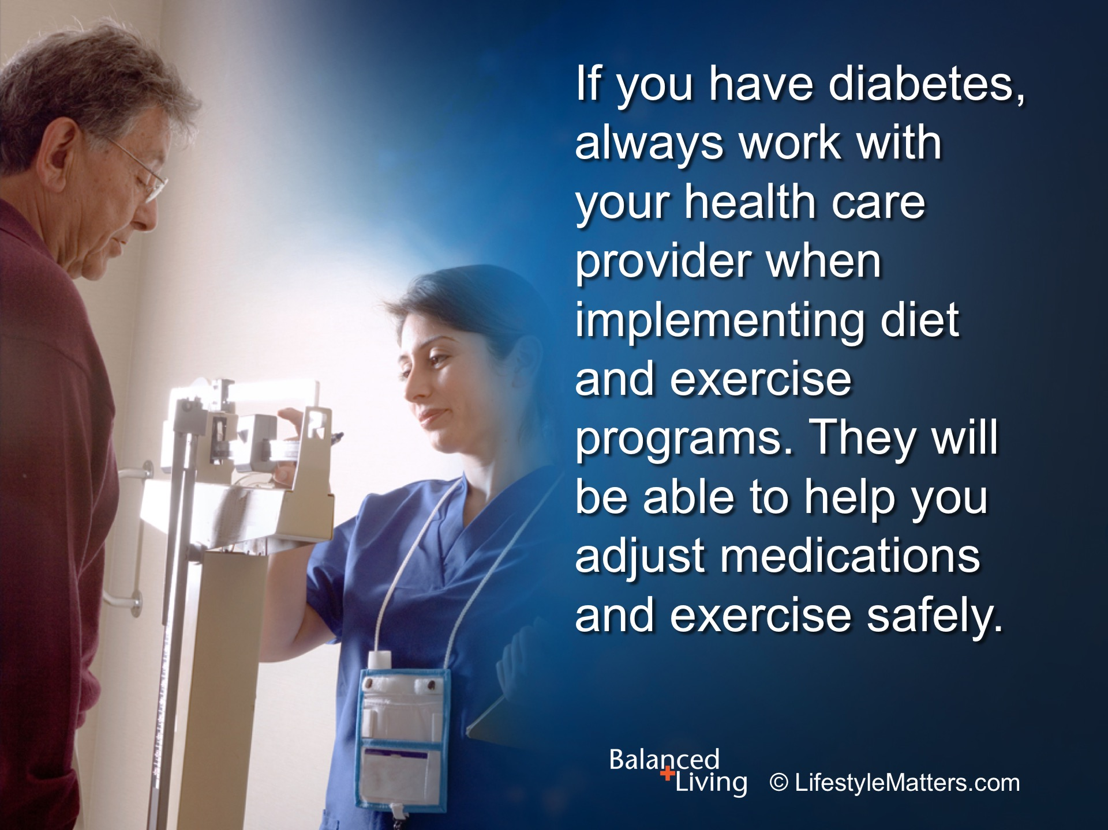
Notes:
Read slide.

Slide 31
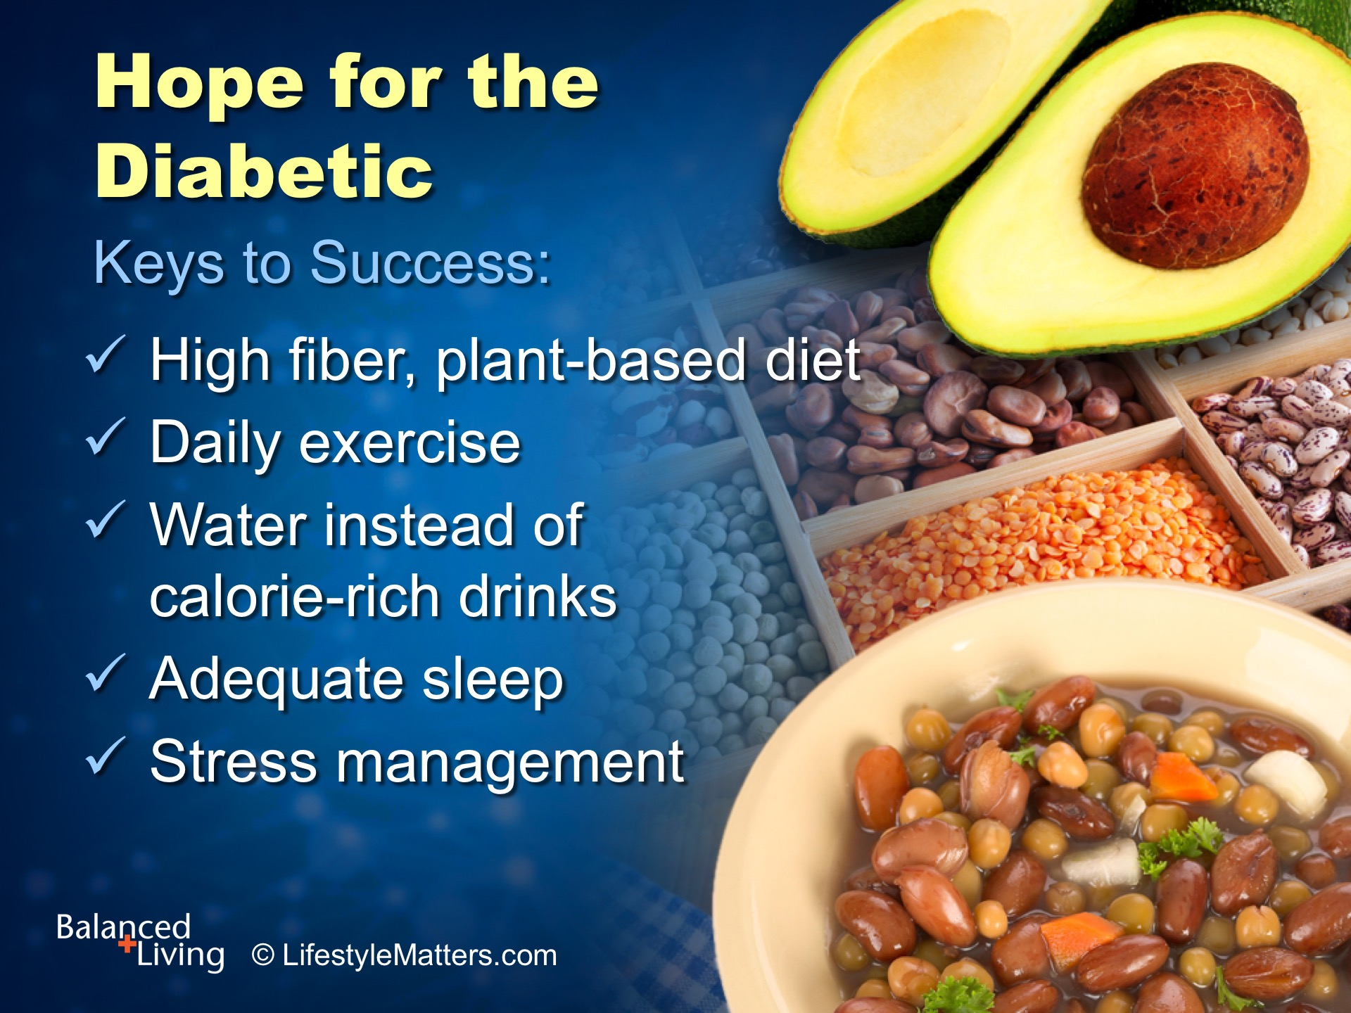
Notes:
Let’s summarize: Read slide.
What are some healthy ways to manage stress instead of eating or using media? (wait for response)
(Note: Walking the dog; visiting with a friend; chores or hobbies; prayer and worship)

Slide 32
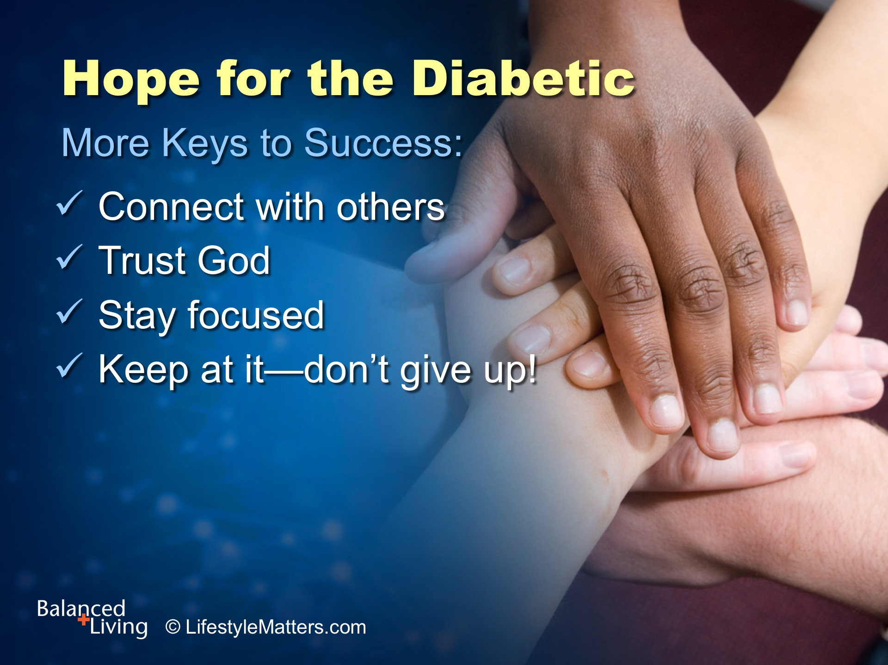
Notes:
Read slide.
Hope is at the heart of a healthy lifestyle.
God will help you stay focused, faithful, and hopeful as you learn new habits each day.
Remember, successful people are not mistake free—they just refuse to give up!
Like a postage stamp, they stick to one thing until they get there!

Slide 33

Notes:
Read slide.
God wants to add value to your life.
He has provided mental, spiritual, and lifestyle keys to help you in this life, and fill you with His Spirit and give you eternal life.
Would you like to ask God for the strength and power to live a healthier lifestyle?
(Raise your hand as you ask the question)

