Slide 1


Images © Alamy
www.alamy.com
Images used in powerpoint presentation are part of the presentation and not to be used out of context of the presentation, may not be used as stand-alone images unless to promote the presentation/event, and may not be resold in singular form or as part of an image library. Images are © Alamy and presentation templates and content therein are © MISDA, any other usage requires written permission from both parties.

Slide 2
Scripture quotations used in Balanced Living PowerPoints are taken from Bibles in the Public Domain which have no USA copyright restrictions. We have indicated which version each quotation is taken from as follows:
KJV - King James Version
BBE - Bible in Basic English
WEB - World English Bible
DBY - Darby's Translation
Any scriptures not otherwise noted are the author's paraphrase of one of these versions.

Slide 3
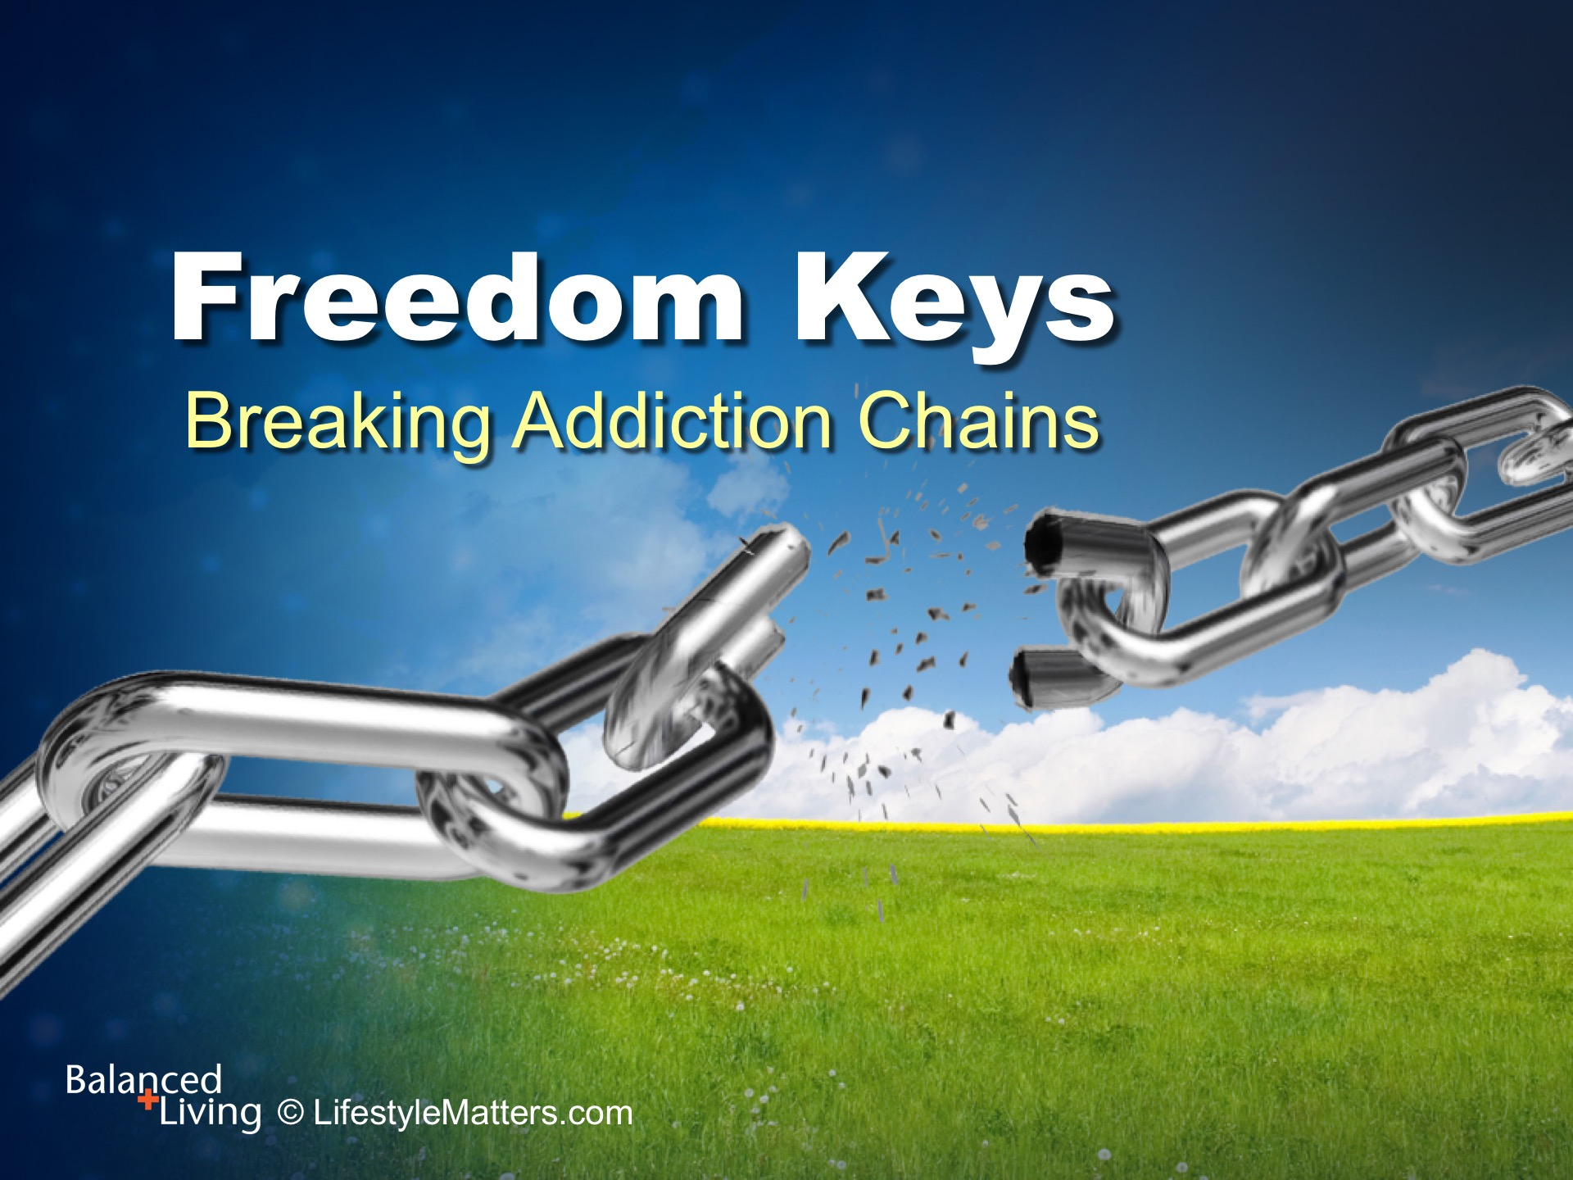
Notes:
Presenter: Please read and study the tract that accompanies this PowerPoint to prepare for this presentation.
In this session we are talking about changing bad habits—for good!
Can the power of a bad habit be broken?
Is it possible to live free?

Slide 4
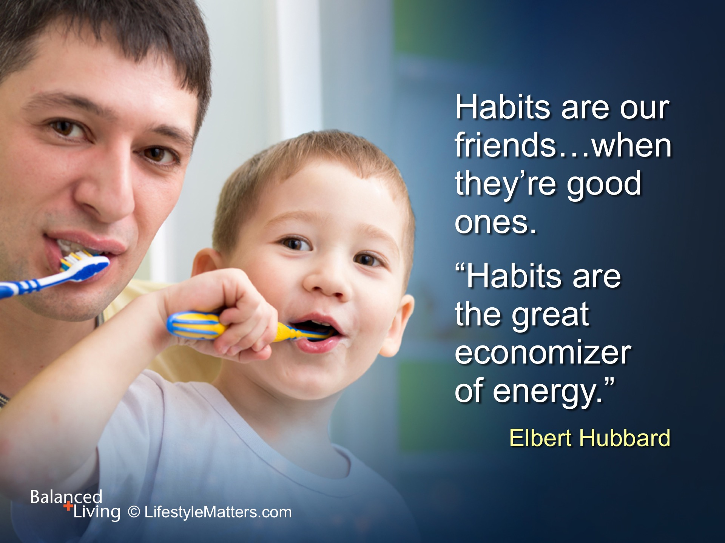
Notes:
Habits. We all have them.
Read slide.

Slide 5
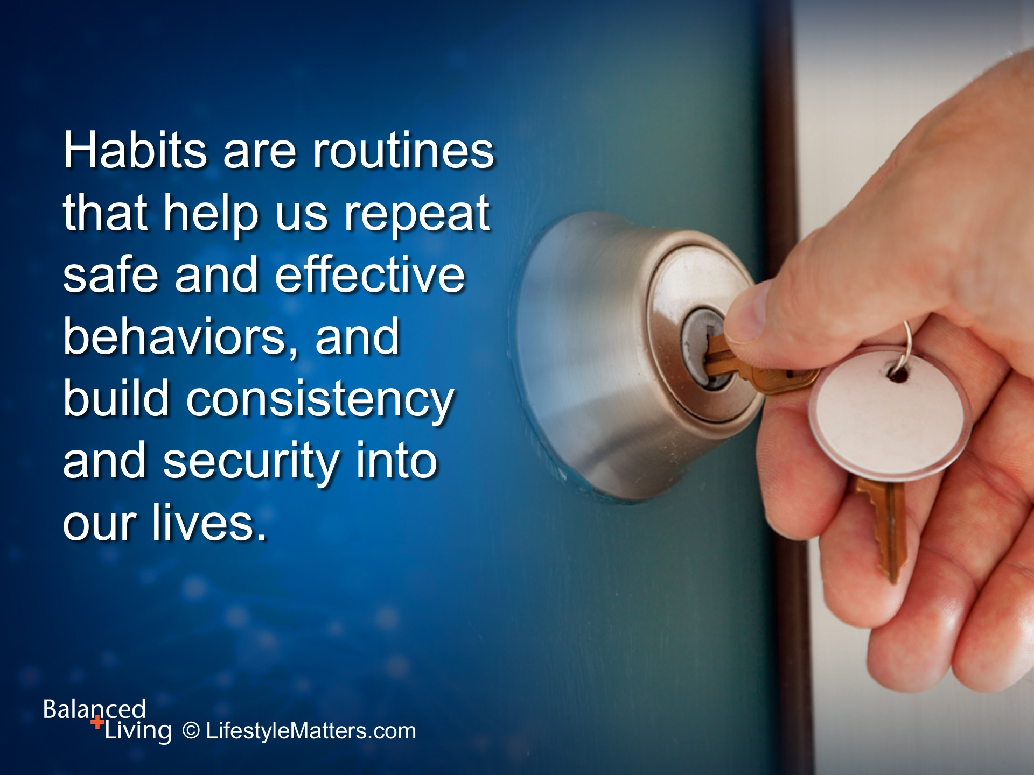
Notes:
Read slide.

Slide 6
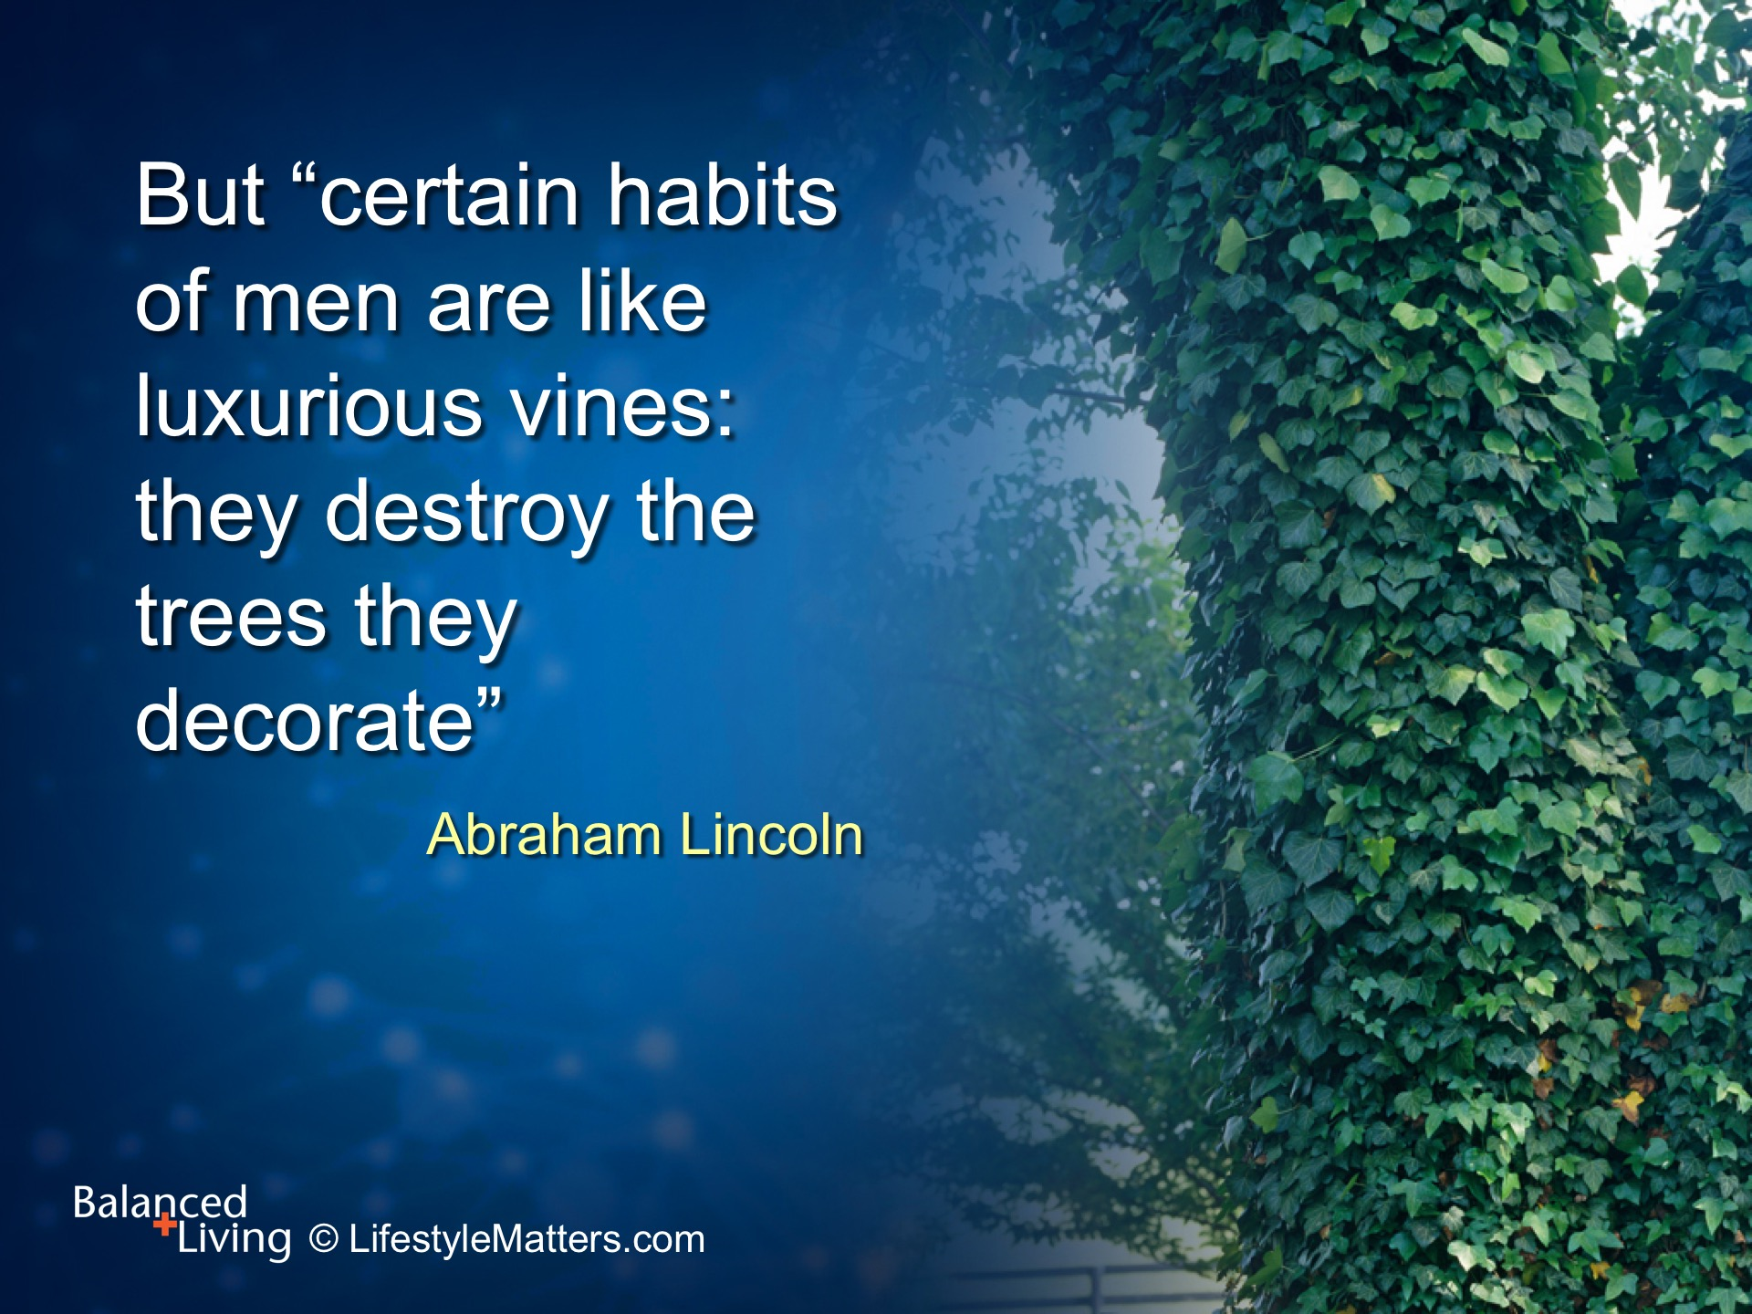
Notes:
Read slide.
Addictions are strong—but the weapons available to win the war against addiction are even stronger.
As in any war, it is important to have a plan—a decided strategy for battle in order to achieve a decided victory over the enemy.
In this case, the enemy is that habit that is stealing your joy, energy, and life.

Slide 7
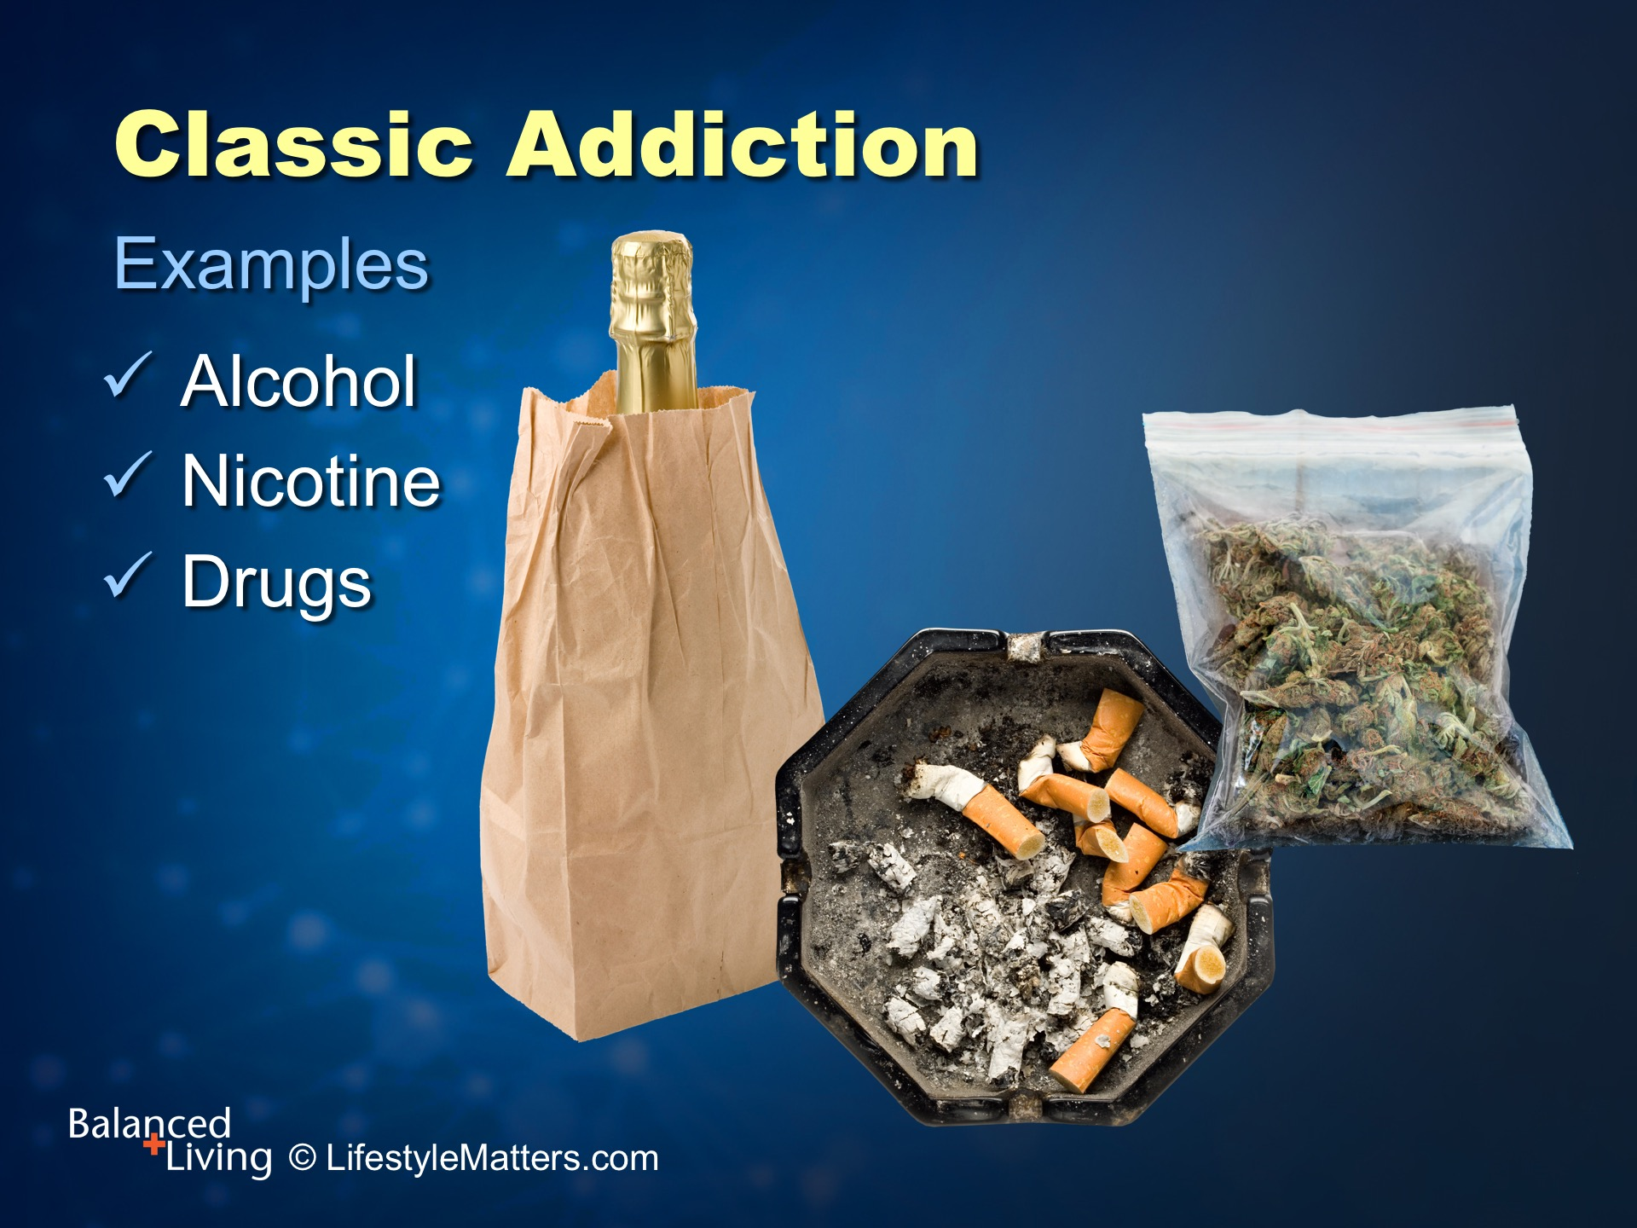
Notes:
In the past, the term “addiction” was used only to refer to problems with substances such as: Read slide.

Slide 8
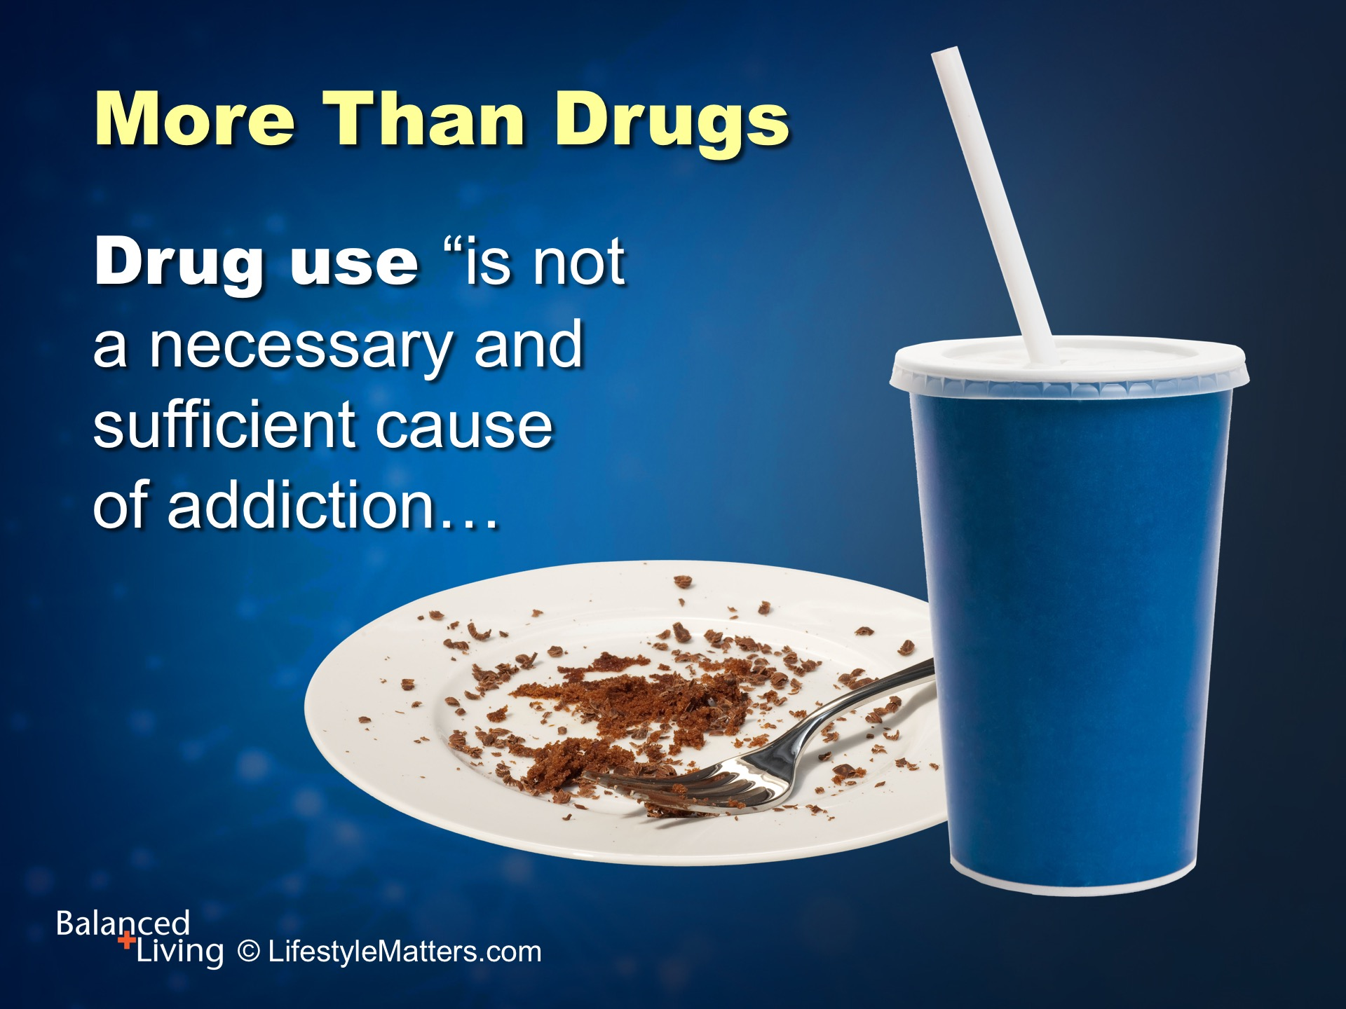
Notes:
But we now know that: Read slide.

Slide 9
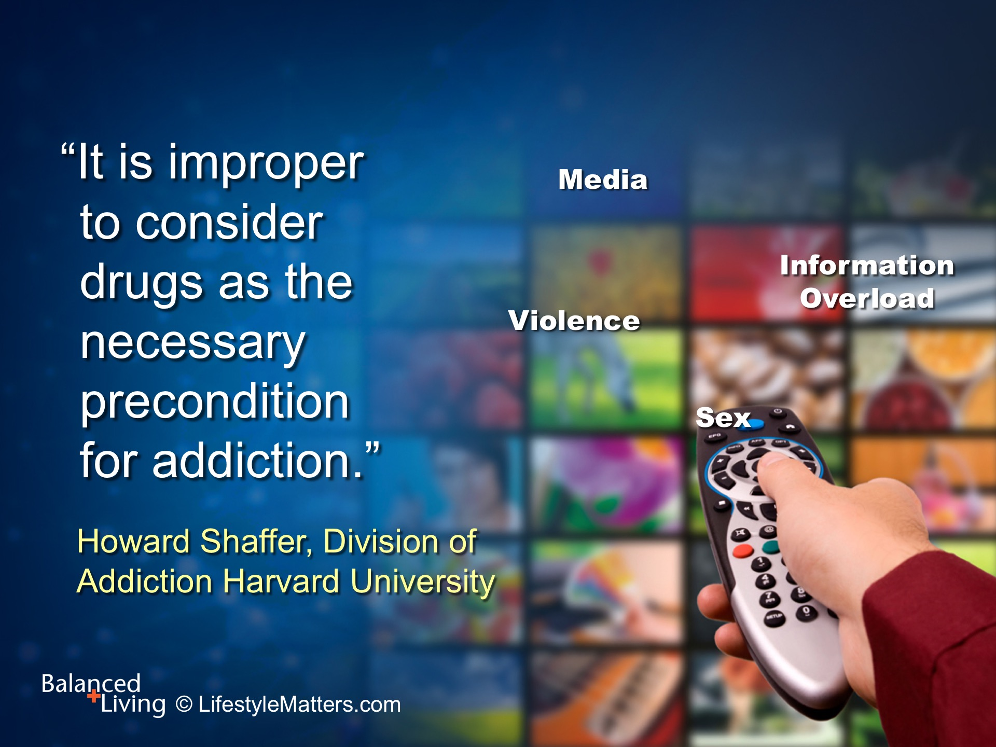
Notes:
Read slide.

Slide 10
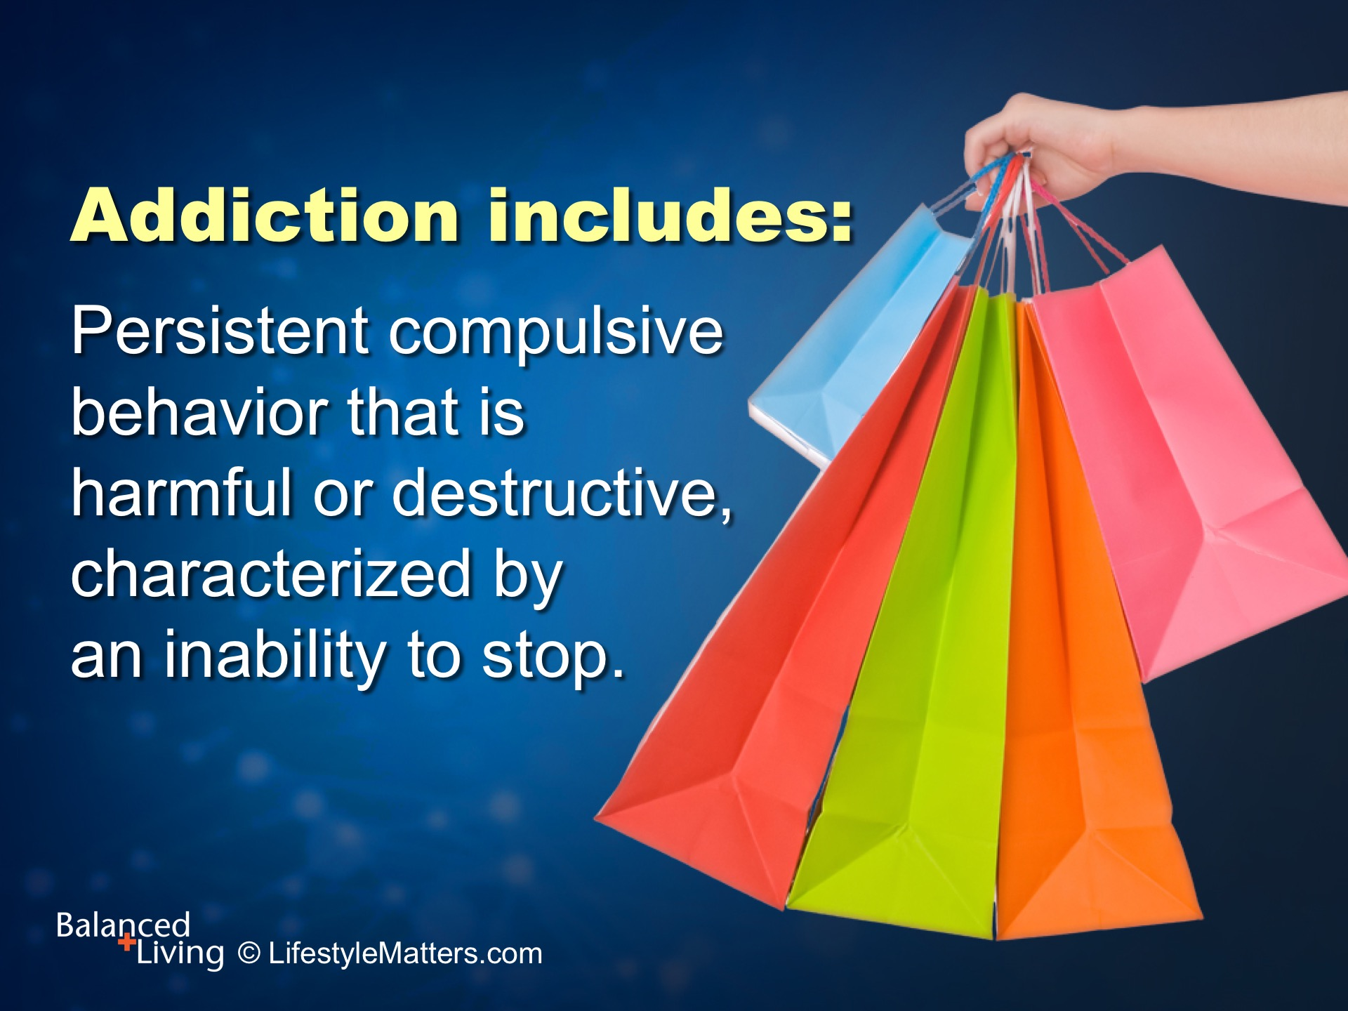
Notes:
Addictions have many possible roots, including emotional, physical, spiritual, genetic, and environmental.
But a key characteristic of any addictive behavior includes: Read slide.

Slide 11
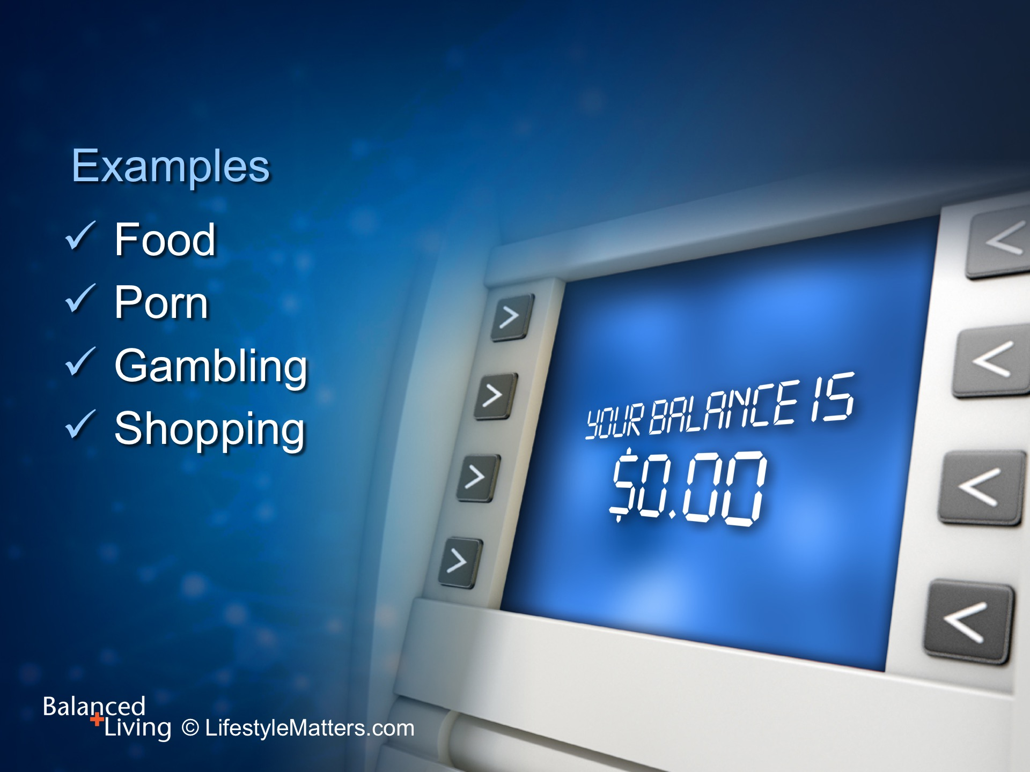
Notes:
Some examples include: Read slide.

Slide 12
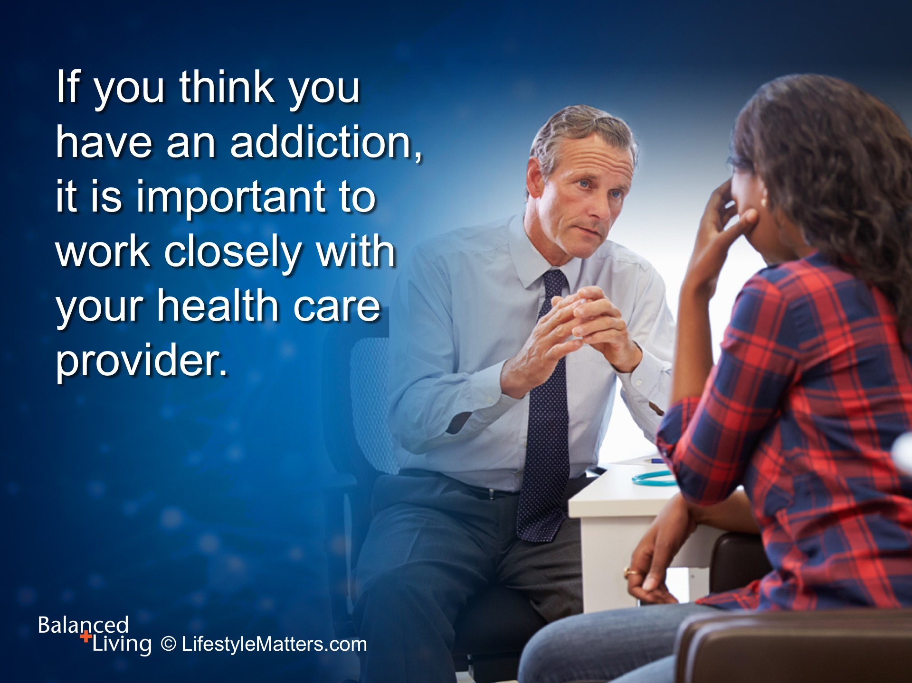
Notes:
Read slide.
This is always true, but especially if the addiction involves drugs or alcohol, or if you are suffering from severe depression. Often there are other conditions that need treatment, so always work with your doctor or healthcare provider.

Slide 13
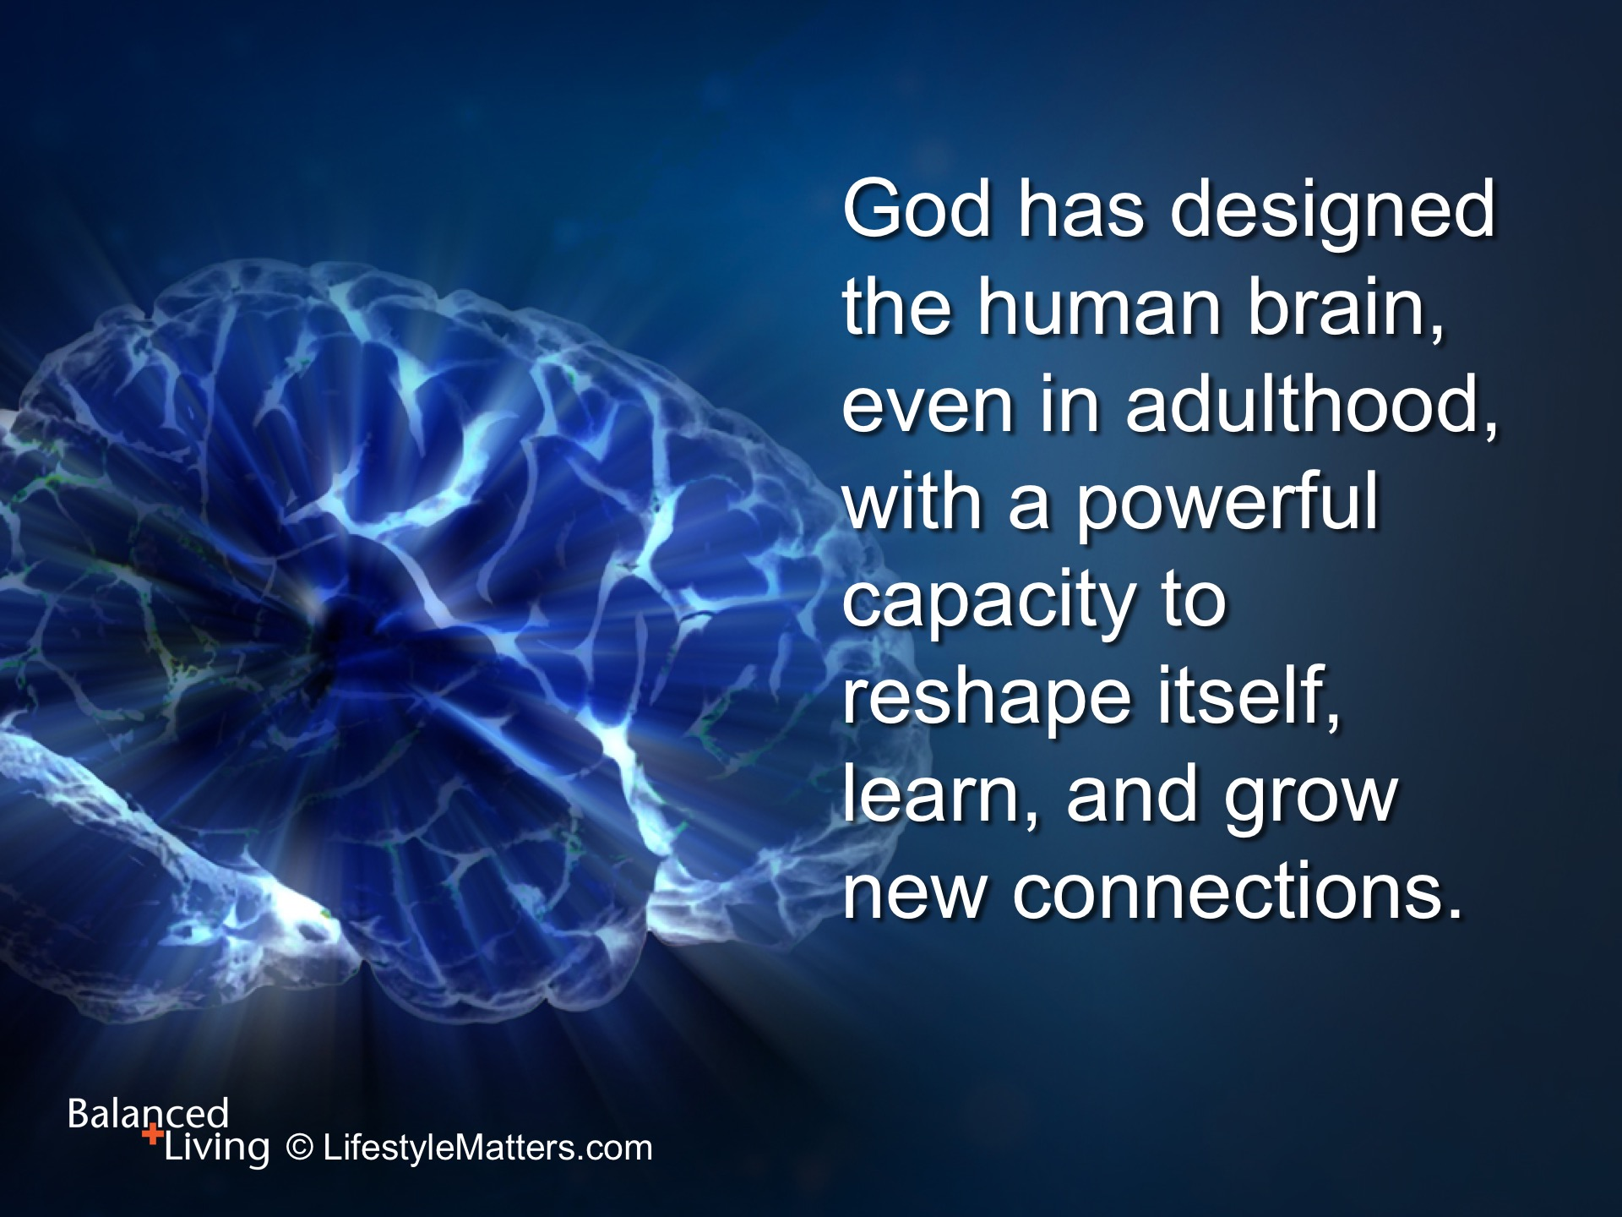
Notes:
Read slide.
God has designed you so that with His creative power in you the strongholds of addiction can be torn down.

Slide 14
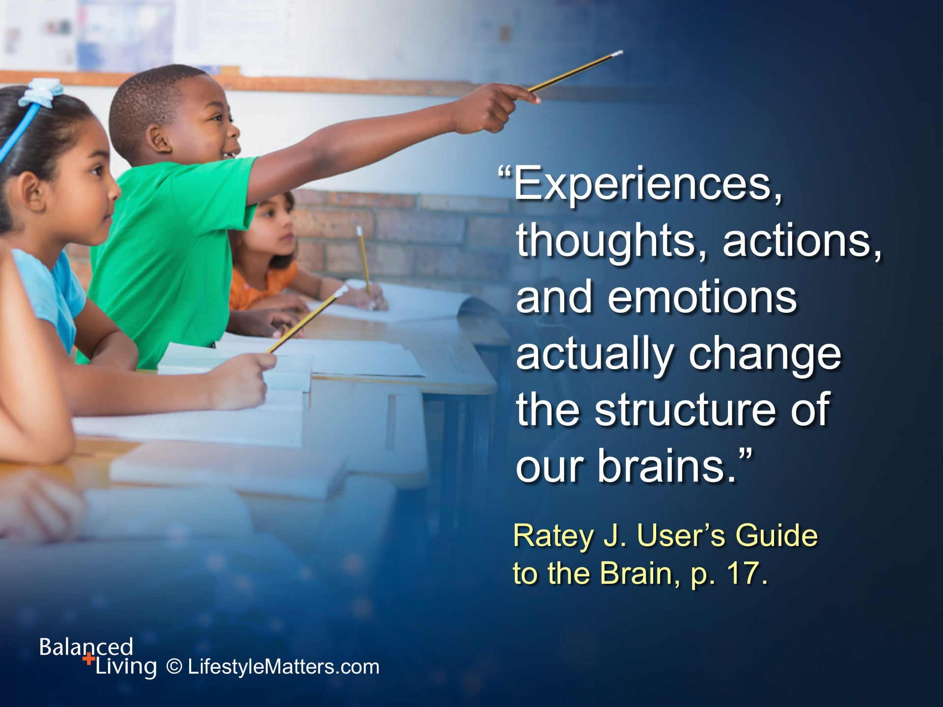
Notes:
Read slide.
Good habits can become just as persistent as bad ones!
Doesn’t that sound like the kind of “rut” we all want to be in?
(Dr. John Ratey, MD, is the author or User’s Guide to the Brain, and is a Psychiatrist from Harvard University)

Slide 15
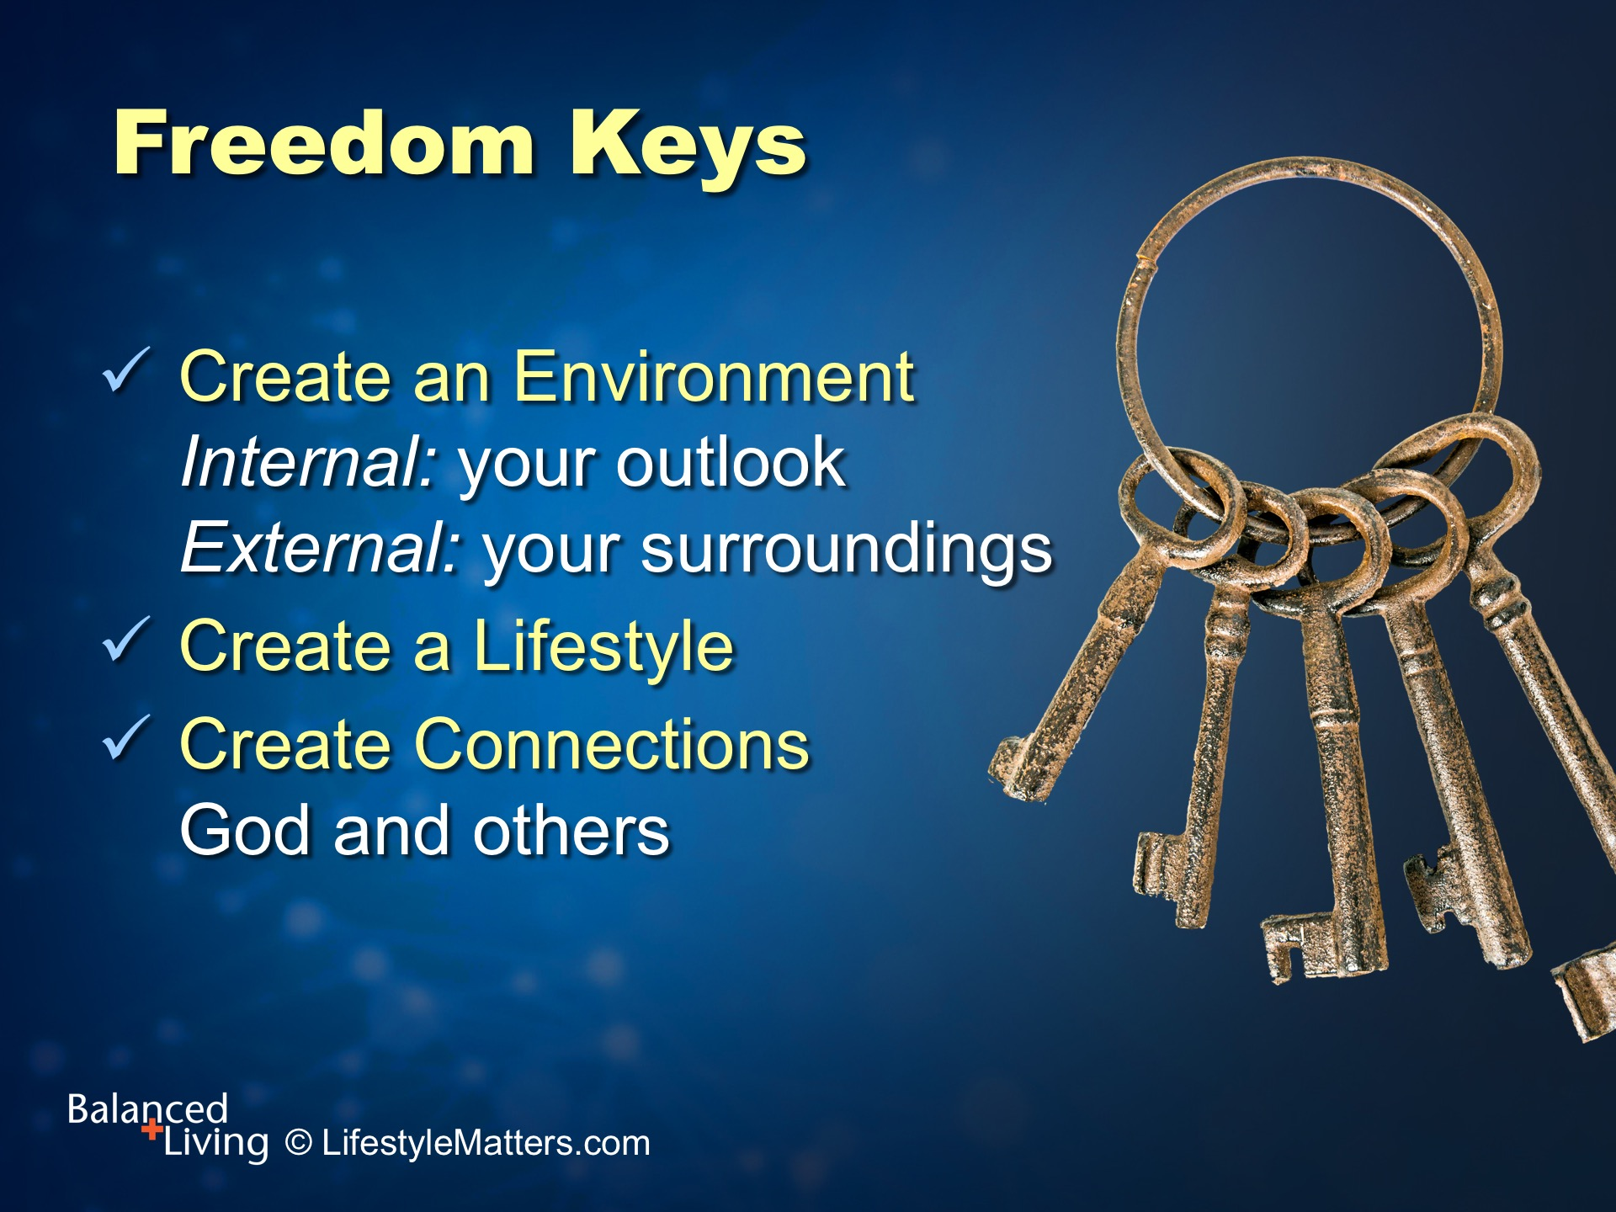
Notes:
Potent, powerful and protective weapons are available to help you make and maintain permanent changes over time.
We call them “freedom keys.” They include: Read slide.

Slide 16
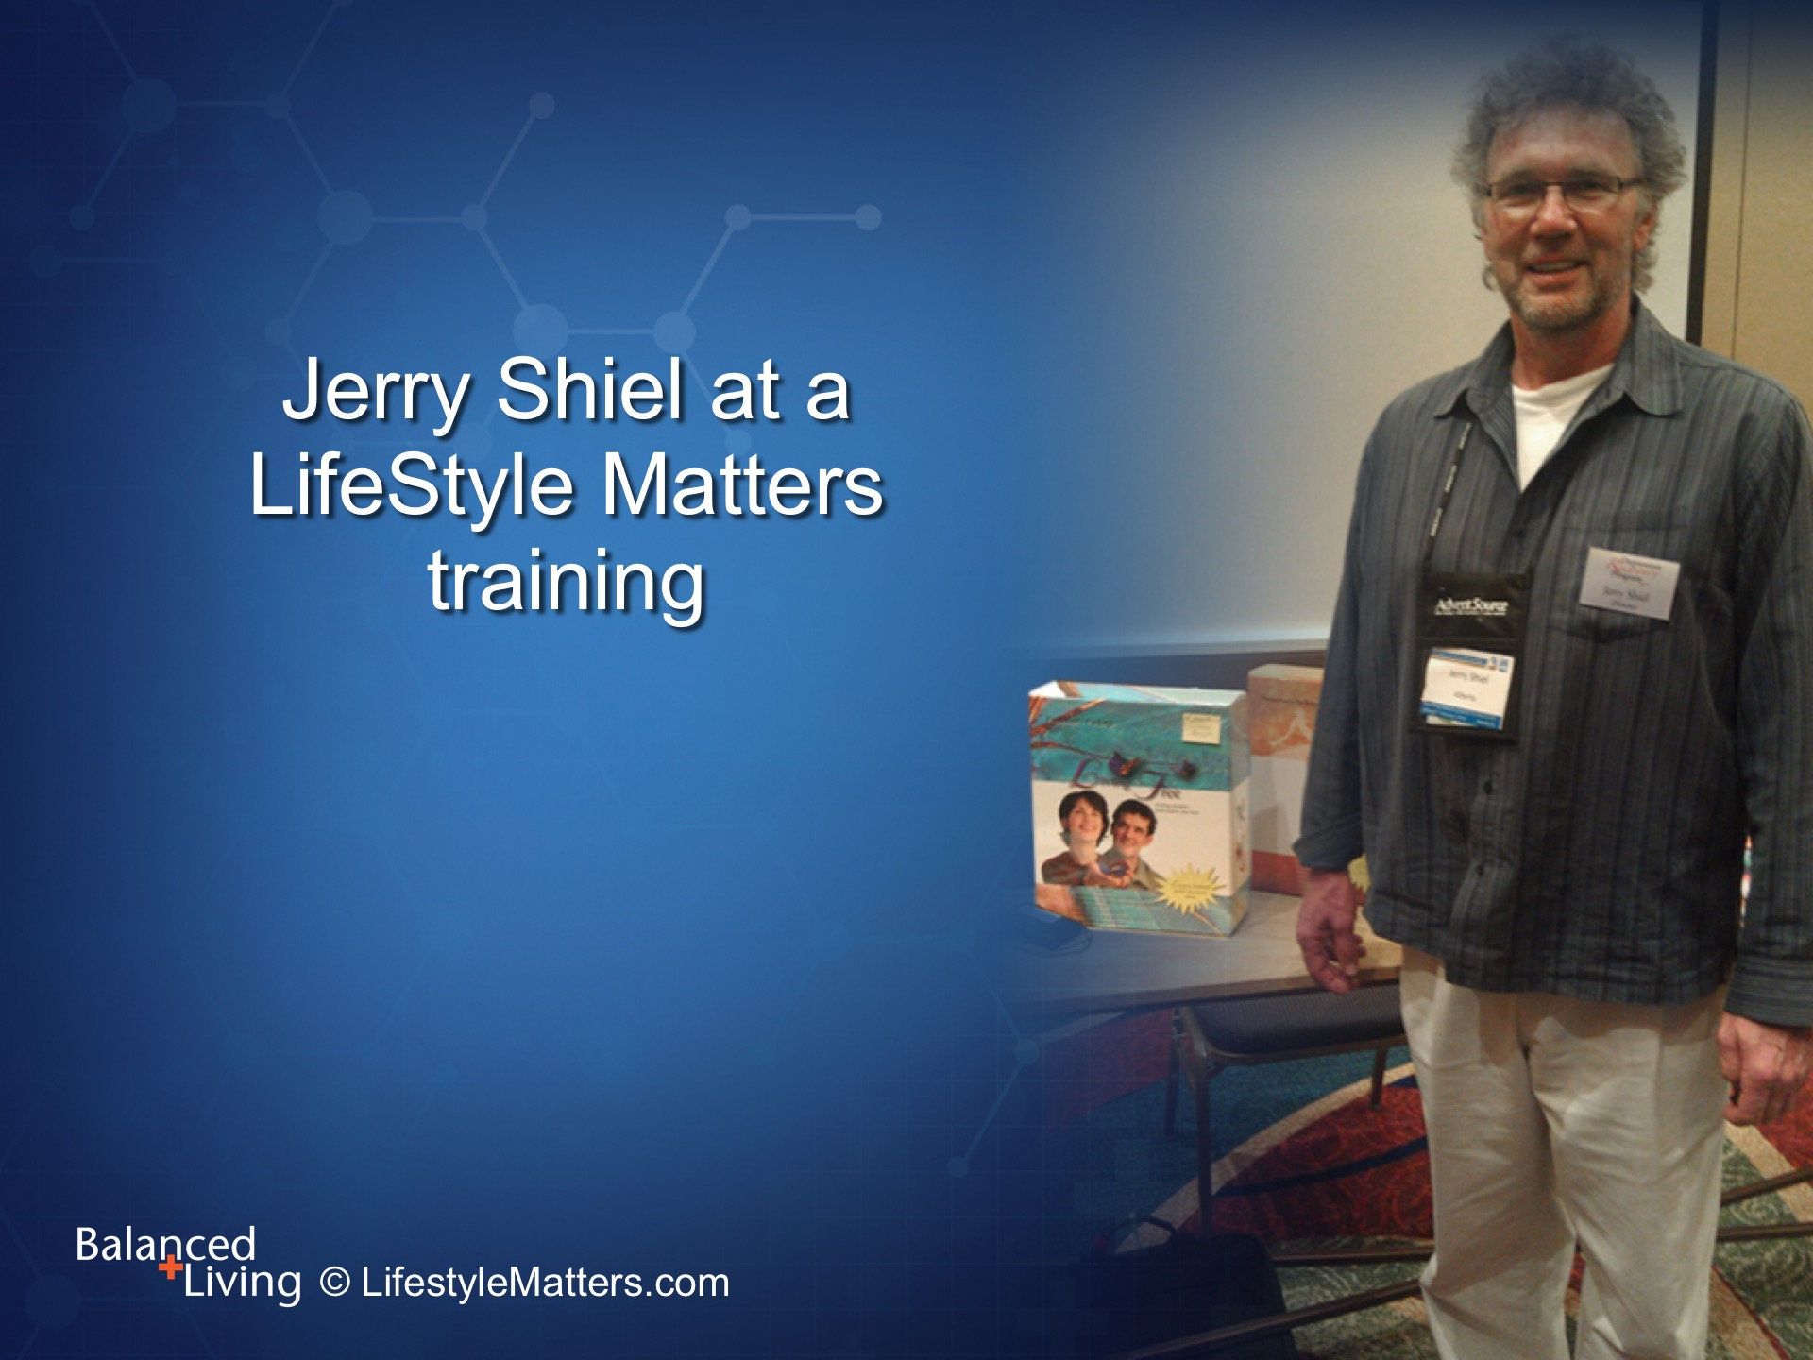
Notes:
Jerry’s story illustrates these freedom keys in action.
Jerry came to a Lifestyle Matters Living Free training and shared his story.

Slide 17
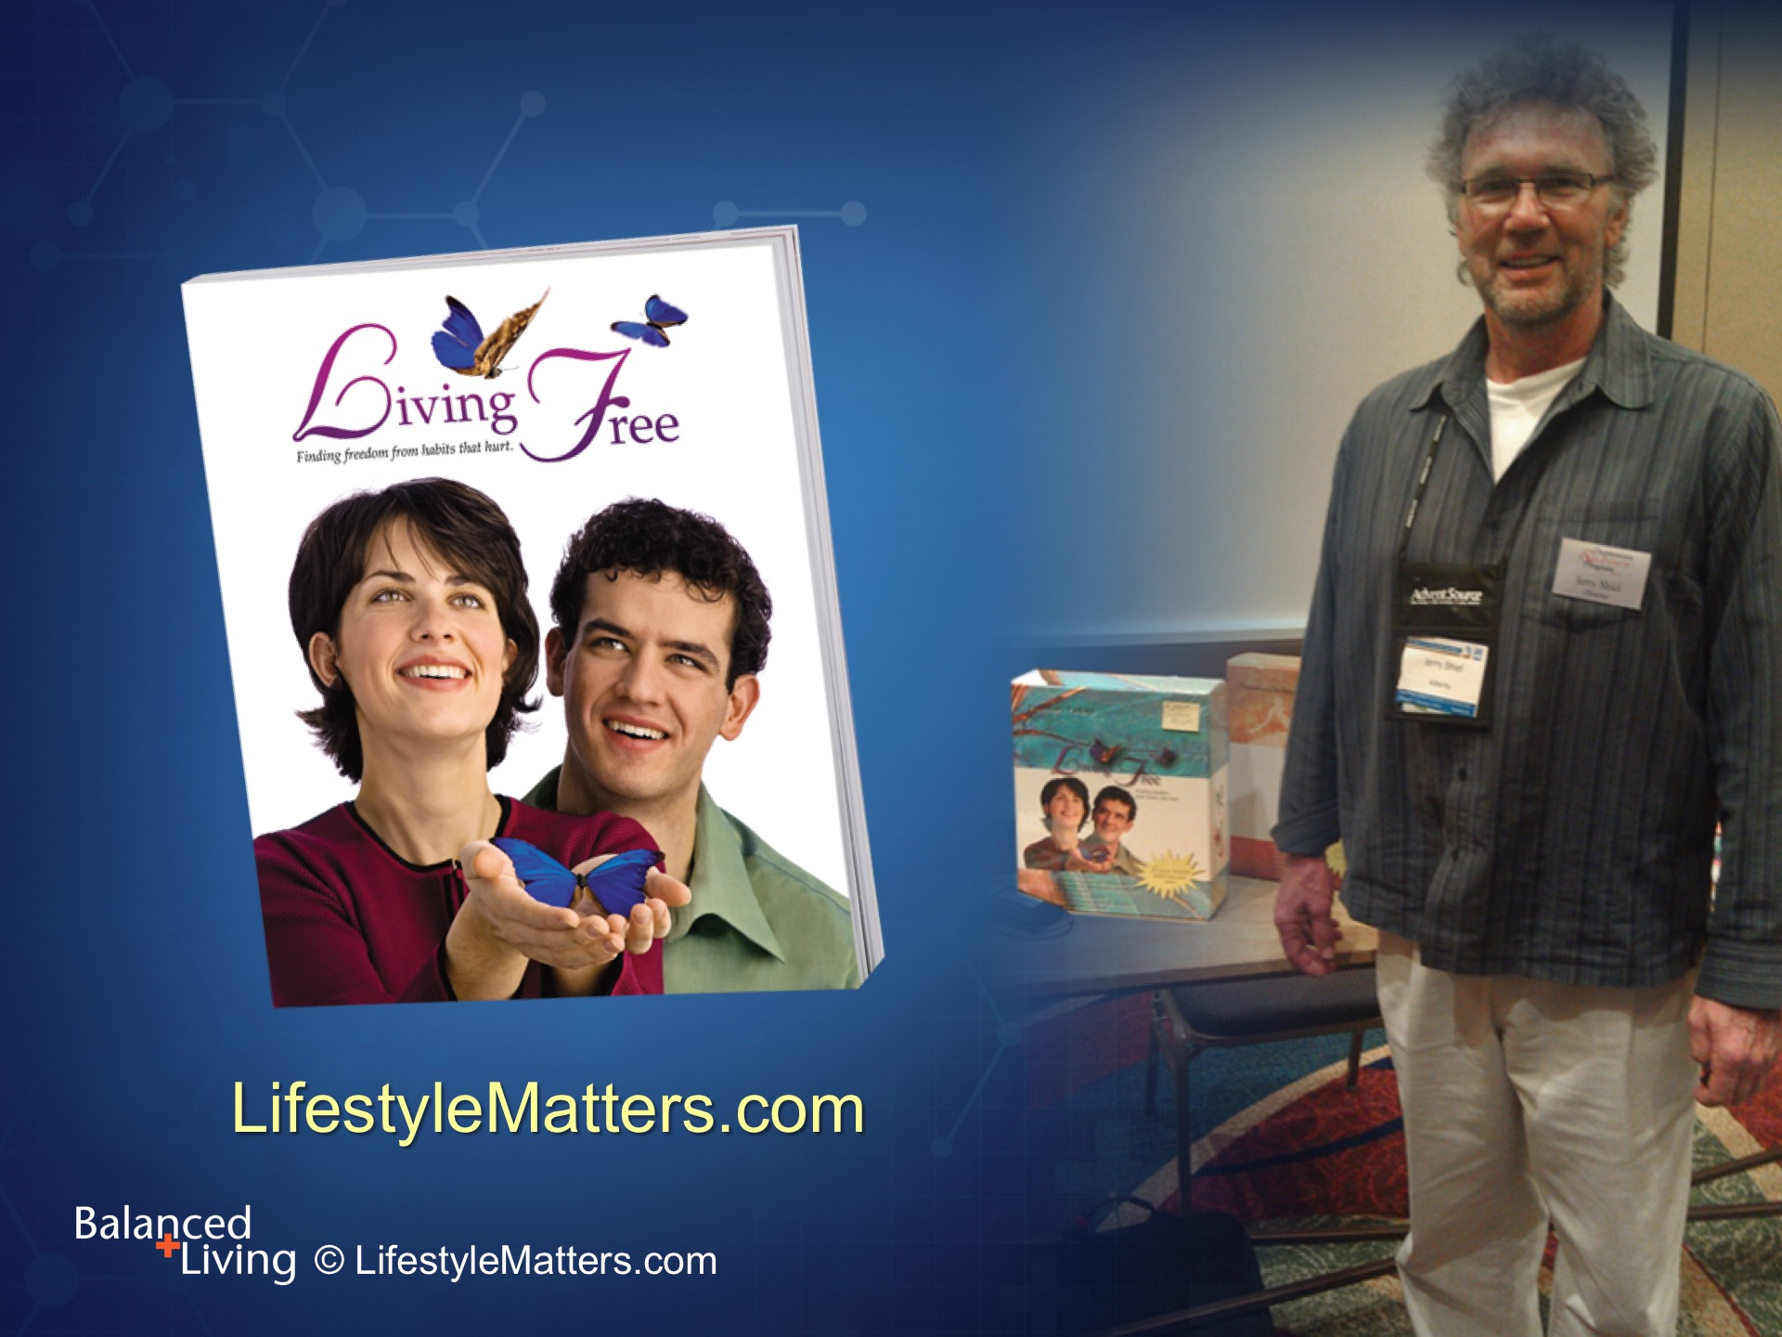
Notes:
Jerry had a lifetime of addictions. In his own words, “I was addicted to everything.”
By going through the Living Free DVD and book and committing his life to Christ and a new way of living, he became free from his addictions, including drugs, alcohol, and pornography.

Slide 18
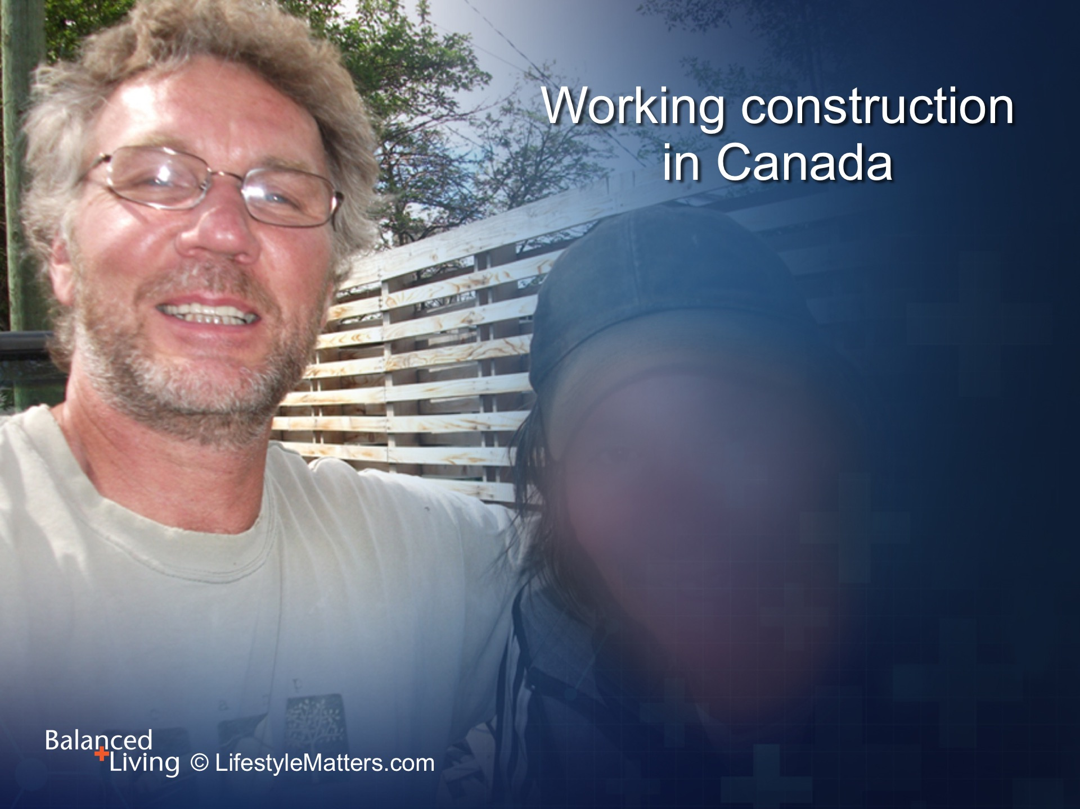
Notes:
As Jerry grew in his new found freedom, fellow workers noticed the difference.
Jerry began holding Living Free seminars of his own, and that is where he met Roger.
Roger was a down-and-out, depressed retired Royal Air Force pilot who had spiraled into a serious drinking problem.

Slide 19
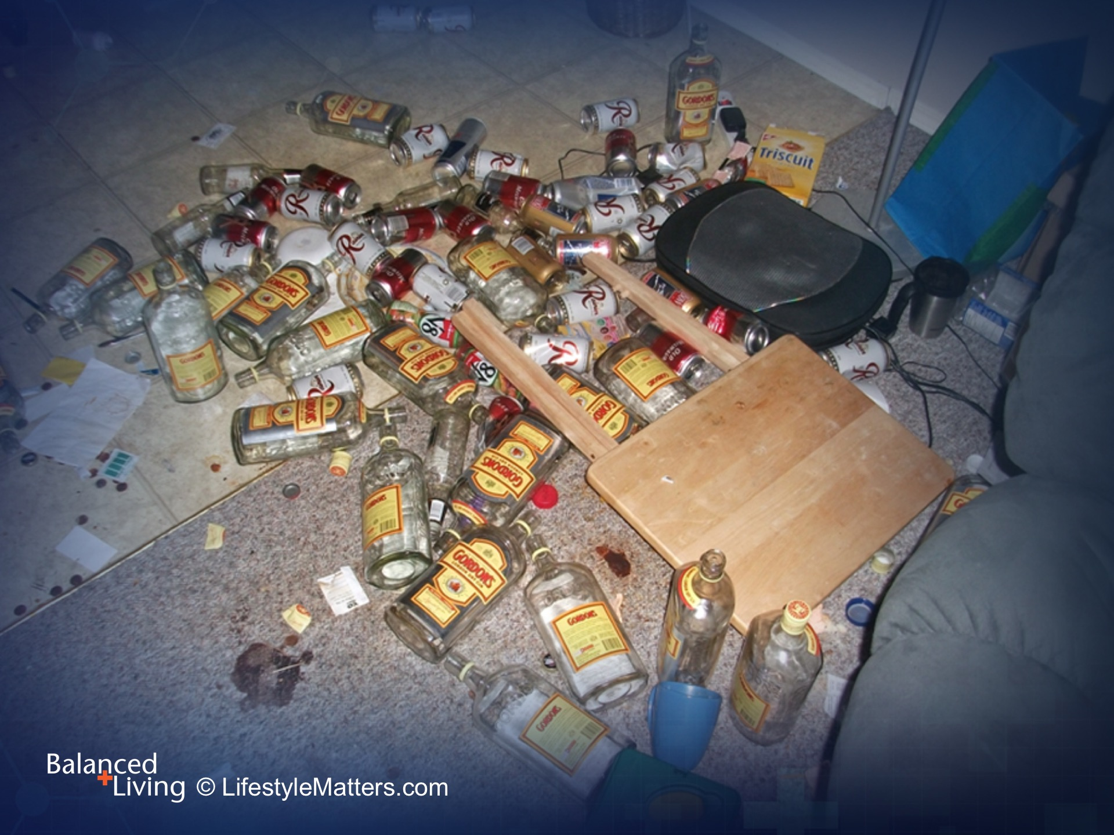
Notes:
You can see from these images how serious Roger’s problem had become.

Slide 20
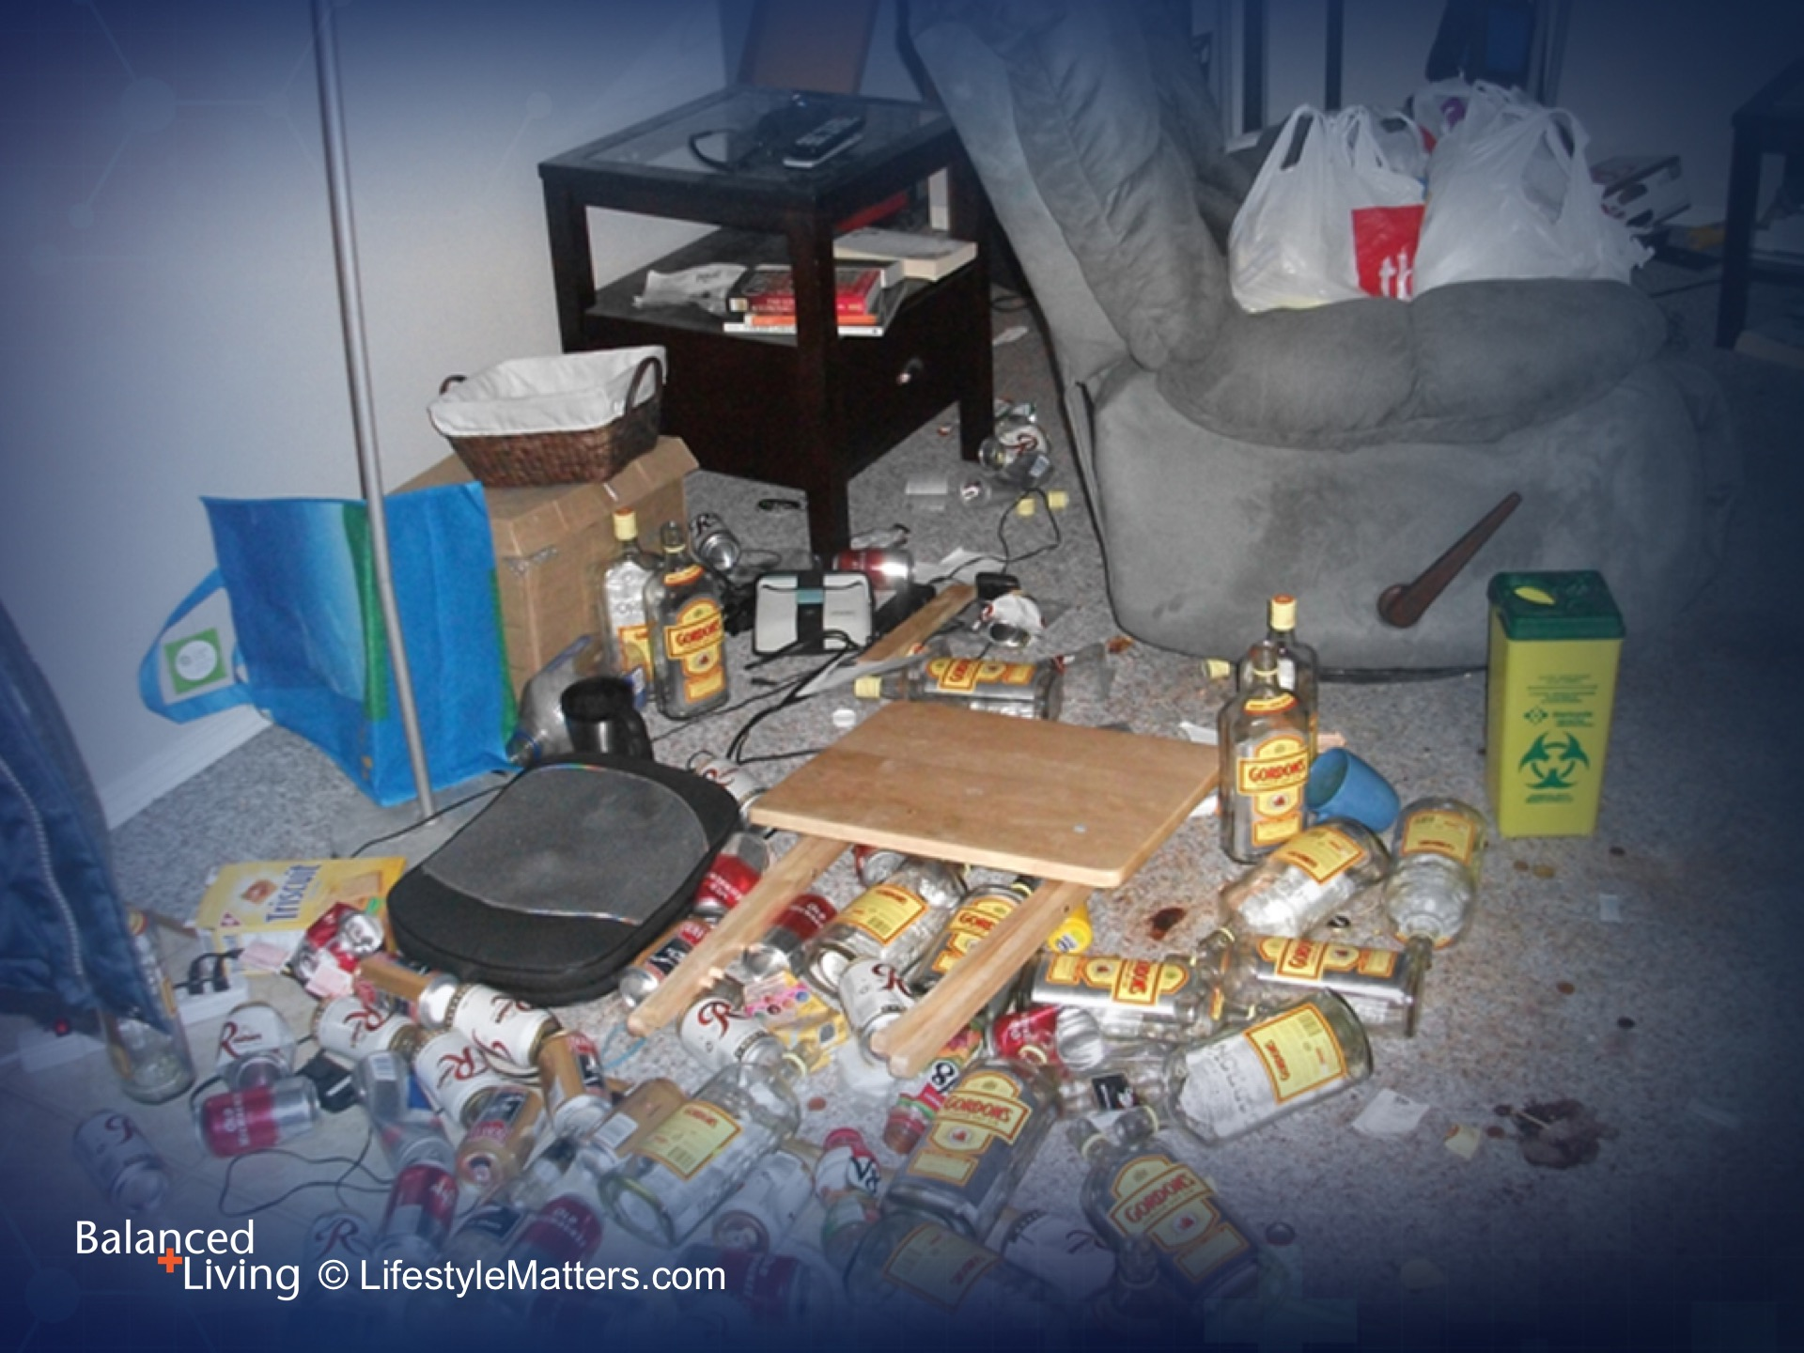
Notes:
Was there any way out of this pit of despair?
When Jerry met Roger, Roger was ready.
He had hit bottom and was willing to try anything to get his life back.

Slide 21
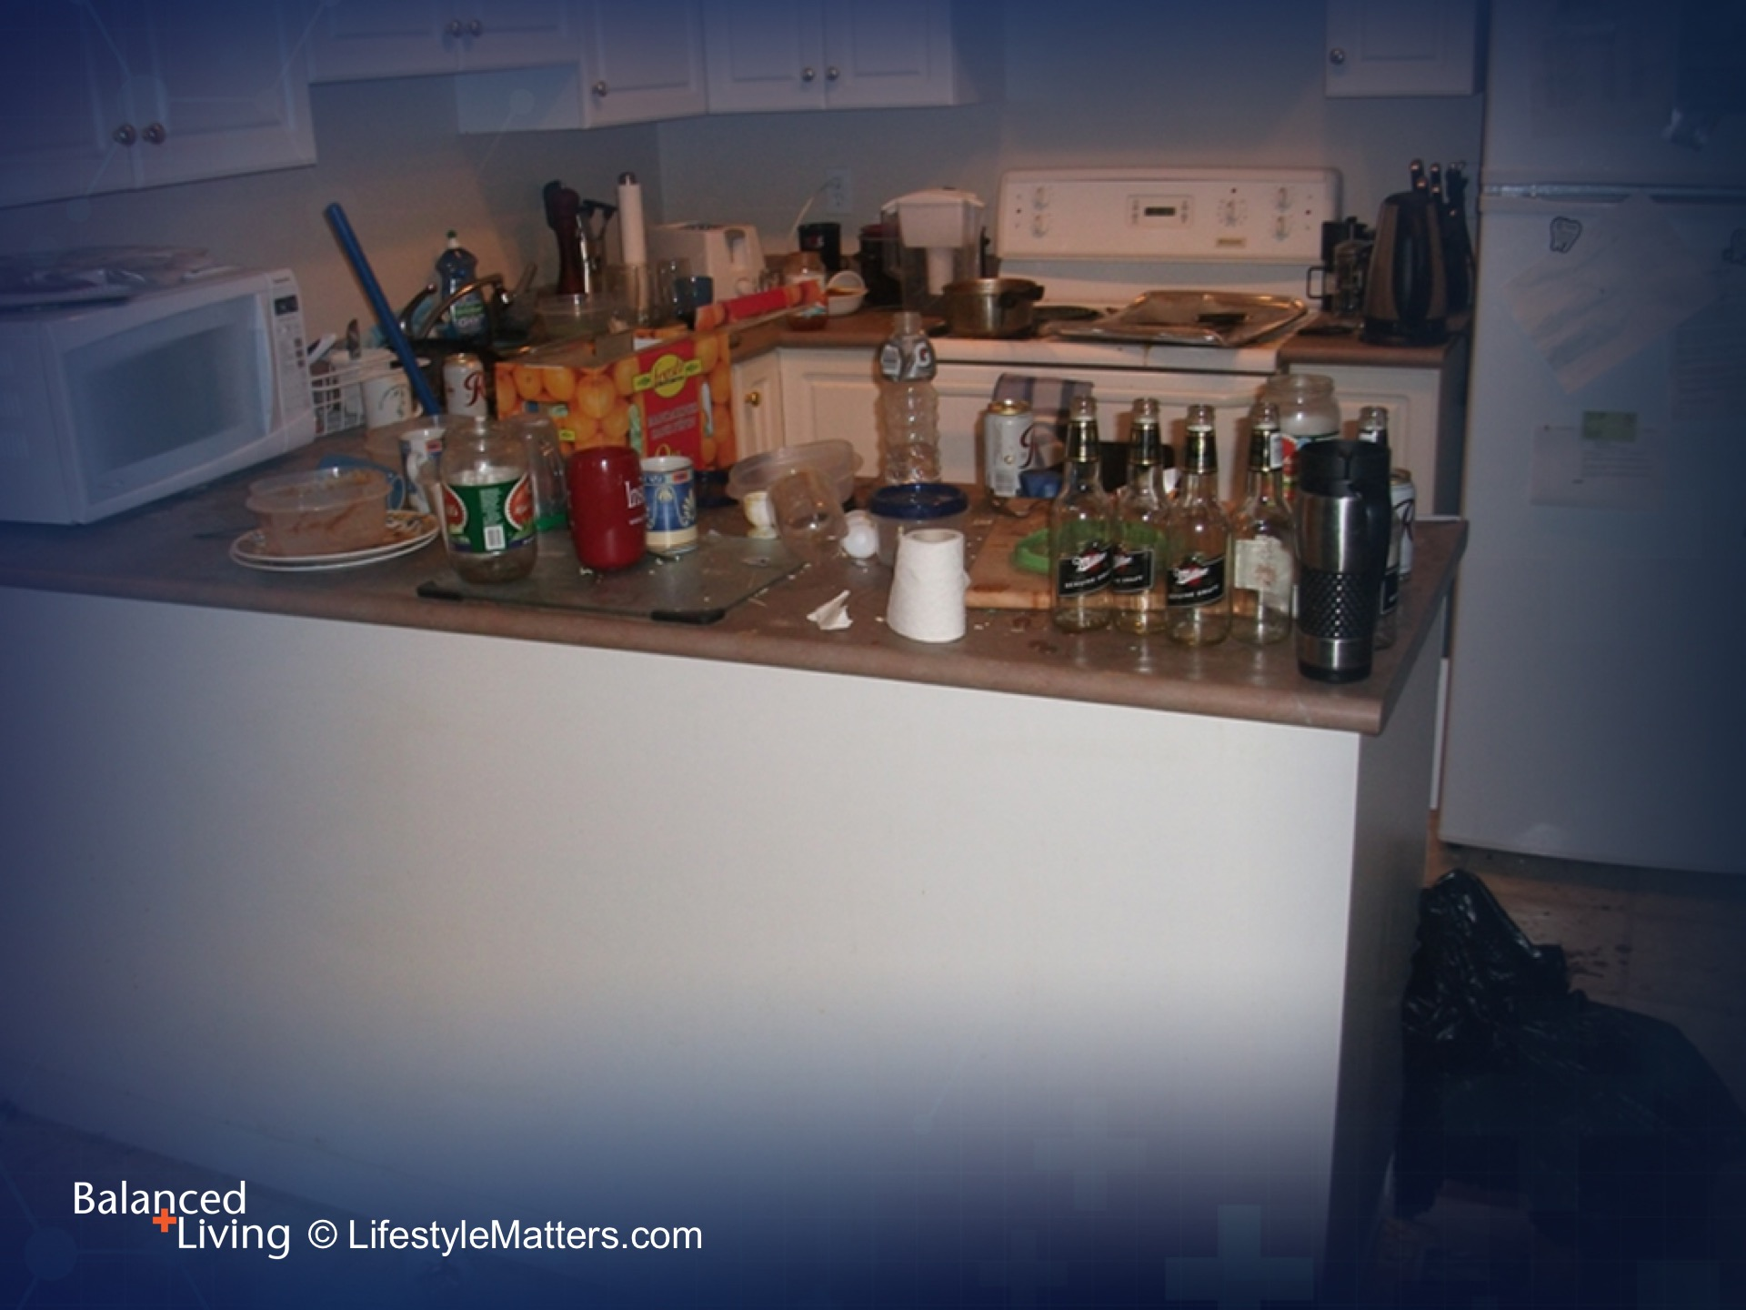
Notes:
Jerry told Roger about the freedom keys for living a new life: creating an internal and external environment; creating a lifestyle; creating connections with God and others; and learning better ways to handle stress.
Was he willing to commit? Yes! Let’s go!

Slide 22
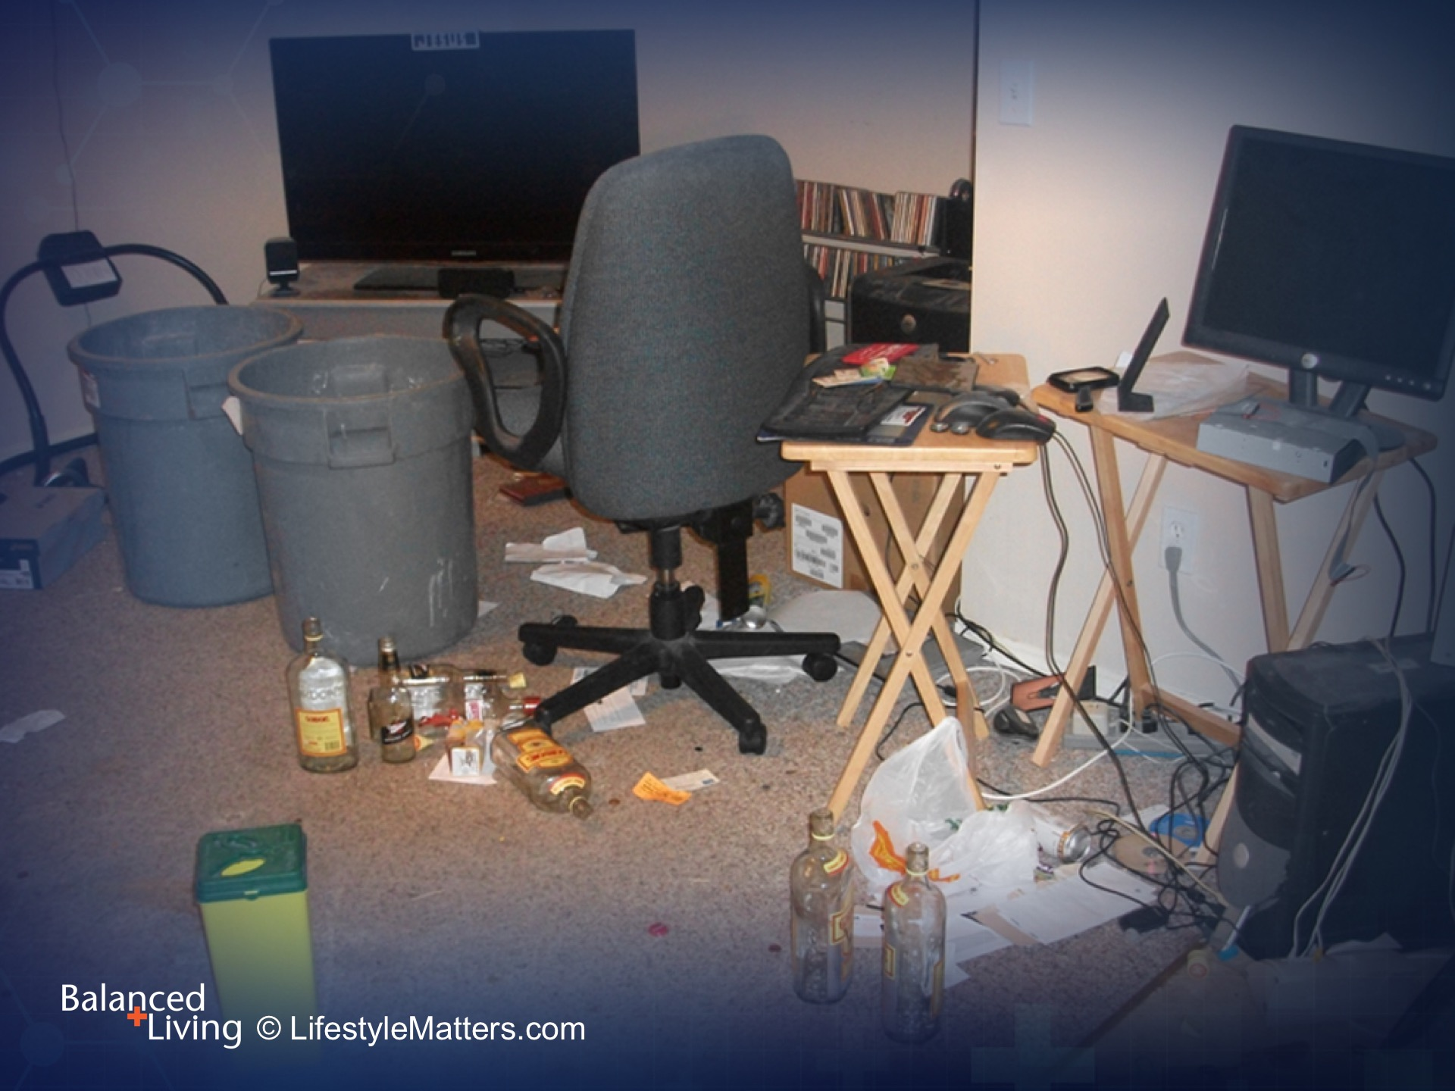
Notes:
With support and help from Jerry, Roger cleaned up his house, his thinking, his habits, and his life.

Slide 23
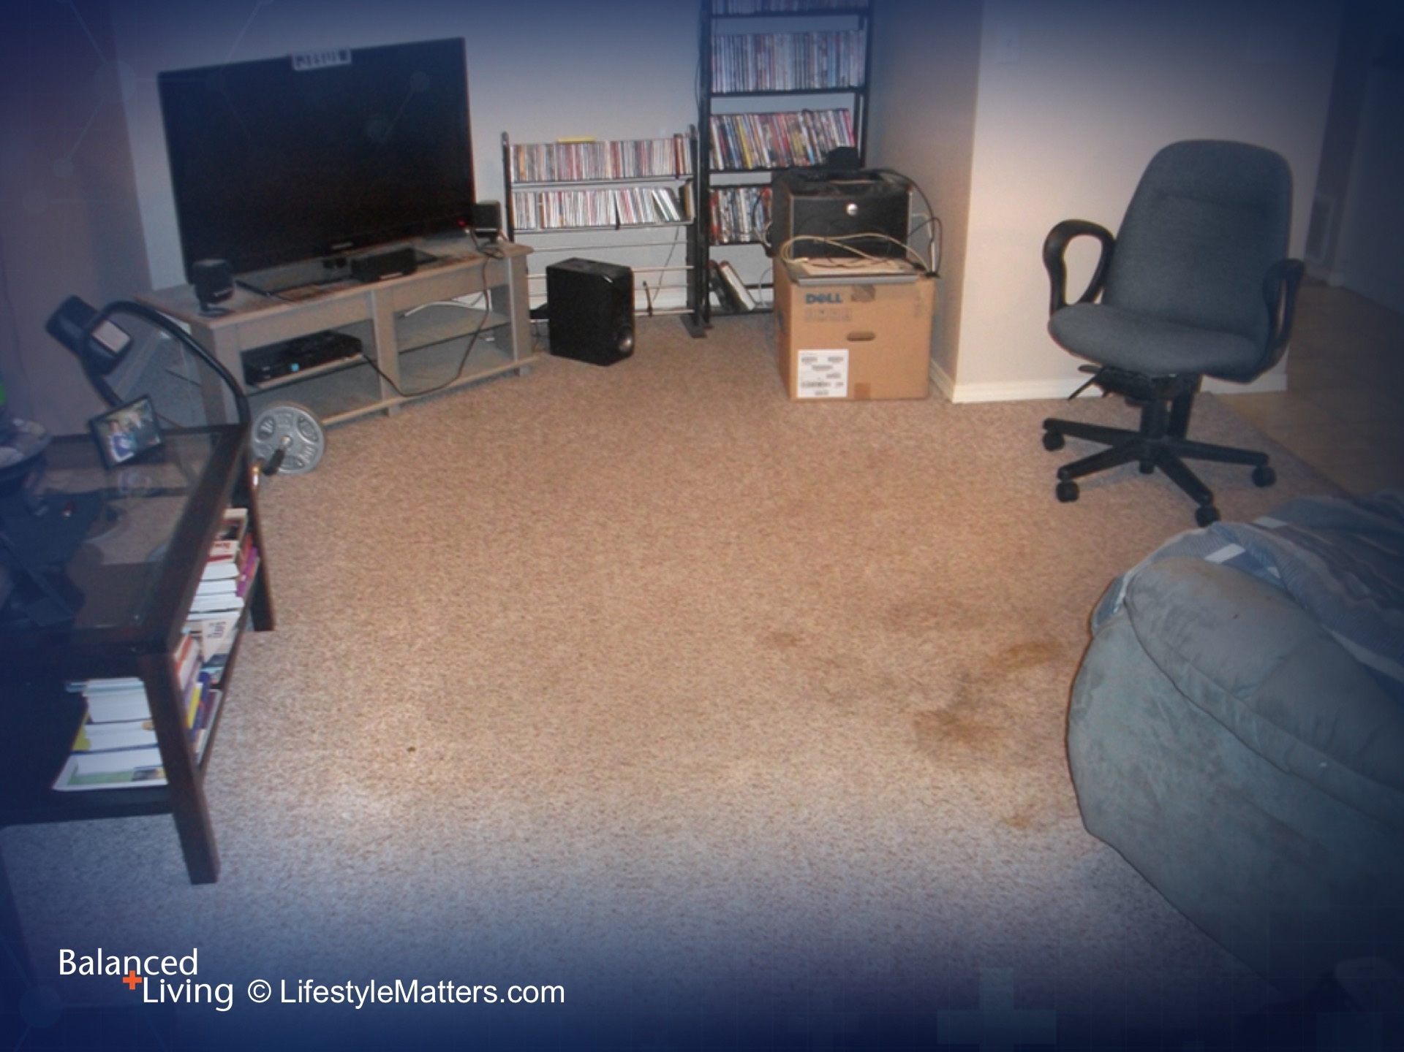
Notes:
It wasn’t easy at first, but nothing about being addicted is easy. This was new. This was better.
Over time Roger regained his confidence and self-respect.

Slide 24
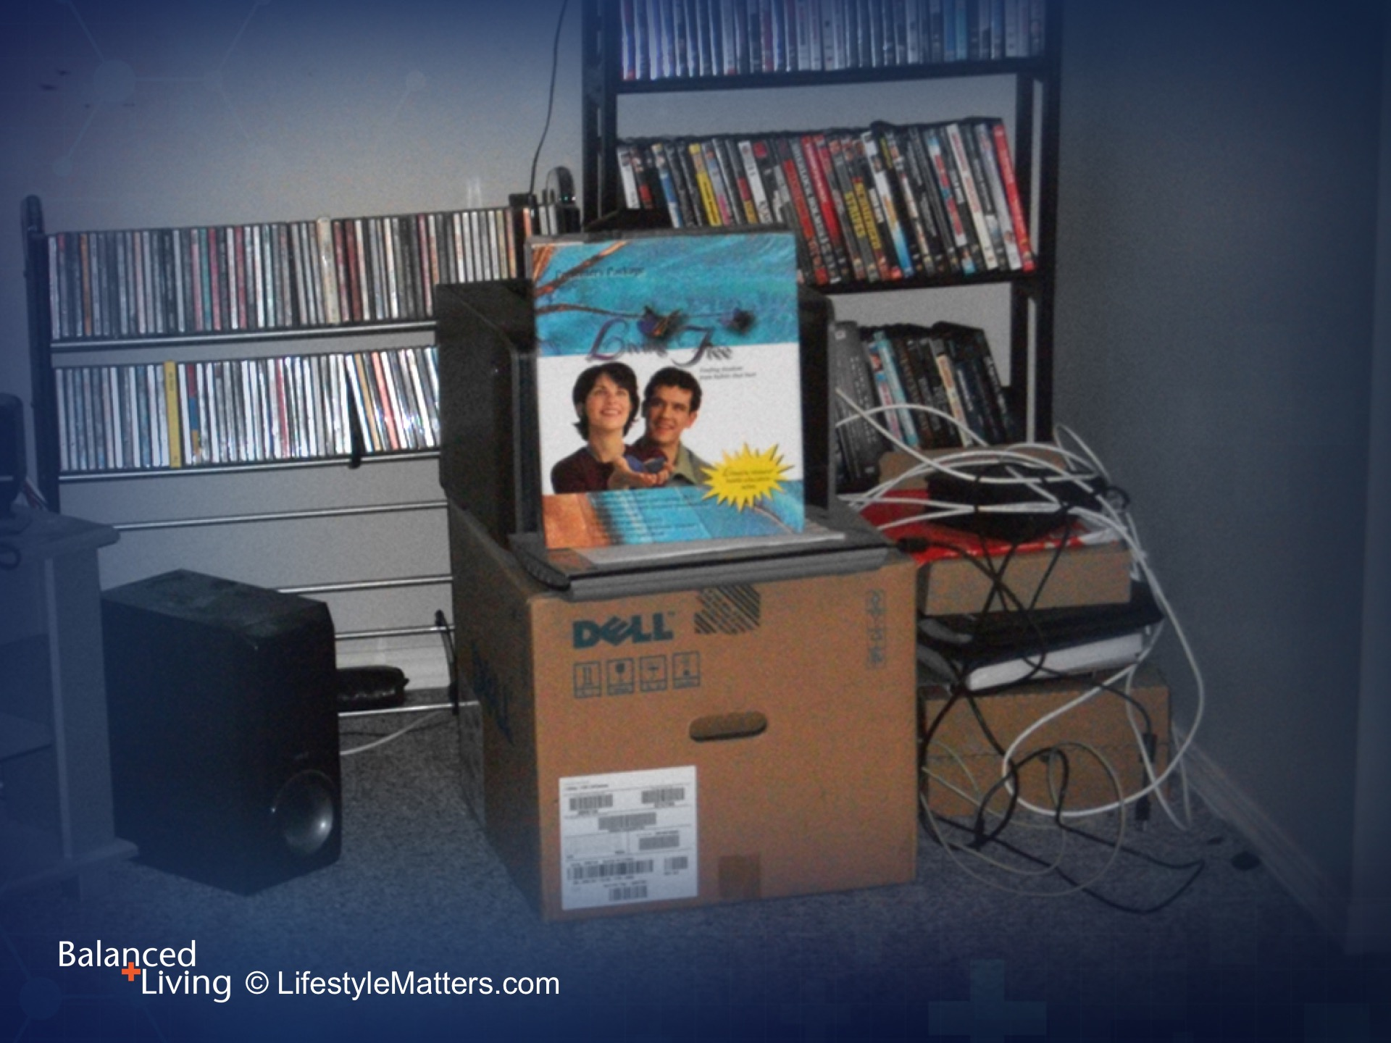
Notes:
He learned about healthy eating, exercising, and trust in God.
He experienced God’s forgiveness and was able to make things right with others and get out from under the shame and guilt that controlled his life for so long.

Slide 25
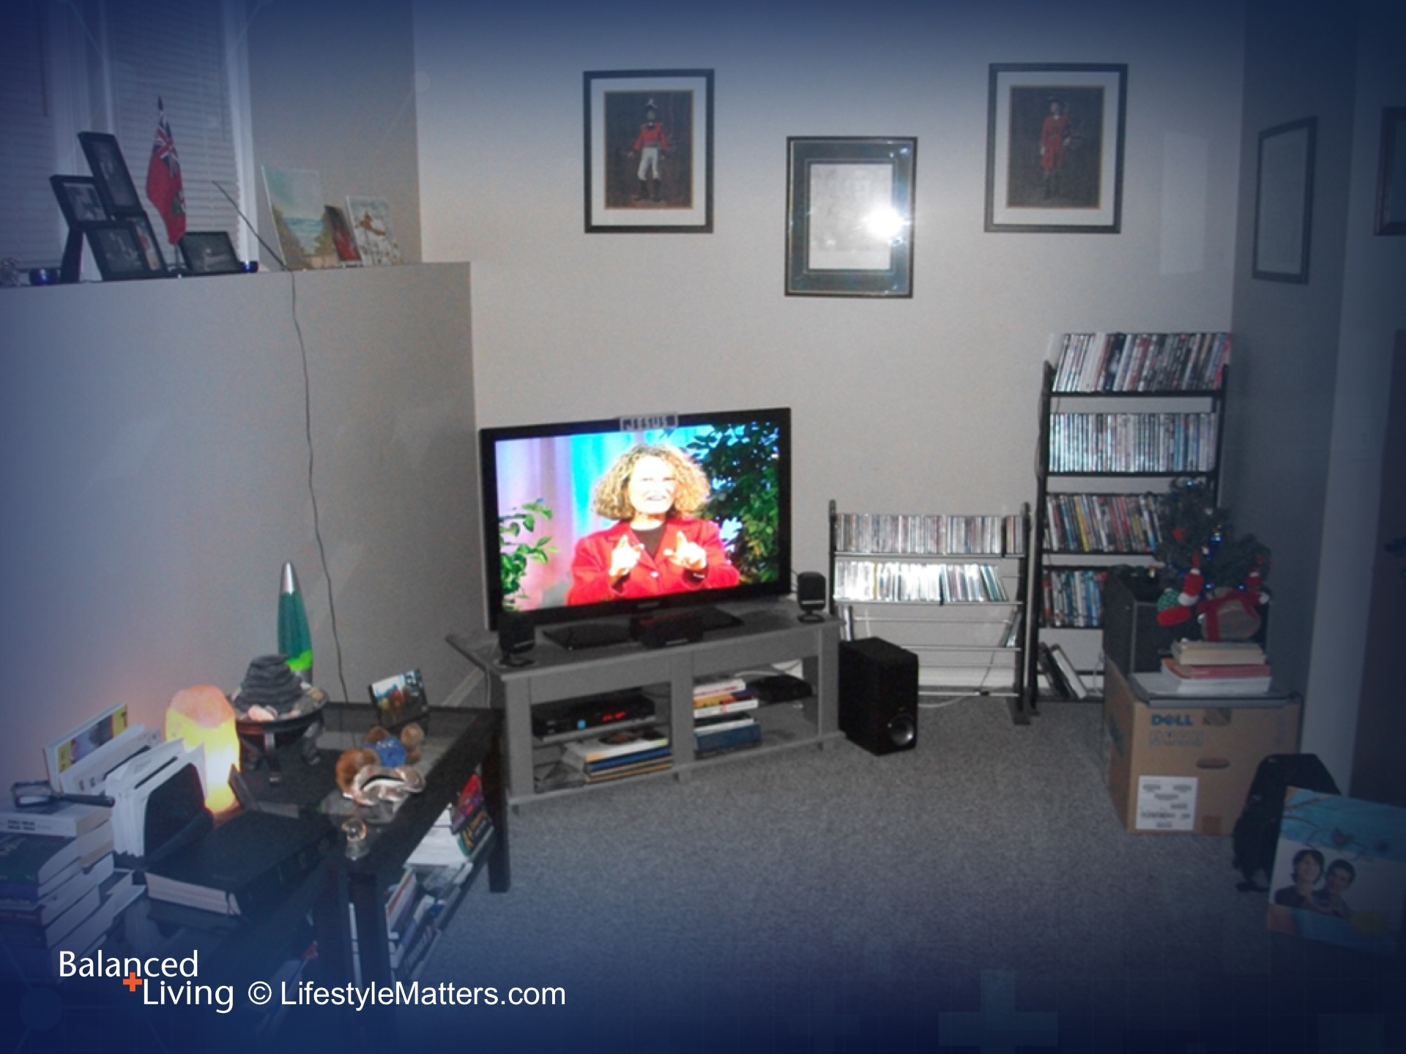
Notes:
Roger didn’t just get the victory over drinking. He gave all his habits to God, including media.
This was a “comprehensive” makeover, involving every area of his mind, body, and spirit.
(Note: This is a DVD image of Evelyn Kissinger, RD, talking about high fiber foods and the brain from Living Free.)

Slide 26
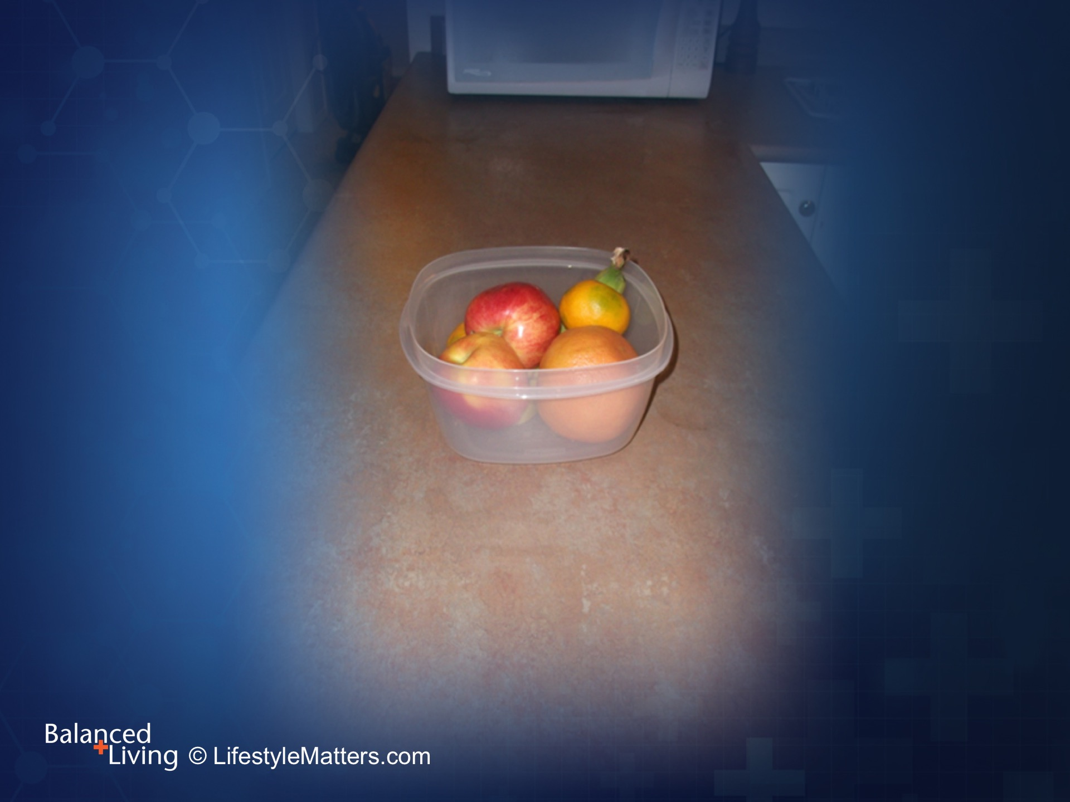
Notes:
Roger began to replace addiction “triggers” with positive reminders of his new decisions.
He was “creating and environment” for success.

Slide 27
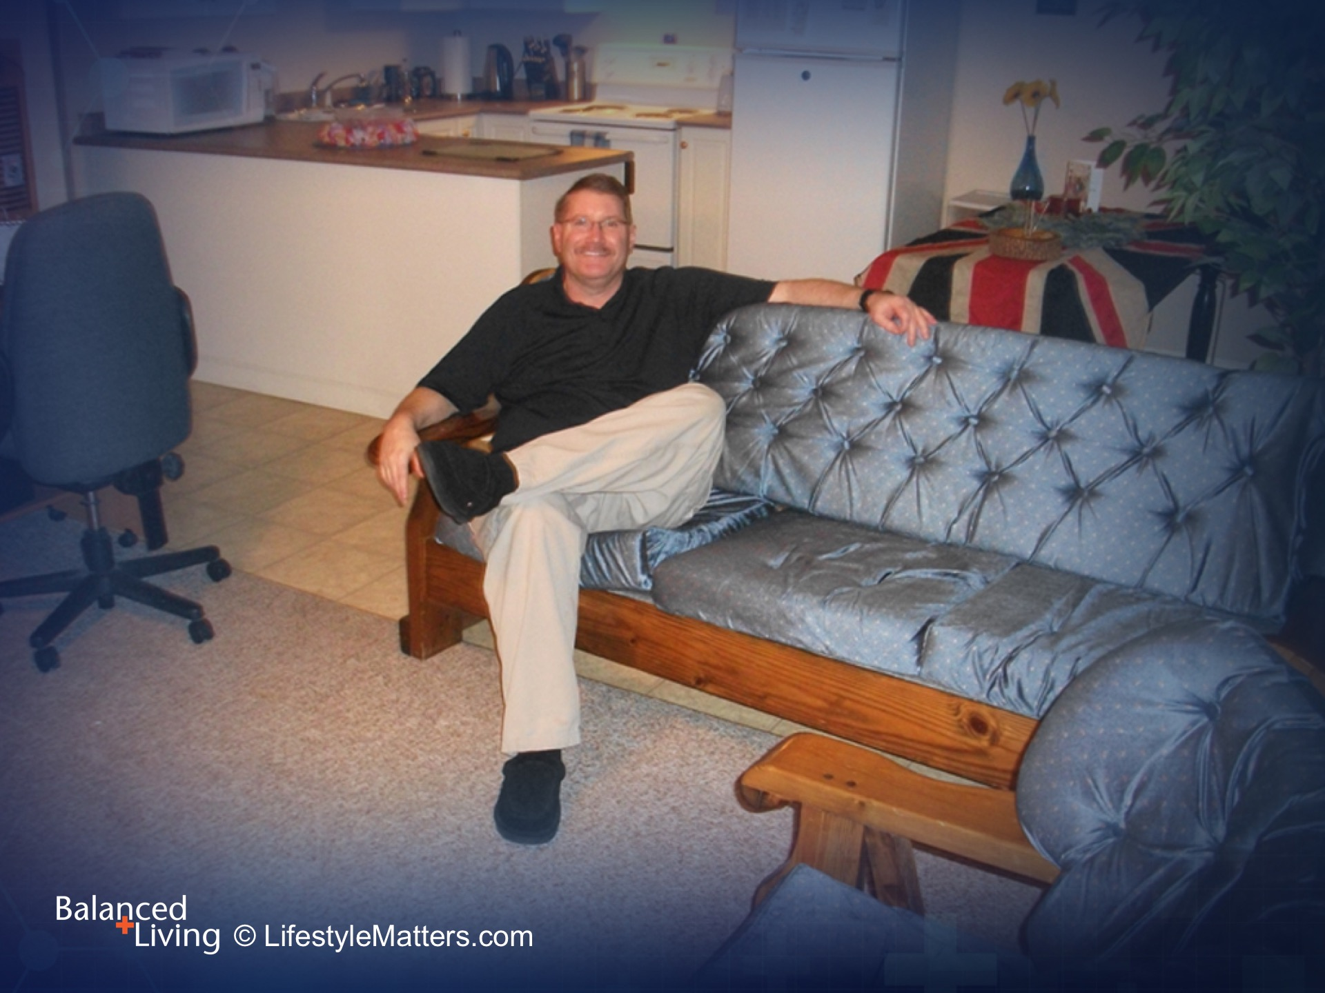
Notes:
Roger was becoming a new creation in Christ.

Slide 28
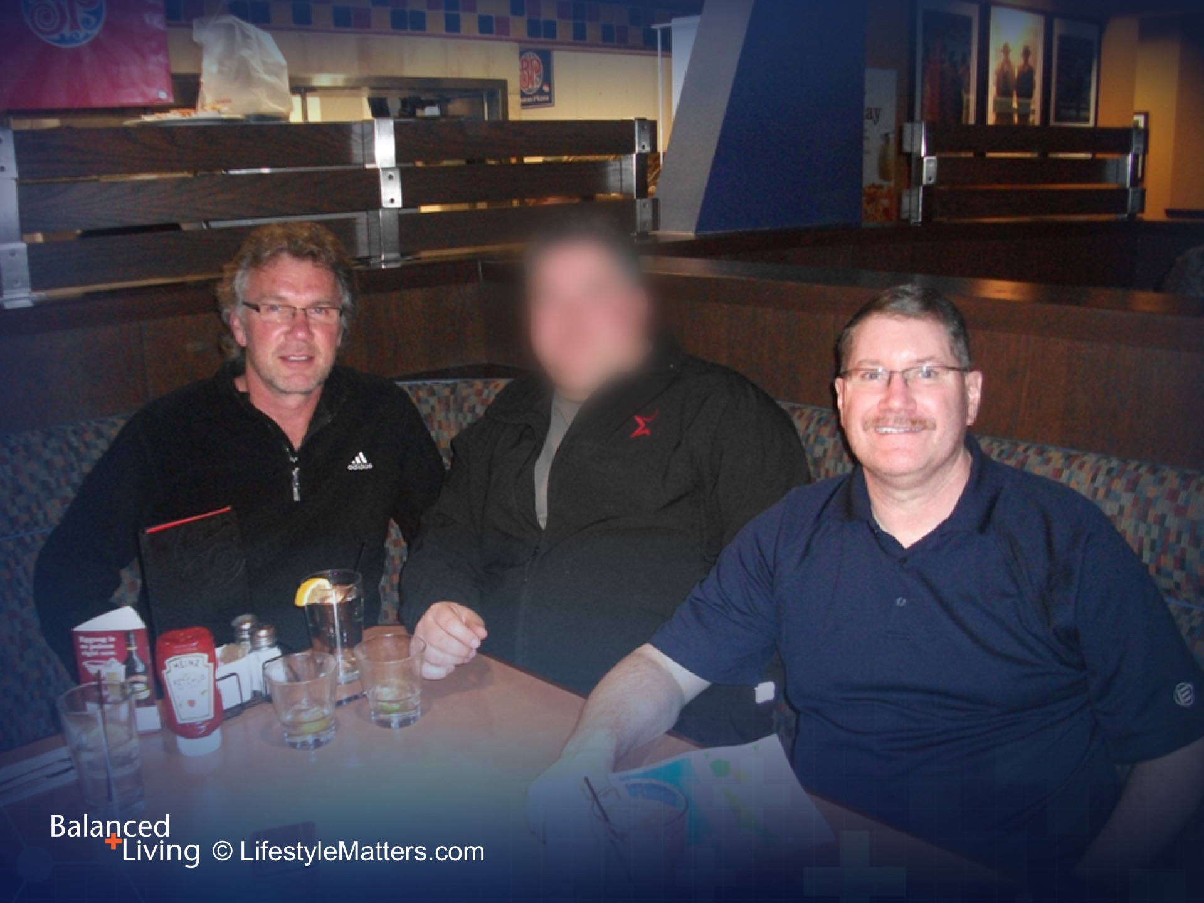
Notes:
He was learning that God’s power, promises, and plan were making him strong in mind, body, and spirit.
Applying God’s “freedom keys” made it easier to cope with stress and face life’s challenges.

Slide 29
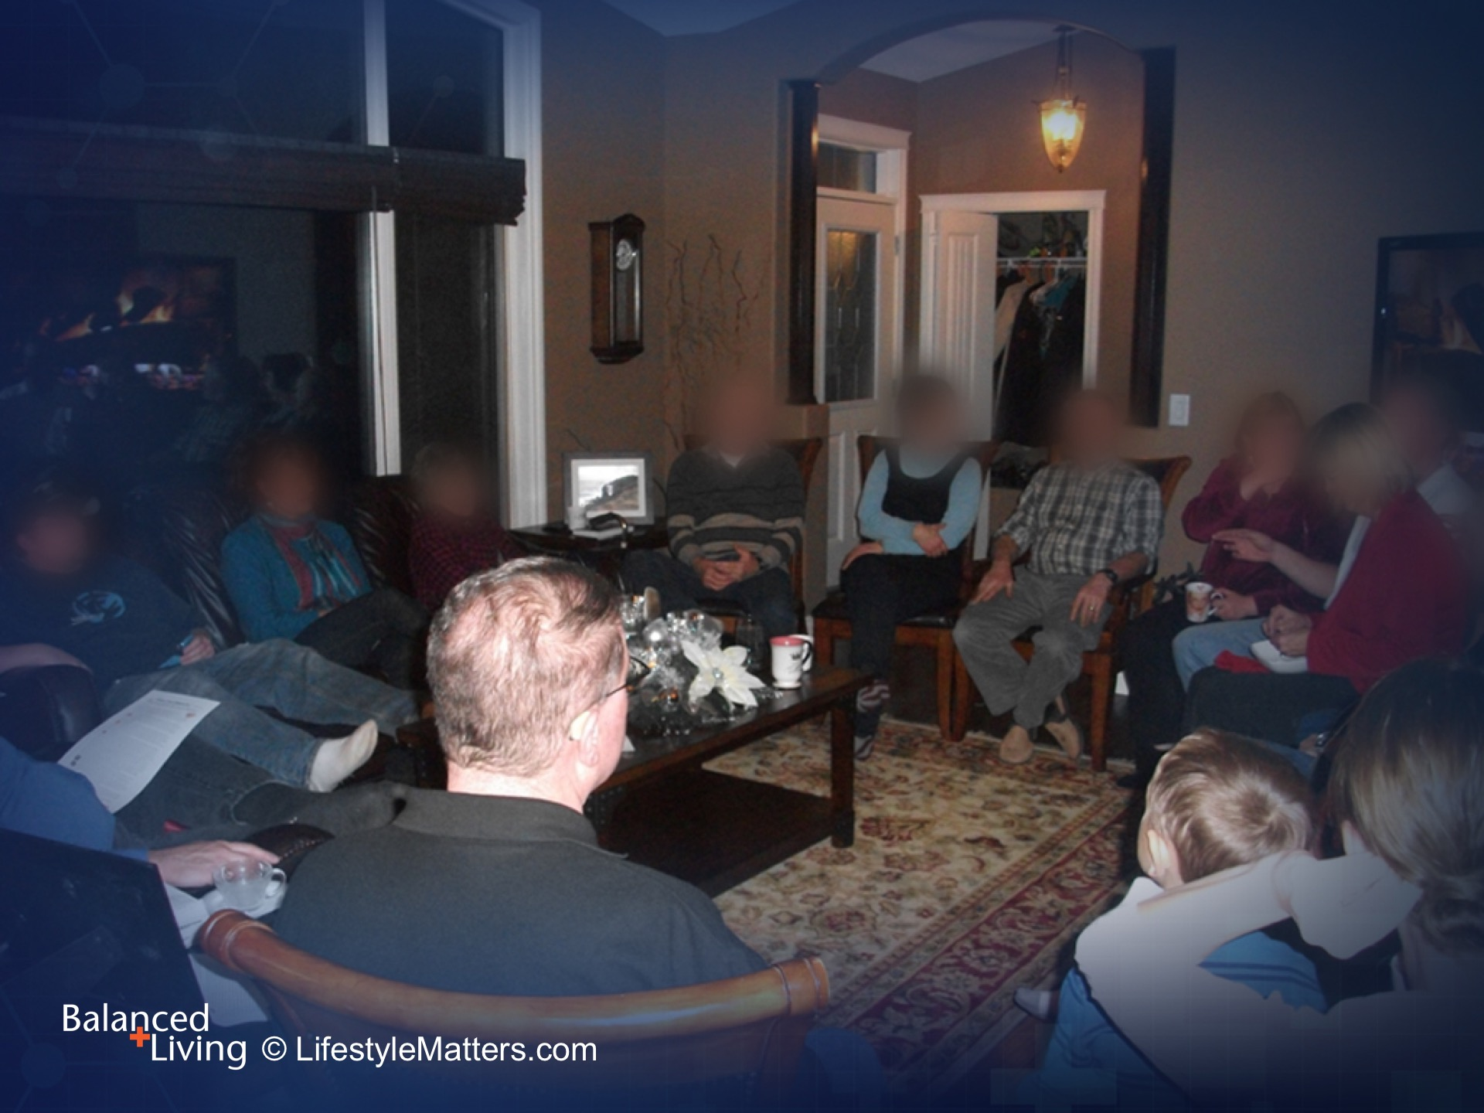
Notes:
He was now able to connect with others. He joined a Bible study group.

Slide 30
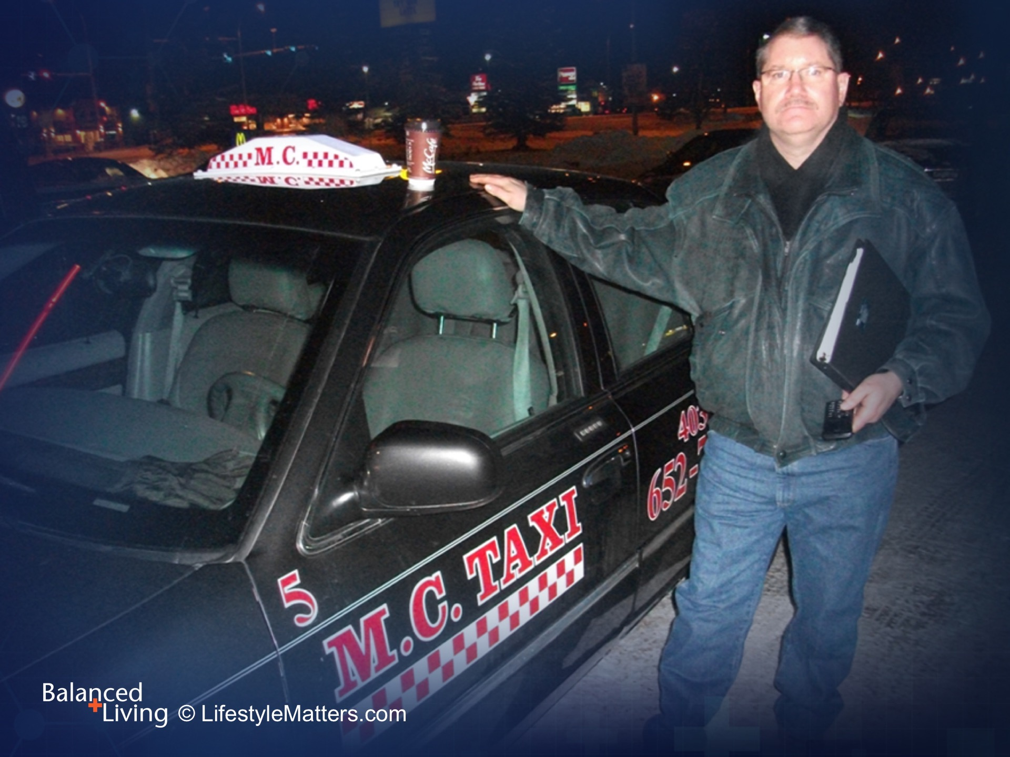
Notes:
Roger was able to work again. He was experiencing a new life. And so can you.

Slide 31
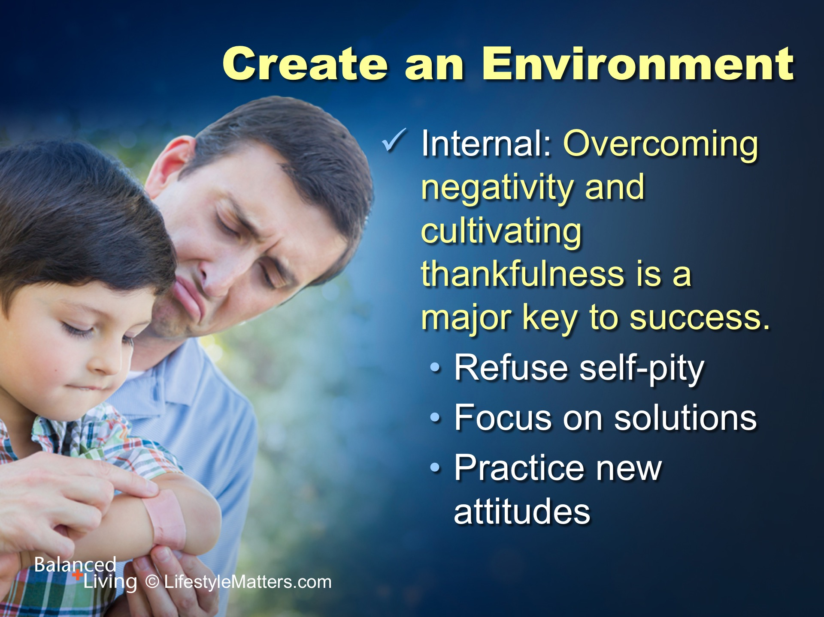
Notes:
Let’s take a few more minutes and review the “freedom keys” for breaking the chains of addictions and bad habits.
Read slide.

Slide 32
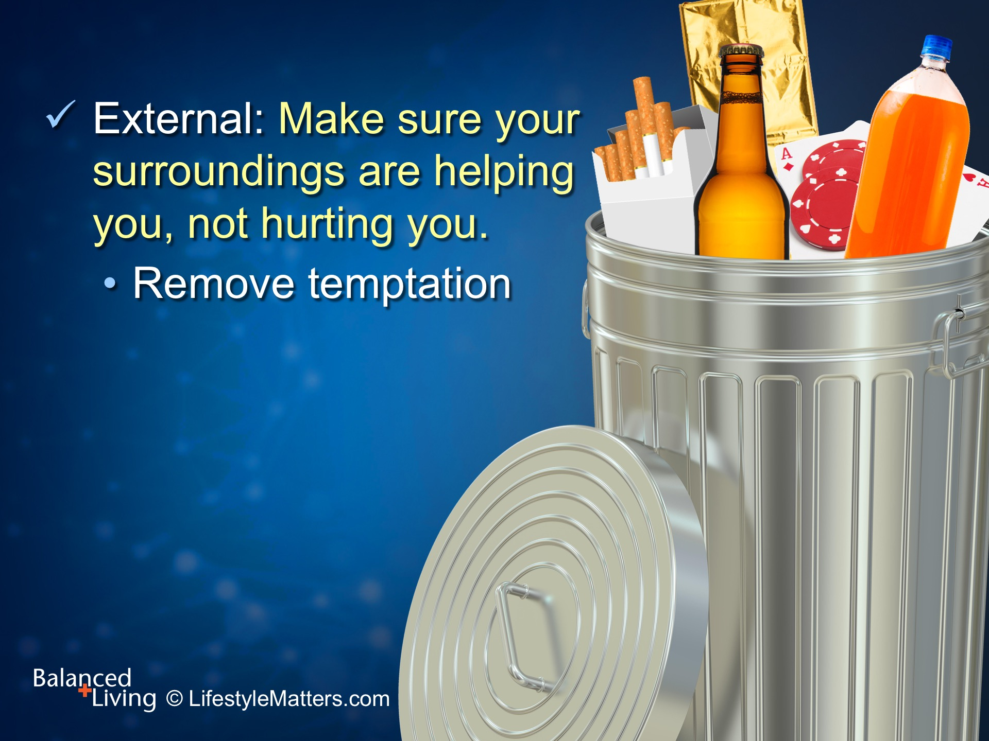
Notes:
Read slide.

Slide 33
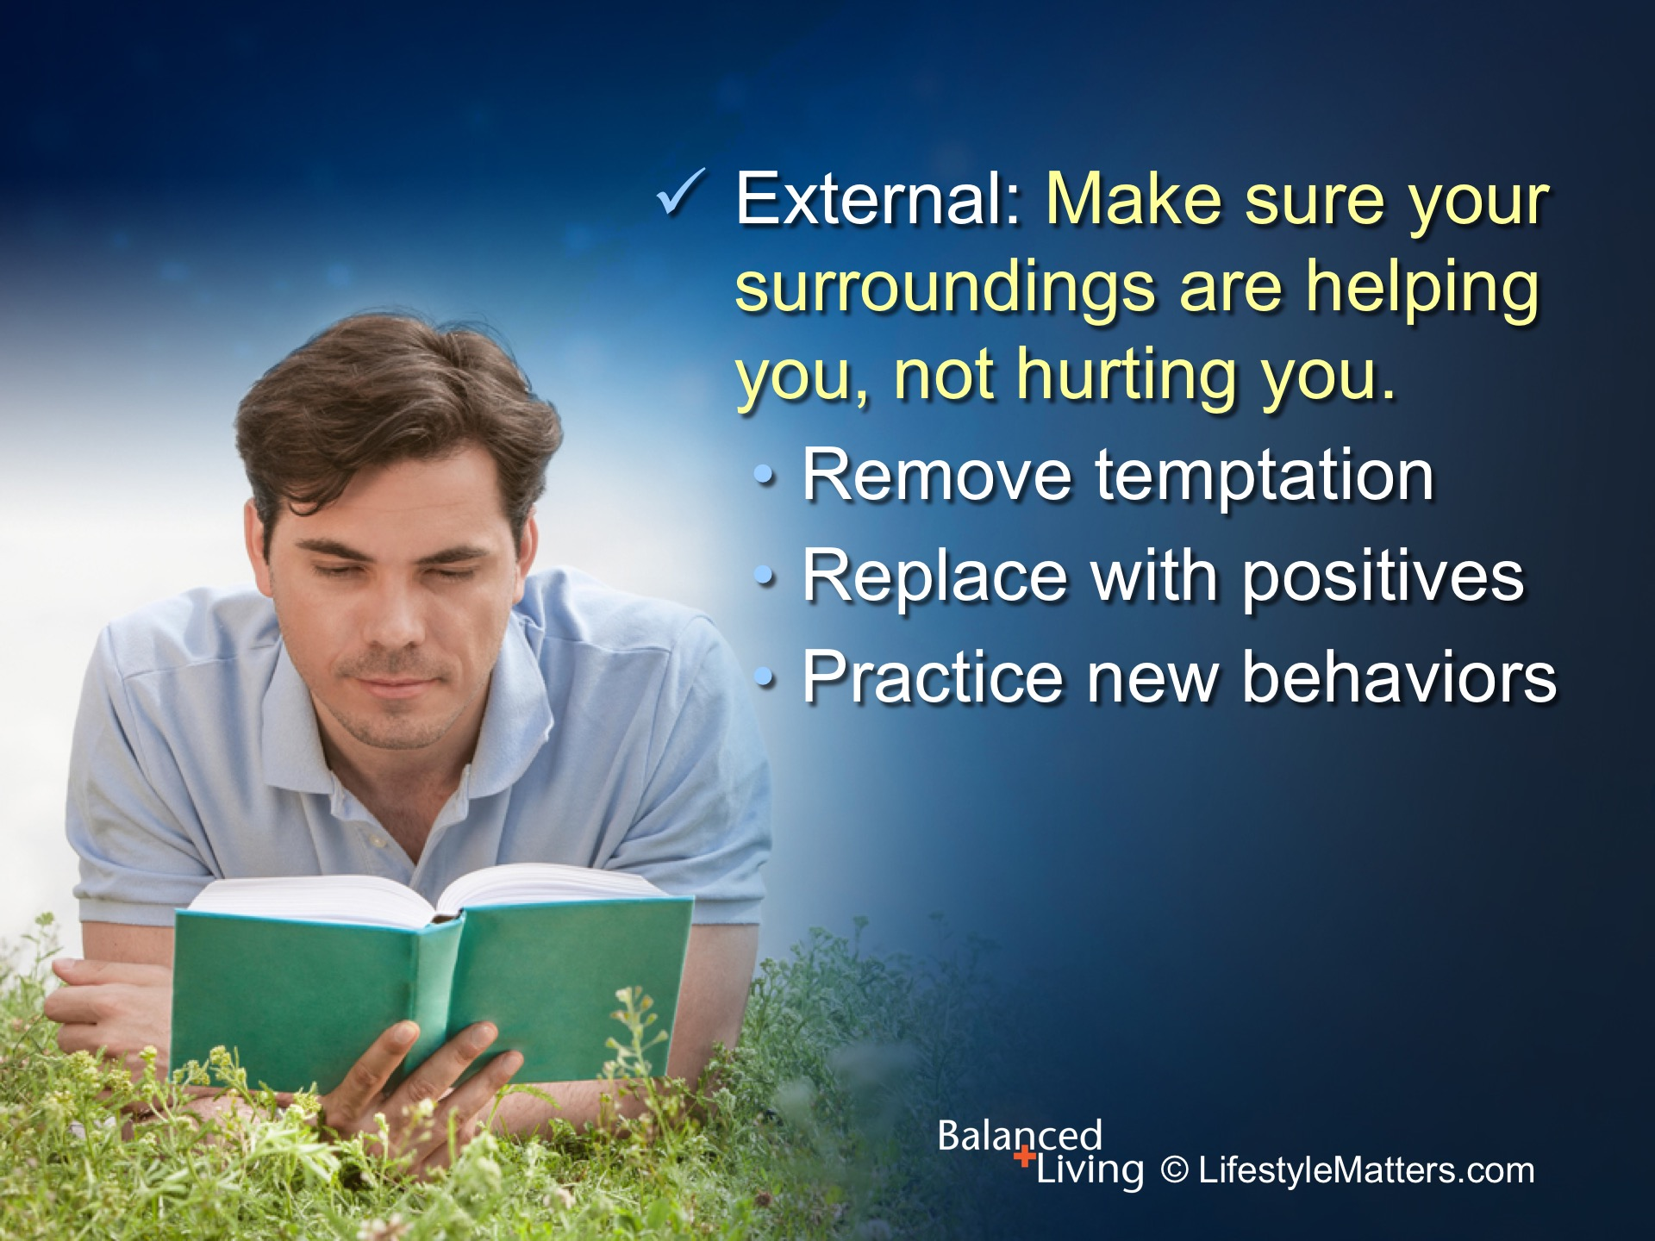
Notes:
Read slide.

Slide 34
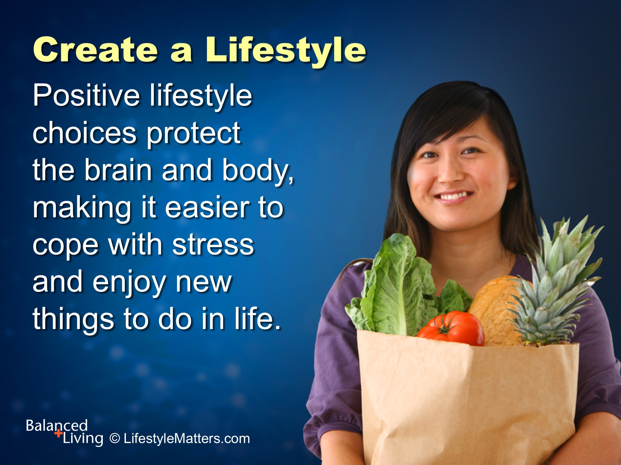
Notes:
Read slide.

Slide 35
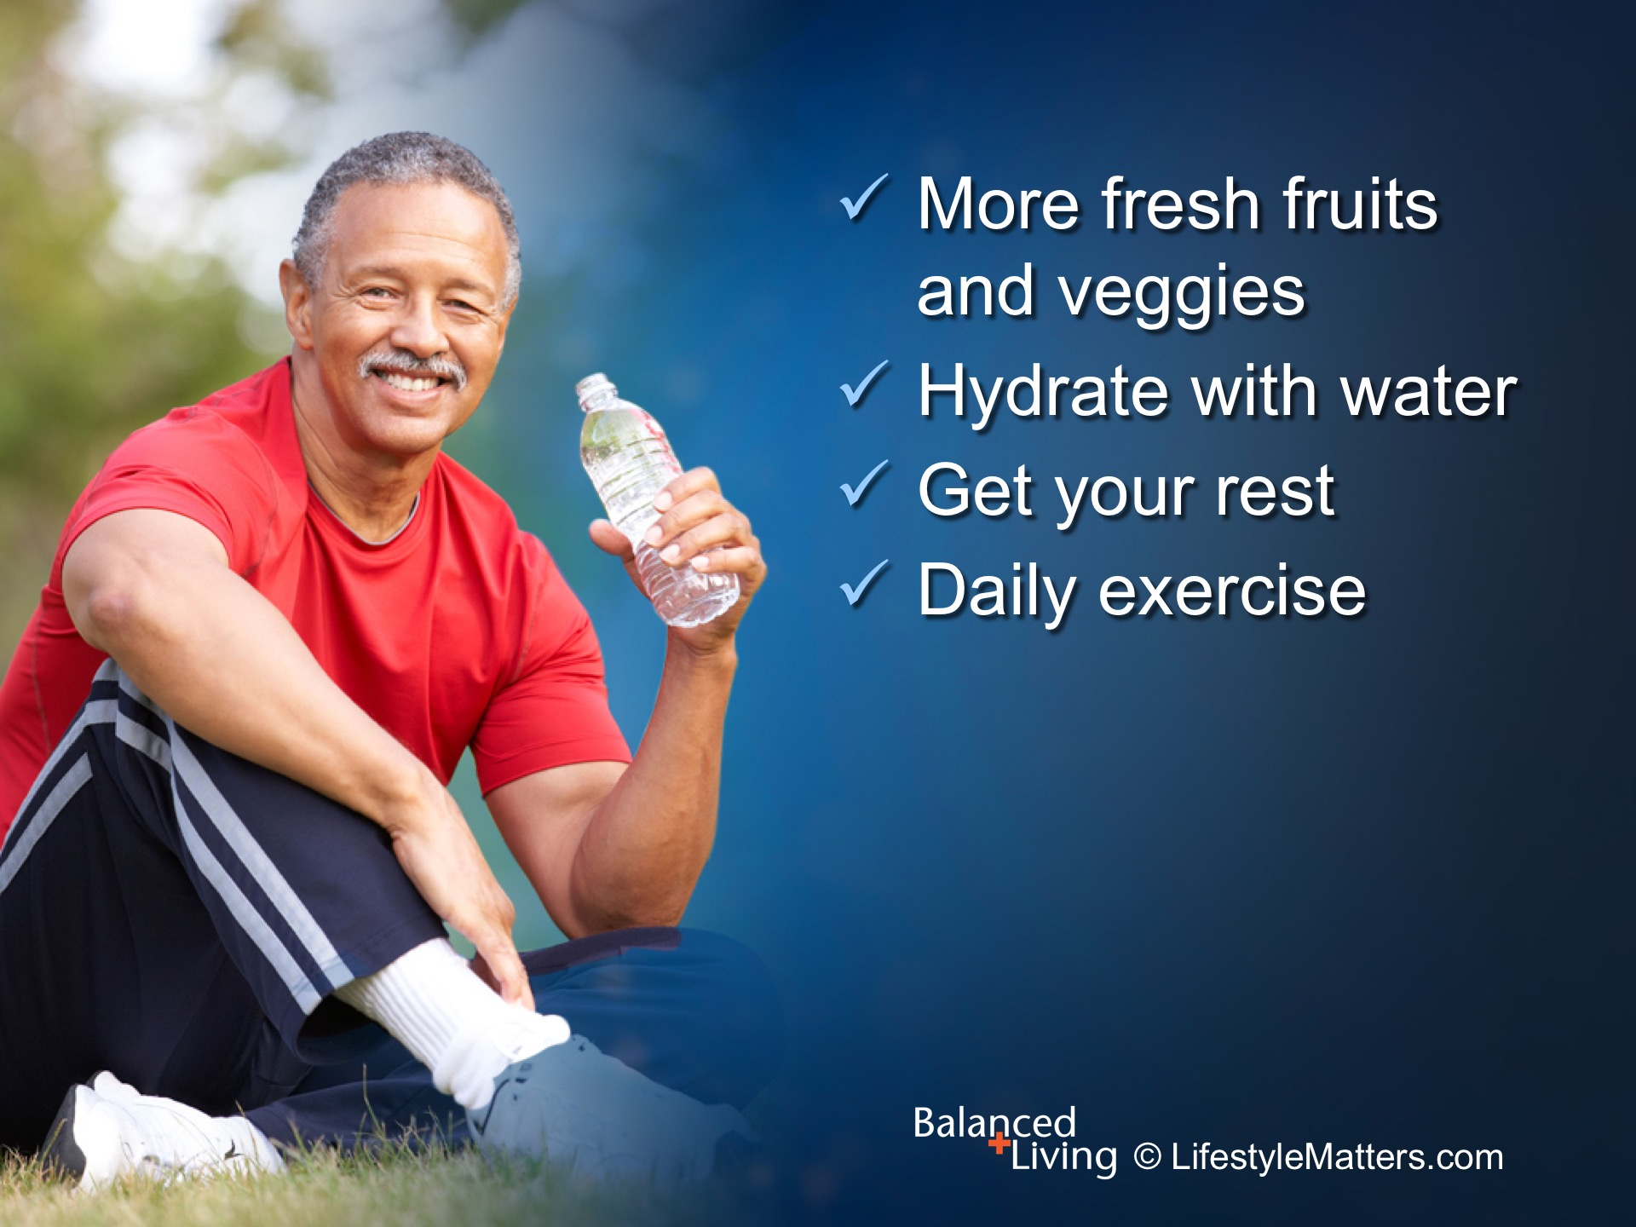
Notes:
Read slide.

Slide 36
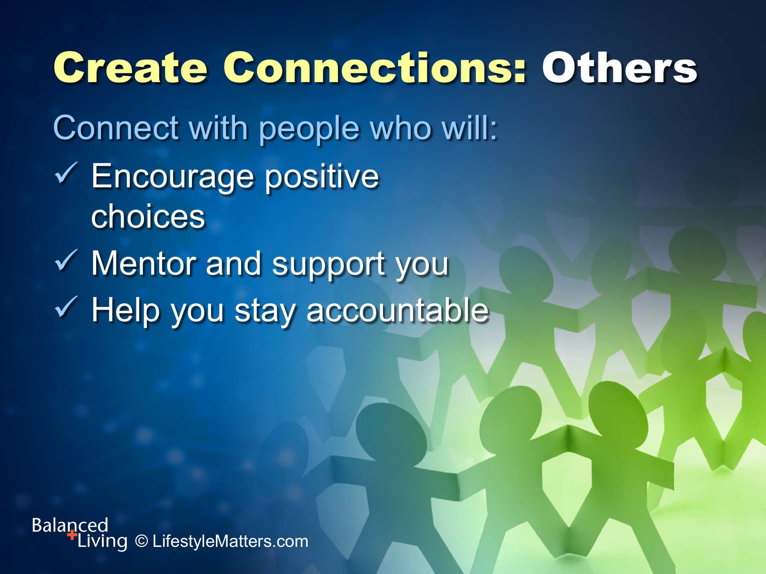
Notes:
Read slide.
Personal growth takes place as we interact with others.
Connecting with church and community resources makes our world bigger than our circumstances.
It creates opportunities for giving, receiving, and learning communication skills, and building meaningful experiences.
What are some positive ways to connect? (wait for response)

Slide 37
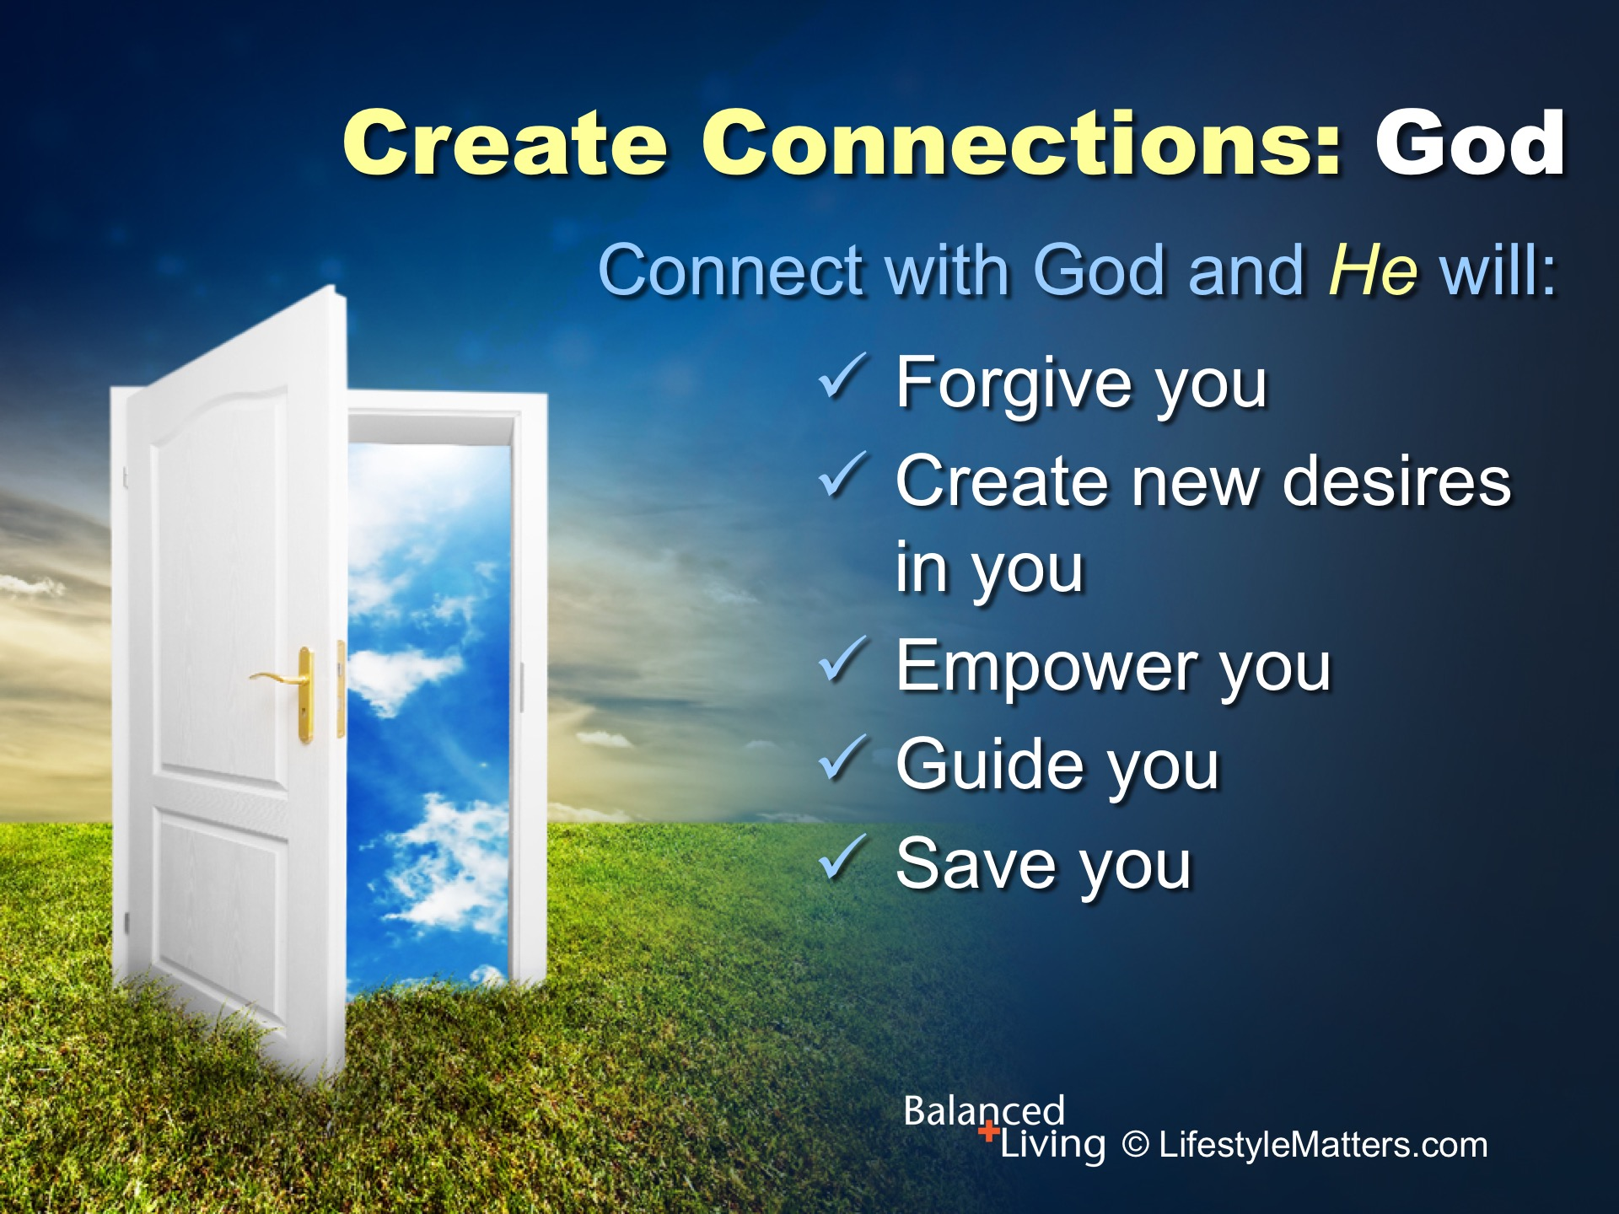
Notes:
In the same way that connecting with others creates a vital, two-way relationship, so does connecting with God.
Read slide.
Connecting with God through His living Word, the Bible, will help you discover the depth of His love for you, and help you discover your true value and His purpose and plan for your life.

Slide 38
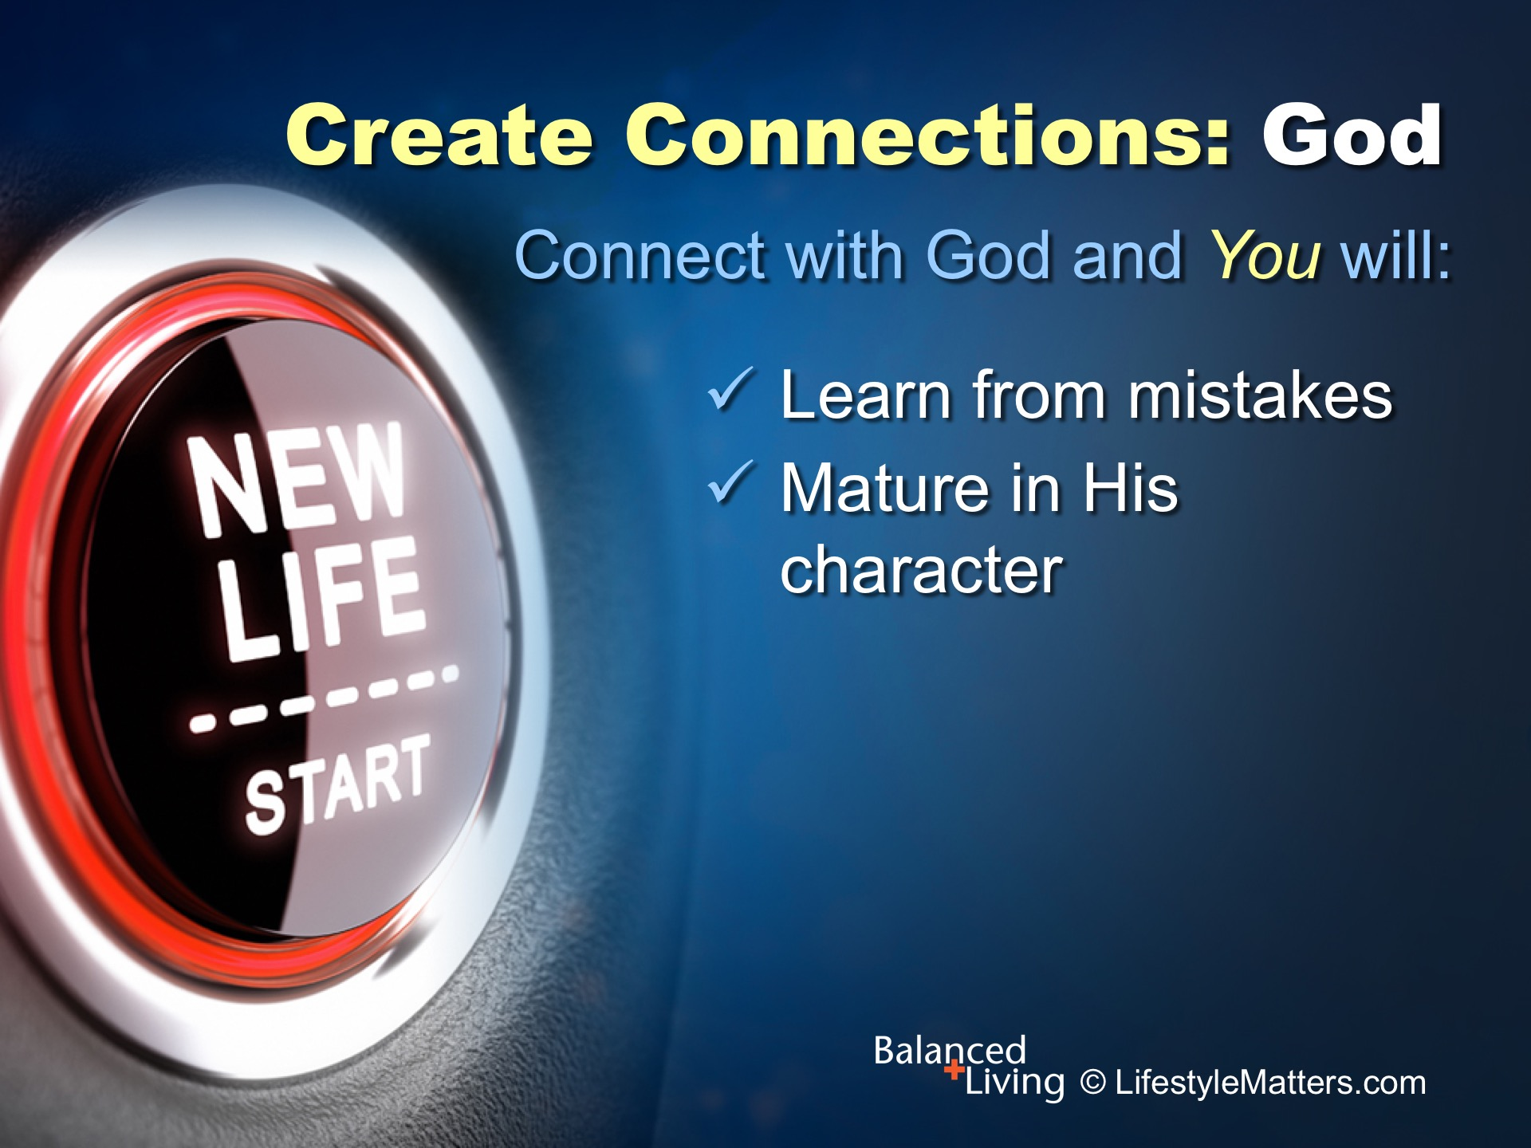
Notes:
Read slide.
People who are “stuck” in addictions or bad habits feel that they have lost the power to do what they know is right.
But once that power is re-harnessed, amazing changes take place.
Mistakes are turned into victories; defeats into determination.

Slide 39
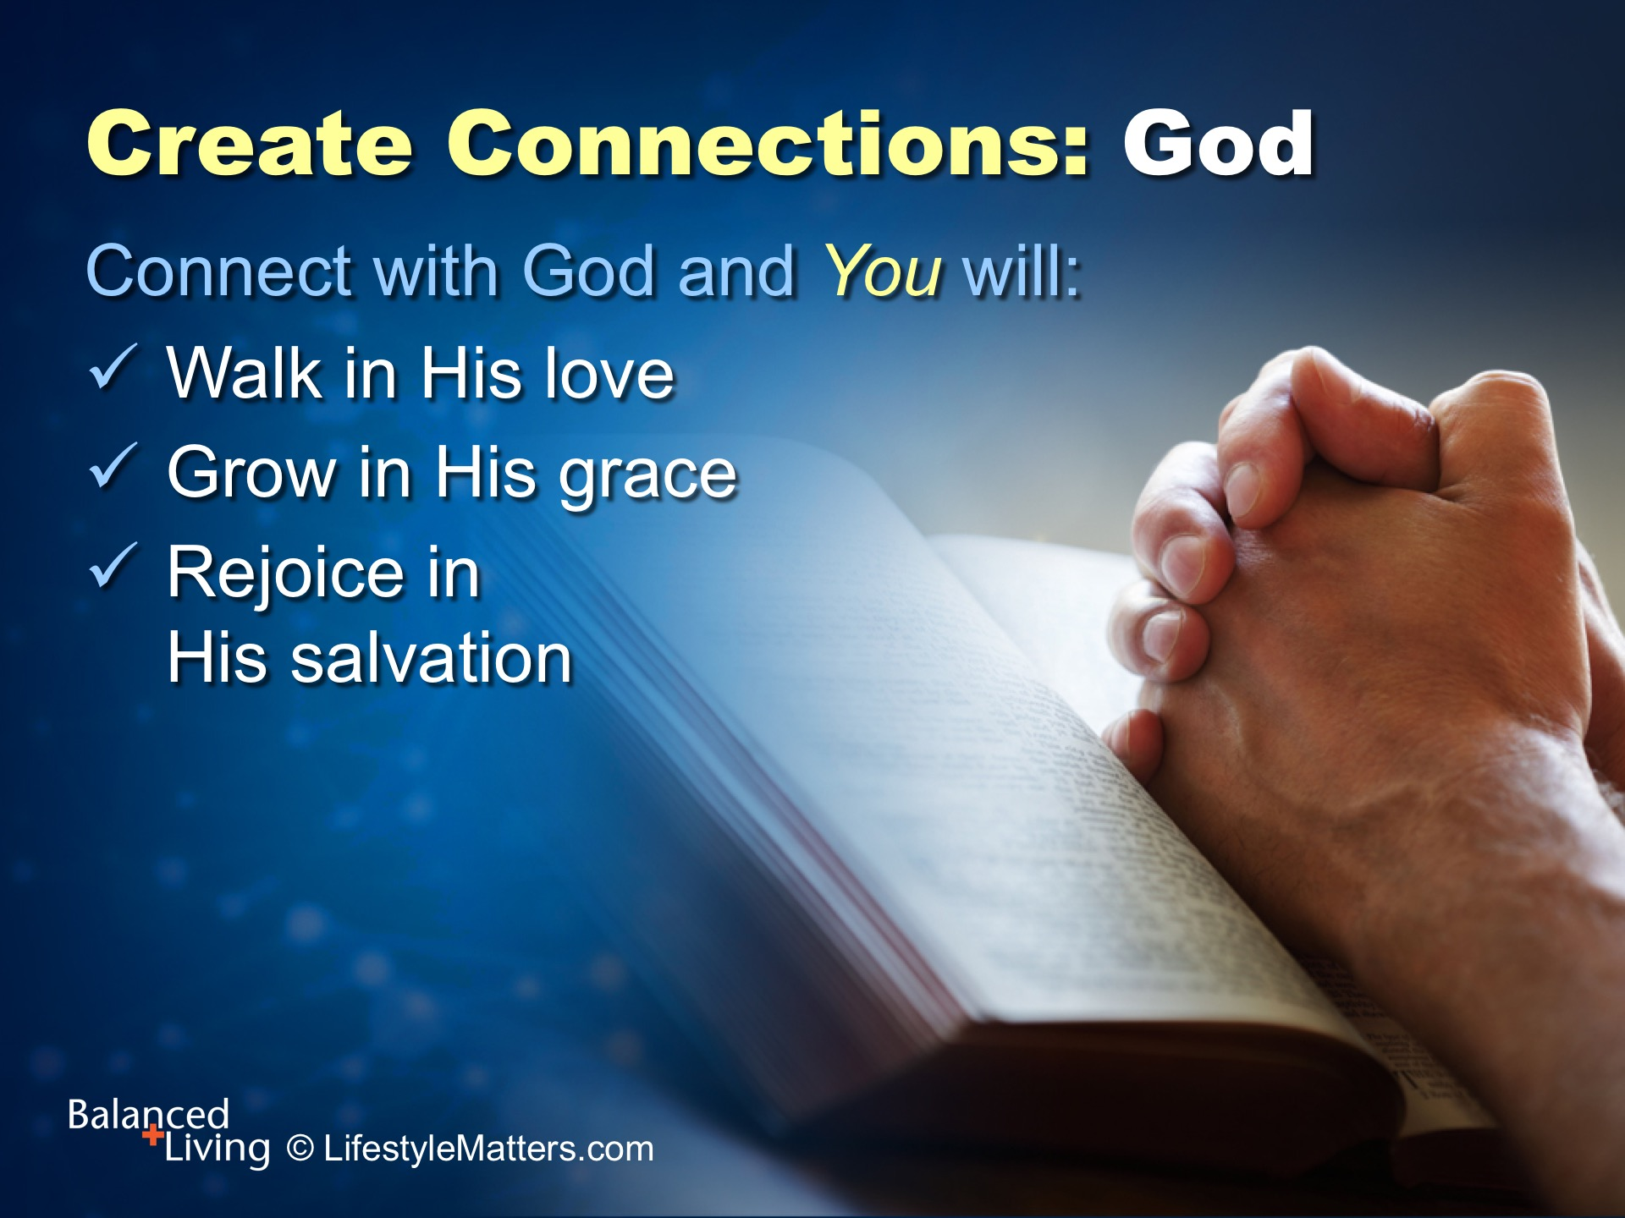
Notes:
Read slide.
It is God’s purpose to lift the veil of sadness and bondage that has hampered your joy and purpose.
God knows you need His help and guidance, and He is there for you.

Slide 40
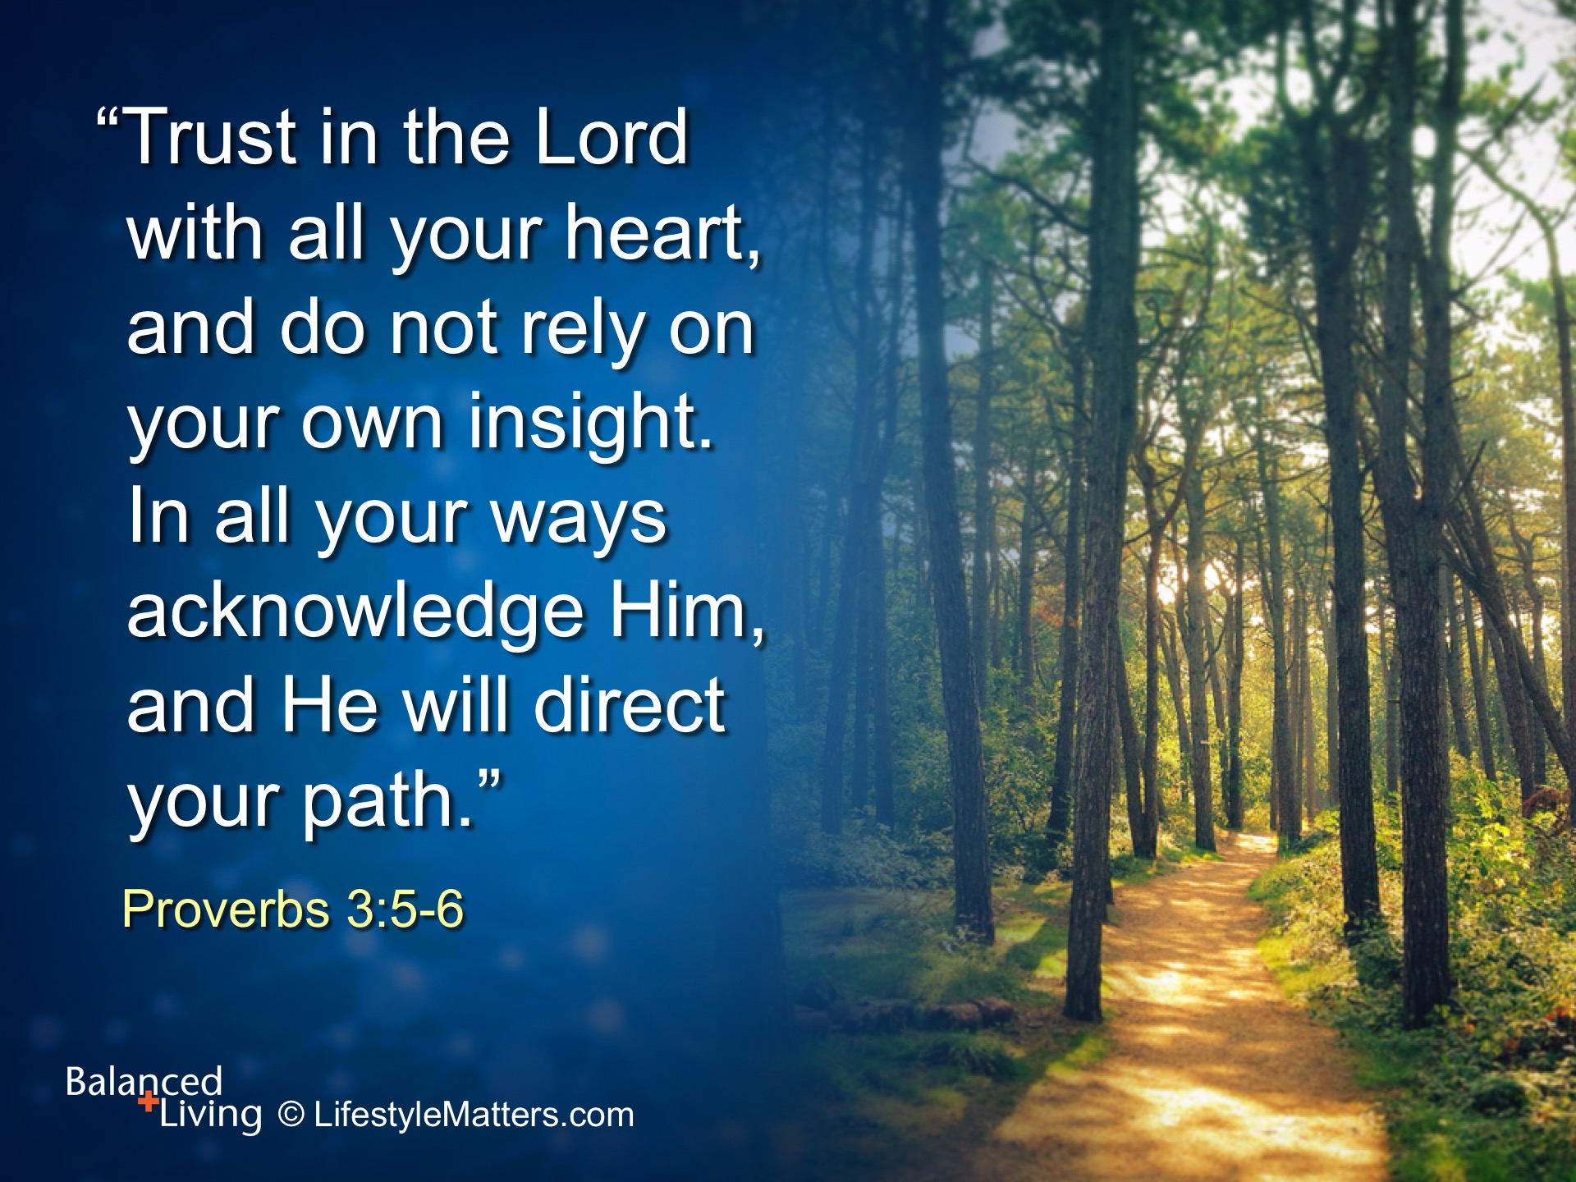
Notes:
You can trust your Redeemer who died to create a new heart in you; new desires, new motives, new strength.
Read slide.

Slide 41
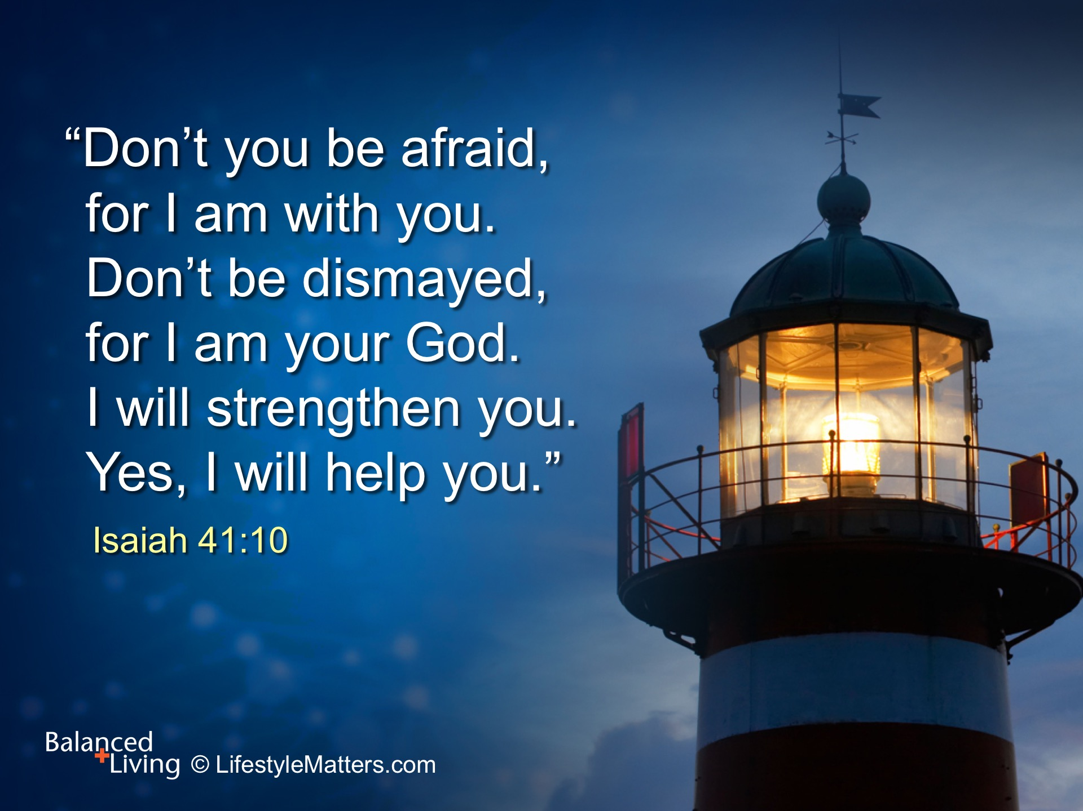
Notes:
God is not looking at your failure. He is looking at your potential.
Read slide.
You are here for a reason. Jesus is reaching out to you.
Will you take His hand right now and say, “Yes, Lord, I believe. Help my unbelief. Strengthen me and guide me in your way.” (Ask for a show of hands or to stand.)
He will never disappoint you.

